Slide 1
Information Sessions for Prospective Bidders

Slide 2
WELCOME!
Notes:
_Thank you for joining this session to learn about Workforce Solutions.
_This is not a bidders’ conference and we won’t address any specifics about our request for proposals or the upcoming procurement.
_We are here to talk about our system – who we are, what we do, and how we’re structured – and to ensure that if you’re interested in bidding on a contract to operate part of our system, we have your contact information in our bidder’s list.
Introduce self and Board staff in attendance.

Slide 3

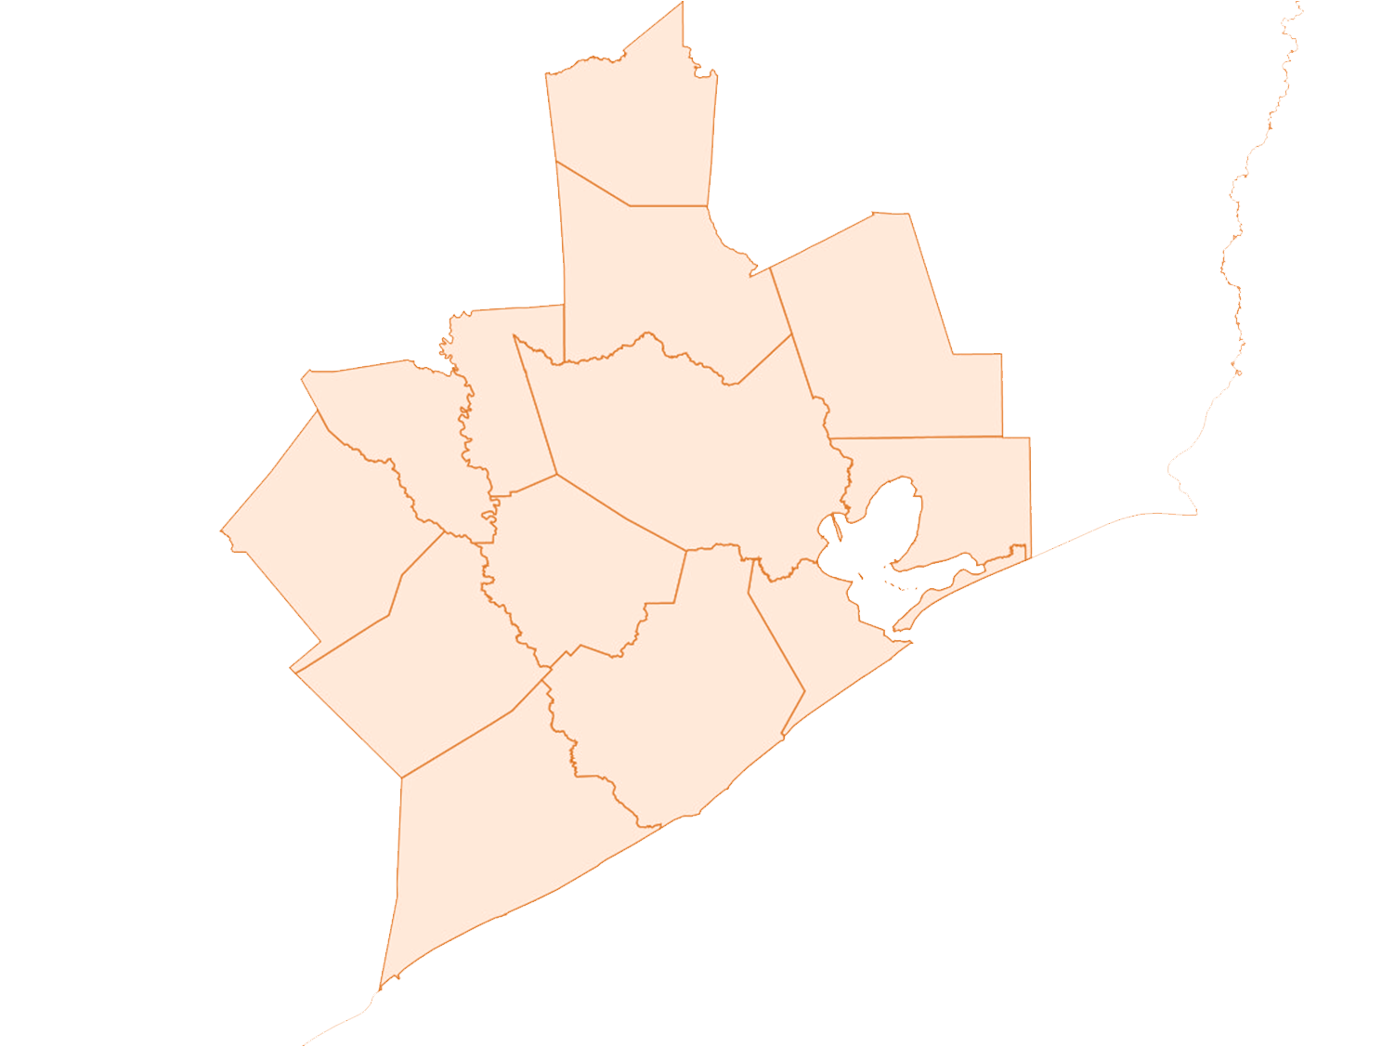
THE WORKFORCE SOLUTIONS SYSTEM
Walker
Waller
Montgomery
Liberty
Austin
Harris
Chambers
Colorado
Fort Bend
Wharton
Brazoria
Galveston
Matagorda
Notes:
_The Gulf Coast Workforce Board and its operating affiliate Workforce Solutions are the public workforce system in the 13-county Houston-Galveston region of Texas.
_We help employers meet their human resource needs and individuals build careers, so both can compete in the global economy.
_The Gulf Coast Workforce Board is business-led and community focused, with approximately 50 members representing private sector business, education, organized labor, and community-based organizations.
_With participation from the region's chief elected officials, the Board sets the strategic direction for the regional workforce system and guides the area's workforce agenda focusing on four key results:
Competitive employers
An educated workforce
More and better jobs
Higher incomes
_The Houston-Galveston Area Council – the region’s council of governments – serves as staff to the Gulf Coast Workforce Board and serves as the corporate office for Workforce Solutions.
_The Board staff:
Supports the Board in its strategic planning for workforce investments and oversight of the public workforce system
Provides the standards, guidelines, policies and procedures for Workforce Solutions
Produces and distributes labor market and career information
Works with employers in the region’s key industry sectors to address their skill shortages
Contracts for the operation of Workforce Solutions
Service area geography
_Our region's 12,500 square mile area is home to nearly 7 million people.
_The region includes 13 counties:
Austin
Brazoria
Chambers
Colorado
Fort Bend
Galveston
Harris
Liberty
Matagorda
Montgomery
Walker
Waller
Wharton
2016 service figures
_During 2016, we served more than 400,000 people and look forward to serving more in the coming year.
_Our Employer Service team helped more than 25,000 employers:
• find candidates to fill close to 200,000 openings;
• outplace more than 11,000 workers; and
• get advice on human resource issues and concerns
_Our career offices, information centers and adult education providers helped:
• about 242,000 go to work;
• more than 26,000 improve their basic education skills; and
• more than 41,000 use $129 million in financial aid to get a job, keep a job or get a better job.

Slide 4
WORKFORCE SOLUTIONS
Employer Service
Career Offices – Call Center – Payment Office
Adult Education
Community and Youth Projects
Early Education Quality
Staff Training and Development
Vendor Networks
Notes:
The Workforce Solutions System (Slide #4 – each system component fades in as we start to talk about it)
_Workforce Solutions includes several related, interlocking parts. We contract with both non-profit and for-profit organizations and agencies to operate those parts and deliver our service.
_Contractors operate as Workforce Solutions – using the Workforce Solutions name and logo – and under a set of franchise requirements that specify staffing and service delivery.
Employer Service
_Employer Service is the marketing and sales arm of Workforce Solutions, dedicated to getting employers what they want and need to find, develop, and support their workforces.
_Our Employer Service team provides individualized service that helps employers find qualified applicants for specific jobs and develop custom solutions to strengthen their current workforce.
_Additionally, Employer Service team provides human resources consulting and technical assistance, outplacement advice and assistance, and labor market information for customers.
_Workforce Solutions Employer Service is intimately connected to our network of local career offices – Employer Service staff are located in many of those offices and work with career office staff to provide local employers with candidates for open jobs.
Current contractor: Employment and Training Centers, Inc.
Career Offices – Call Center – Payment Office
_Our career office network is Workforce Solutions visible presence in the community with 24 offices and 10 information centers to help individuals get a job, keep a job or get a better job.
_Our financial aid call center and payment office support the network by serving as central points for customers who request financial assistance from us to go to school, take a job or continue working.
_Modeled after the public library, we design our career offices to be open and inviting for the general public – and to have on hand professional staff to offer advice and assistance in getting a job and building a career.
_Career offices:
Help customers use resource centers in the office to look for work and apply for jobs
Recruit, screen, and refer individuals to open jobs listed with Workforce Solutions
Offer professional advice, assistance, and seminars for job search, including resumes, interviewing, and applications for work
Assist customers with career planning and career education – including identifying and resolving challenges that get in the way of finding and keeping a job
Help customers access financial assistance to go to school, go to work, or continue working
Provide information about the regional labor market, careers, and good jobs of the future
_The financial aid call center supports the work of the offices by:
Determining customers eligible for financial assistance
Making arrangements for eligible customers to receive and use our financial assistance
Answering customer inquiries about their financial assistance
_The payment office supports both the call center and the career offices by:
Ensuring a robust network of vendors is available to provide education, training and services for customers
Paying vendors for services delivered
Reviewing and monitoring vendors
Current contractors: Interfaith of the Woodlands and Neighborhood Centers (Baker Ripley)
Adult Education
_The Gulf Coast adult education consortium is connected to, supported by, and supportive of the other parts of the region’s workforce system. _The providers and staff in the consortium deliver literacy instruction, English language and civics classes, adult basic and adult secondary education, preparation for the high school equivalency exam, integrated basic and occupational skills classes, and transition into post-secondary skills training across the region.
_Providers deliver service through 175+ different sites throughout the region, including their own campuses and locations, community organizations, and some Workforce Solutions offices.
Current contractors:
Brazosport College
College of the Mainland
Harris County Department of Education
Houston Community College System
Lone Star College
San Jacinto College
Wharton County Junior College
Region 6 Education Service Center
Community and Youth
_Our community and youth efforts include a variety of projects directed to specific areas or customers around the region.
_These projects provide a range a service including work-based learning and access to education and training to help community residents and young people go to work.
Current contractors: SER Jobs for Progress, Dynamic Educational Systems, Gulf Coast Trades Center
Early Education Quality Improvement
_The Board has, from its inception, has been concerned with improving the quality of early education in the region and supporting the upskilling of workers in the industry.
_Workforce Solutions is the largest single payer for early education and care in the region, and we are committed to helping providers deliver high-quality service.
_Early Education Quality Improvement works with early education/child care providers to improve the quality of the educational experience and care they offer our region’s young children.
_Quality Improvement efforts include assessment, mentoring, technical assistance and support to providers interested in achieving a Texas Rising Star designation for quality.
_It also includes providing technical assistance and support to improve the quality of care with providers in our network through scholarships and equipment grants, education for parents, and help in securing matching resources for our system to fully draw federal funds for early education.
Current contractors: Collaborative for Children and the Texas Association for the Education of Young Children
Staff Training and Development
_Our staff training and development contractor is responsible for the professional development of all Workforce Solutions staff.
_This contractor provides training, coaching, technical assistance and performance support to all parts of the Gulf Coast workforce system – including powering a system-wide, online learning management system to help staff plan, enroll in, and keep track of classes and certifications.
_We require contractors in the rest of the system to participate in our training and professional development activities and to obtain a level of certification in the National Workforce Institute’s credentialing process.
Current contractor: Learning Designs, Inc.
Vendor Networks
_We maintain several networks of providers – including our education/career training network, early education and care network, public transportation, and foreign language translation and interpreter services.
_Although solicitations for our vendor networks will not be part of our upcoming Request for Proposals, we want to make sure that if you are interested in providing these kinds of services, we will have your contract information.
_We will be able to notify you right away when we are soliciting for network providers.
The Franchise Model
_The Workforce Board’s staff establish the franchise requirements which govern how all contractors operate and deliver service under Workforce Solutions name.
_The franchise requirements:
(1) describe how contractors will staff and operate the various divisions and relate to one another and the Board staff,
(2) establish system policies and operating procedures, and
(3) set performance expectations.
We appreciate your attention today, and we invite you to sign up for our bidder’s list.
Being on our bidder’s list means you will be able to receive immediate notice of and access to our Request for Proposals when we issue it.

Slide 5
1. RFP Release
2. Bidder’s Conference
3. Proposals
Due
4. Evaluations
&
Presentations
5. Workforce Board Committees
9. Contracts Begin
8. Contracts Signed
6. Workforce Board
7. H-GAC Board of Directors
PROCUREMENT
PROCESS

Slide 6
NOTIFICATION OF RELEASE
comments@wrksolutions.com
www.wrksolutions.com/rfp
www.h-gac.com/purchasing

