Slide 1
Job readiness tool kit
MODULE 2

Slide 2
MODULE 2: JOB READINESS TOOLKIT
The purpose of this module is to:
Evaluate resumes and applications
Explore best practices for job interviews
See how to effectively introduce yourself

Slide 3
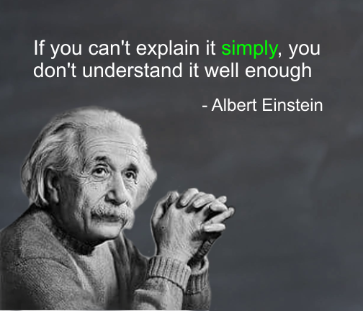
LESS IS MORE

Slide 4
COMMUNICATING WITH LESS
Make it easy to read
Keep it short and clear
Quantify
Avoid personal pronouns
Use key words
Example:
Resolved 5-10 customer complaints on a daily basis.

Slide 5
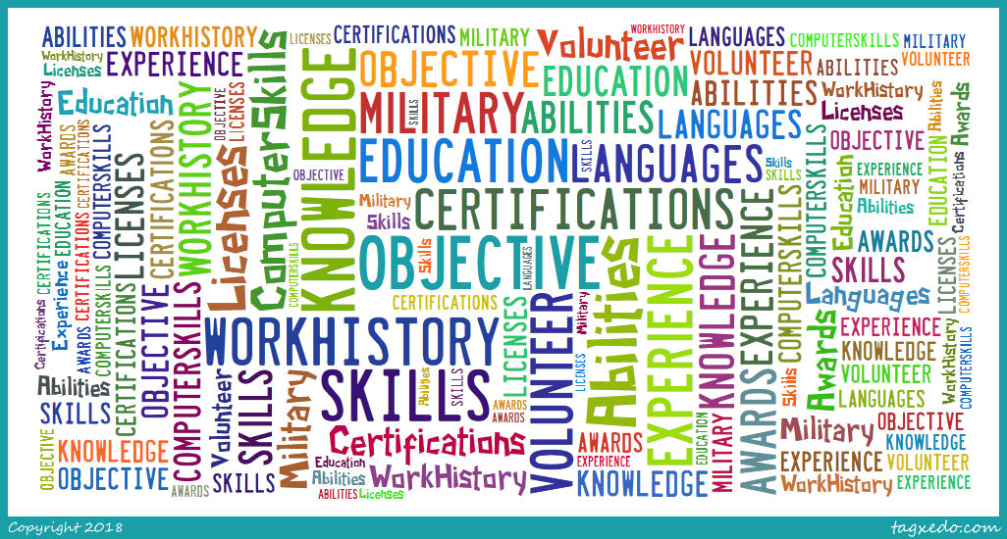
SIMILAR BUT DIFFERENT
Notes:
Lesson E: Flash Resumes
Page 32 facilitator’s manual

Slide 6
SIMILAR BUT DIFFERENT (page 2)
Applications | Resumes | Both

Slide 7
TELL ME ABOUT YOURSELF
Notes:
Here is a list developed by "Monster.com" as the top 10 questions employers ask at interviews.
If we look at #1, the most common interview question is: “What can you tell me about yourself?”
The answer lies within the “30-Second Commercial.”
Source: https://www.monster.co.uk/career-advice/article/what-are-the-most-common-job-interview-questions

Slide 8
YOUR ONLINE JOB SEARCH

Slide 9
YOUR ONLINE JOB SEARCH (page 2)
Notes:
Lesson D: Your Online Job Search
Page 29 facilitator’s manual

Slide 10
FLASH RESUME

Slide 11
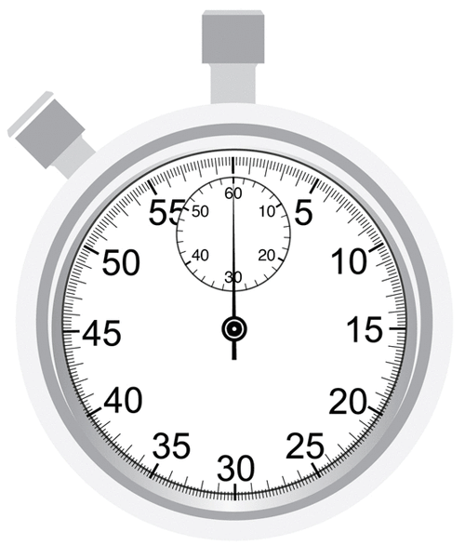
30 SECOND COMMERCIAL
Notes:
My name is Dale Cooper and I have over 5 years of experience in the business services industry. I hold a Bachelor's degree in management from the University of Houston. I have received training in customer service, conflict resolution, and team building. I am skilled in enterprise software, Office 365, and Google applications. I have received many awards for meeting performance goals for myself and teams I've previously worked with. I truly believe that all this will help you meet your goals at XYZ Co.

Slide 12
THANK YOU!

