Slide 1
Module 2:
Job Readiness Toolkit
Notes:
Smile ☺ Greet and welcome class. Introduce yourself and co-facilitator(s).
Some slides will have:
Workbook
Page #(s)
Instructor’s guide
Page #(s)
Words in quotations are examples. Review, practice module so that you can teach in your own words.
Use white space on slide to annotate, if needed.
Provide email address(es) in Chat, if needed. Copy/paste in Chat:
https://www.wrksolutions.com/Documents/Individuals/Online-Training/Adult-Curriculum-Workbook-Module-2.pdf
https://www.wrksolutions.com/for-individuals/online-learning
https://www.surveymonkey.com/r/YBGBN6V

Slide 2
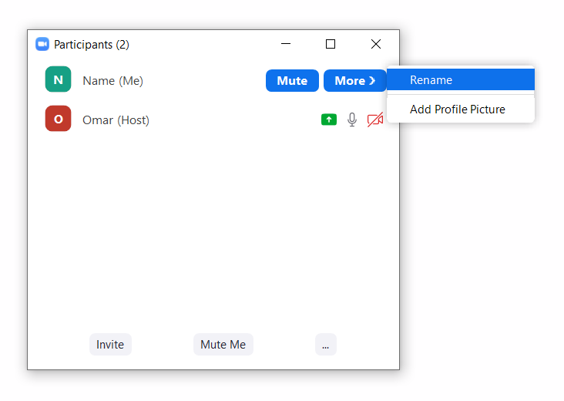
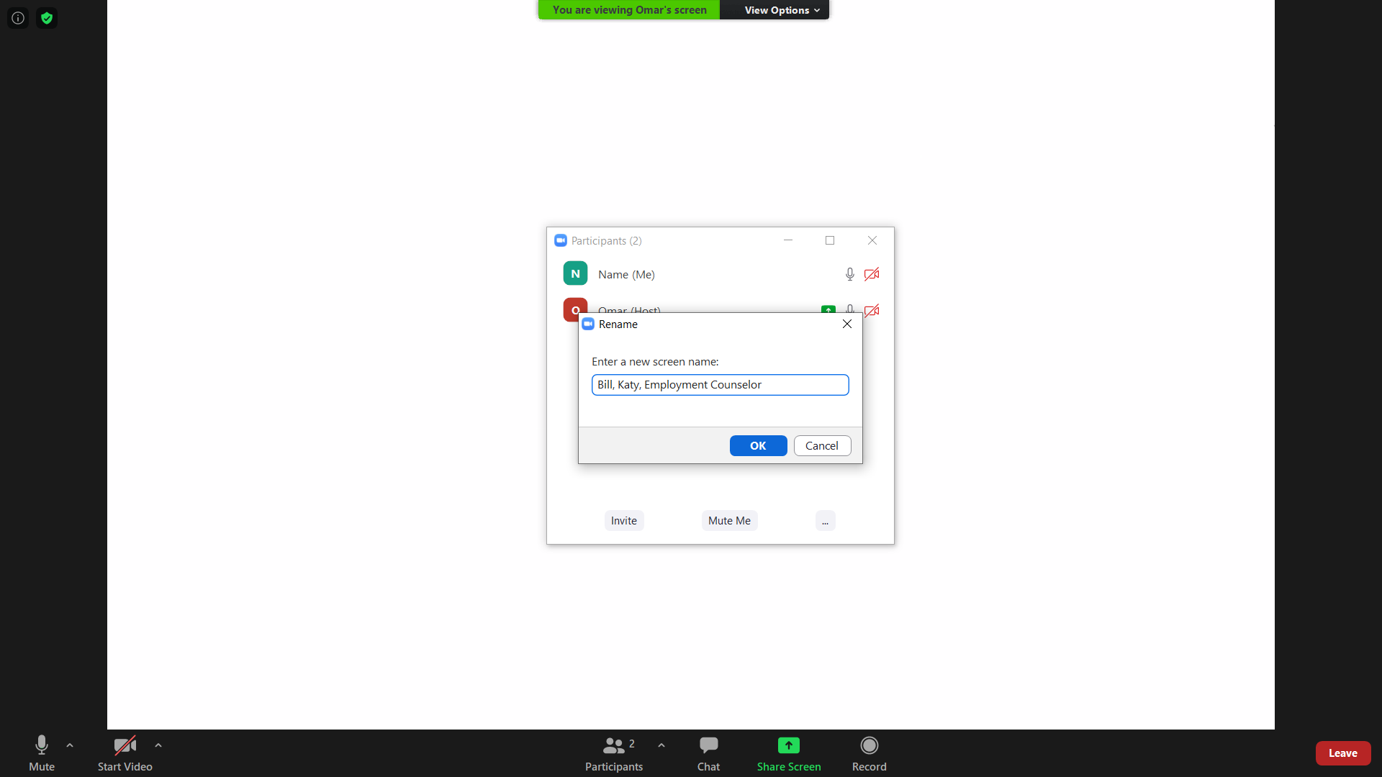

Participants More > Rename
First name, Work interested in
Staff First name, Office, Title
Notes:
“Including the work you are interested in will help me to customize examples relevant to your job search.”

Slide 3
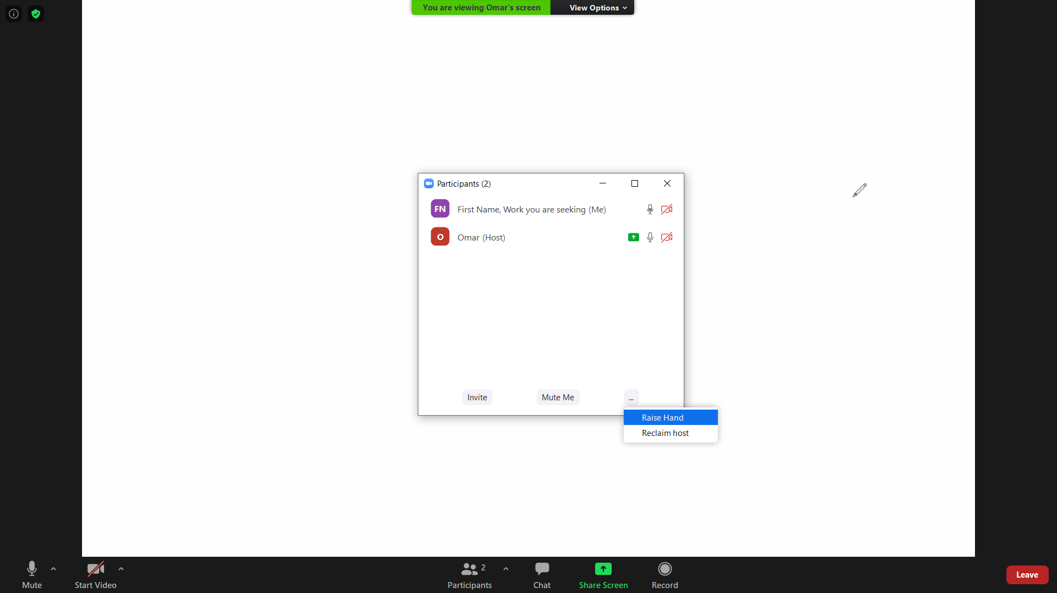
Participants … Raise Hand

Slide 4
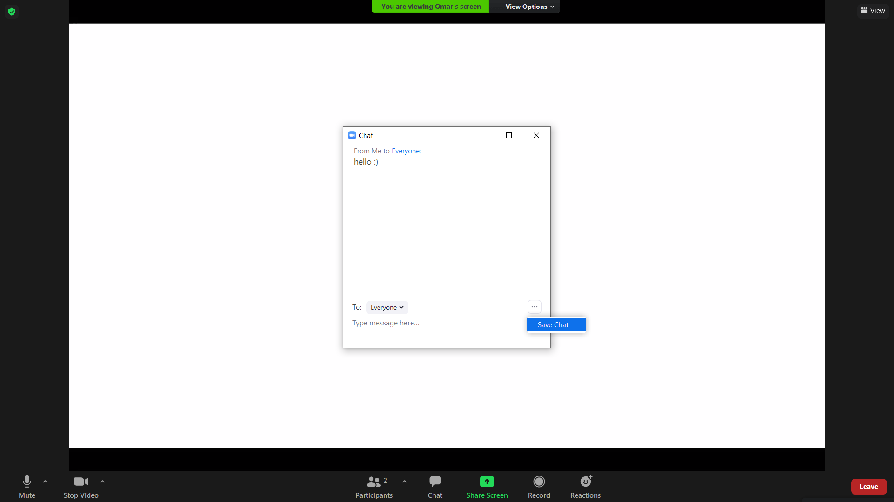
Chat & … Save Chat

Slide 5
What do you hope to learn in this class?
Purpose
Evaluate effective communication in applications and resumes
Lessons
Less Is More
Similar but Different
Flash Resumes
Online Job Search Resources

Slide 6
Less Is More

Slide 7
Describing Skills & Accomplishments
Use bulleted statements
Start with action verbs
Keep it short
Quantify
    #, %, $
Avoid personal pronouns
    I, me, my, we
Use keywords from job posting
Notes:
Workbook
1

Slide 8
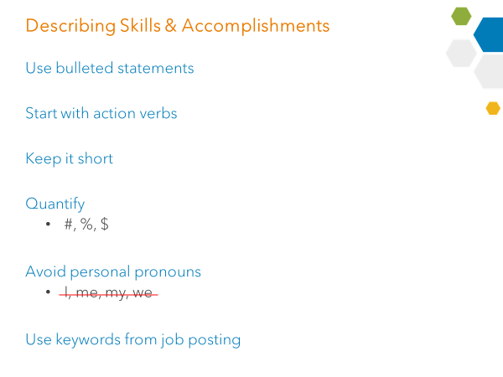
Let’s Improve
Before:
Duties included me emptying trash cans, dusting, vacuuming floors, cleaning bathrooms, changing bed linens and replacing used items such as towels, soaps, complimentary coffee, and mini bar items.
After:
Cleaned and replenished up to 16 rooms daily for a high-end hotel chain
Notes:
Workbook
1

Slide 9
Your skills, accomplishments
Notes:
Ask if anyone would like to volunteer a statement from their resume to improve. If no one has a resume, ask for an accomplishment related to their most recent job and discuss how to improve.
Use following to improve:
Use bulleted statements
Start with action verbs
Keep it short
Quantify (#, %, $)
Avoid personal pronouns (I, me, my, we)
Use keywords from job posting

Slide 10
Similar but Different

Slide 11
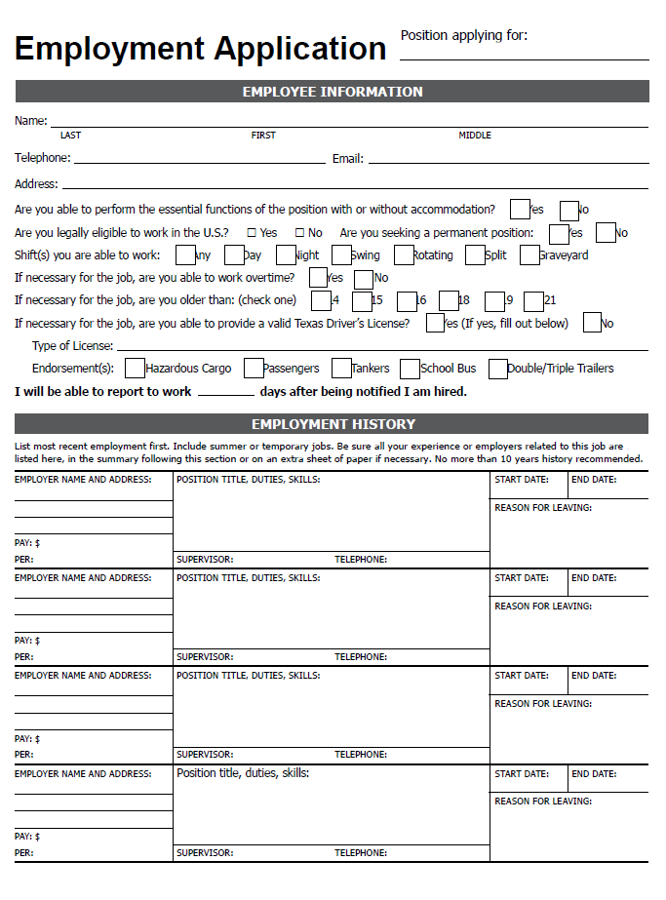
Notes:
Workbook
3-6
Compare, discuss first page of application and resume:
What is only on an application
What is only on a resume
What is on both

Slide 12
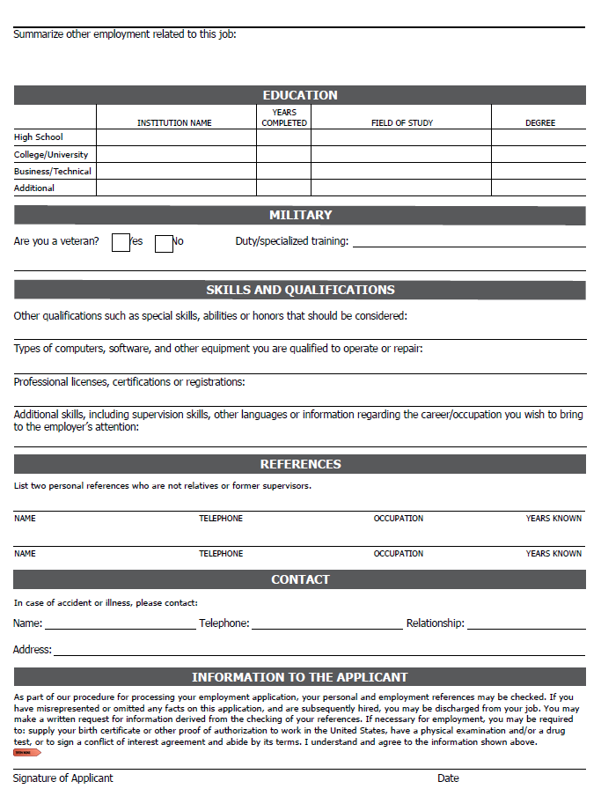
Notes:
Workbook
3-6
Compare, discuss second page of application and resume:
What is only on an application
What is only on a resume
What is on both

Slide 13
Similar but Different
APPLICATIONS | RESUMES | BOTH
Social Security # | Summary | Name, Contact Information
Salary History | Honors / Achievements | Work History
References | Volunteer | Education / Certifications
Ethnicity (optional) |  | Military
Sex (optional)
Criminal History
Employer Phone #s
Notes:
Workbook
3-6

Slide 14
Flash Resumes

Slide 15
Example Job
Customized
Administrative Assistant
Location: Pearland, TX 77584
Requirements: 1-2 years experience in office environment. Microsoft Office.
Summary
Ensure company commitments, goals, objectives are on track
Coordinate, schedule meetings for Managing Partners
Attend meetings: take notes, track progress of action items, provide updates
Review proposals, client documents
Provide feedback, draft presentations, conduct research
Manage expense reports, invoices; follow up - clients, vendors
Notes:
“For the next minute, review this example job listing. And remember, when comparing the resumes to the job listing, look to see how well each resume is customized to the job listing.”

Slide 16
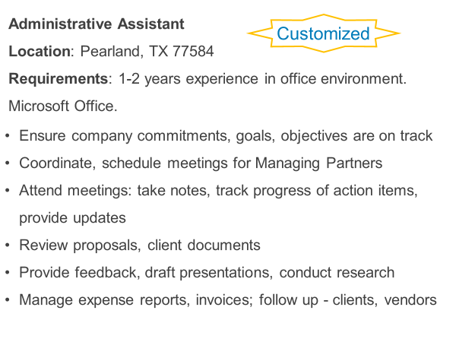
Kathy Guessing
P.O. Box 111
Houston, Texas 77777
(555) 123-1155
keepinguguessing@hotmail.com
Administrative Skills
Computer Skills: Microsoft Word, Excel, PowerPoint, Internet Explorer, typing 55 wpm
Office Skills: Customer service, answering phones, faxing, copying, filing
Additional Skills: Money handling, order processing, timesheets, bank deposits, payroll processing
Work History
Assistant Manager, Creative Detailing, 10-16
Owner, Guessing, Inc., 03-10
Customer Service, 4B’s, 00-03
Education
Walton University, BSBA
Notes:
Email address not appropriate
Not enough description for each employer
Confusing dates and information

Slide 17
JAMES JARVIS
1234 Estelle, Houston, TX 77777 * 832.123.5432 • james.jarvis@ggmail.com • linkedin.com/in/jamesjarvis
ACCOUNTANT, JOB POSTING #45342
College student with 2+ years experience in customer service. Member of Student Government Association and volunteer for Habitat for Humanity. Currently works on individual projects and in team environments. Understands tax, managerial, state/federal compliance and Generally Accepted Accounting Principles (GAAP). Looking to use knowledge of accounting principles to impact the bottom line at ABC Corp.
EMPLOYMENT EXPERIENCE
Resident Assistant January 2016 – Present
Calhoun Lofts Houston, Texas
Conducts room visits in a 500 unit complex
Checks inventory on supplies and equipment for office usage
Presents to audiences of 15-30 staff employees and residents on new safety policies and procedures
Uses Calhoun Loft’s specific software to balance all Request for Proposals valuing of $1000+
Sales Associate July 2014 – December 2015
Target Spring, Texas
Used QuickBooks Point of Sale system to balance deposits of $3000+
at day of business end
Audited store inventory of various departments to report lost items
Ran reports to assure management was meeting weekly sales targets of 80%
EDUCATIONAL BACKGROUND
University of Houston, January 2015 – August 2018
Bachelor of Business Administration, Accounting, Houston, Texas
Notes:
He has skills necessary to do job but is he a good candidate if he is looking for an accountant position?
How long would he stay at an admin assistant position?

Slide 18
Online Job Search Resources

Slide 19






Notes:
Workbook
8-9

Slide 20
Knowledge Check
When writing skills and accomplishment statements,
keep it short and start with action verbs.
True
Resumes and applications contain the same information.
False
Hiring managers take about 15 seconds to review a resume and it is their opinion that matters most.
True
www.mynextmove.org can be used to explore careers.
True

Slide 21

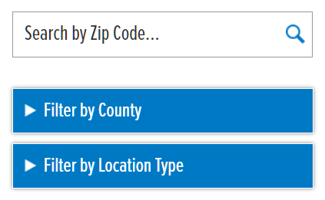

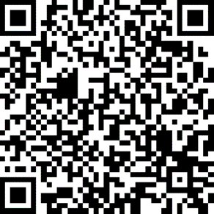
https://www.wrksolutions.com/
Notes:
Inform class to contact local WFS office for assistance.
Provide email address(es) in Chat, if needed.
https://www.surveymonkey.com/r/YBGBN6V

