Slide 1
Sharpening your interviewing skills
Module 3

Slide 2
MODULE 3: SHARPENING YOUR INTERVIEWING SKILLS
The purpose of this module is to:
Focus on the interview process
Determine proper interview attire
Prepare answers to common interview questions
Notes:
Discuss the purpose – PLEASE DO NOT READ THE SLIDE
Could show interview attire video here or at end if time permits (https://www.youtube.com/watch?v=nubwMHP1ej4)

Slide 3

BUSINESS PROFESSIONAL ATTIRE
Notes:
Show on point #9 pace 47 of Instructor Guide

Slide 4

BUSINESS CASUAL ATTIRE
Notes:
Show on point #10B page 47 of Instructor Guide

Slide 5

CASUAL ATTIRE
Notes:
Show on point #10C page 48 of Instructor Guide

Slide 6
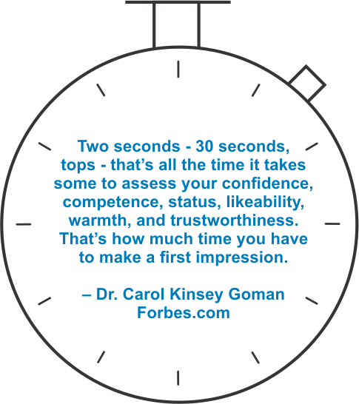
FIRST IMPRESSIONS
Notes:
Show on point #13 page 50 of Instructor Guide, and viewing into next lesson:
ACTIONS SPEAK LOUDER THAN WORDS

Slide 7

ACTIONS SPEAK LOUDER THAN WORDS
Notes:
Show on point #6 page 52 of Instructor Guide

Slide 8

TELL ME ABOUT YOURSELF
Notes:
Show this slide as you introduce the lesson on page 54 of Instructor Guide
Here is a list developed by "Monster.com" as the top 10 questions employers ask at interviews.
If we look at #1, the most common interview question is: “What can you tell me about yourself?”
The answer lies within the “30-Second Commercial.”
Source: https://www.monster.co.uk/career-advice/article/what-are-the-most-common-job-interview-questions

Slide 9

SPEED INTERVIEWING
Notes:
Show this slide as you introduce the lesson on page 59 of Instructor Guide
Here is a list developed by "Monster.com" as the top 10 questions employers ask at interviews.
If we look at #1, the most common interview question is: “What can you tell me about yourself?”
The answer lies within the “30-Second Commercial.”
Source: https://www.monster.co.uk/career-advice/article/what-are-the-most-common-job-interview-questions

Slide 10




SPEED INTERVIEWING EVALUATION
Eye Contact
Volume
Content
Body Language
Notes:
Show slide on point #8 page 60 of the Instructor Guide
SPEED INTERVIEWING
Observations
Volume
Eye Contact
Body Language
Content

Slide 11

ROUND ROBIN INTERVIEWS
Notes:
Show slide at introduction to lesson ROUND ROBIN INTERVIEWS page 62 of Instructor Guide

Slide 12
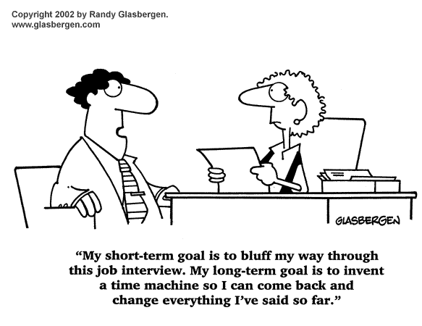
BEHAVIORAL INTERVIEWS
Notes:
Show this slide for point #1 page 62 of Instructor Guide
What is a behavioral interview question? Behavioral interviews make it more difficult to bluff.. CAR statements provide the structure for the most favorable response to this type of question.

Slide 13

BEHAVIORAL INTERVIEW QUESTIONS
Notes:
Show this slide on point #3 page 64 of Instructor Guide

Slide 14

TURNING THE TABLES
Notes:
Show this slide as the TURNING THE TABLES lesson is introduced on page 66 of Instructor Guide
Show video at end of the lesson (https://www.youtube.com/watch?v=nawXGma_65w)

Slide 15
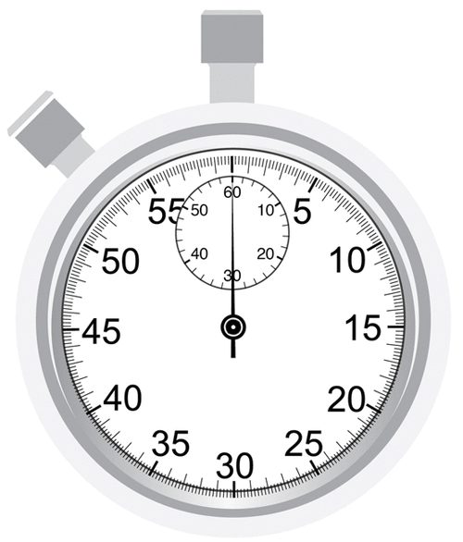
30 SECOND COMMERCIAL
Notes:
Show slide as you introduce the lesson on page 71 of Instructor Guide

Slide 16
Thank you!

