Slide 1
Module 4: Closing the Deal
Notes:
Smile ☺ Greet and welcome class. Introduce yourself and co-facilitator(s).
Some slides will have:
Workbook
Page #(s)
Instructor’s guide
Page #(s)
Words in quotations are examples. Review, practice module so that you can teach in your own words.
Use white space on slide to annotate, if needed.
Provide email address(es) in Chat, if needed. Copy/paste in Chat:
https://www.wrksolutions.com/Documents/Individuals/Online-Training/Adult-Curriculum-Workbook-Module-4.pdf
https://www.wrksolutions.com/for-individuals/online-learning
https://www.surveymonkey.com/r/YBGBN6V

Slide 2
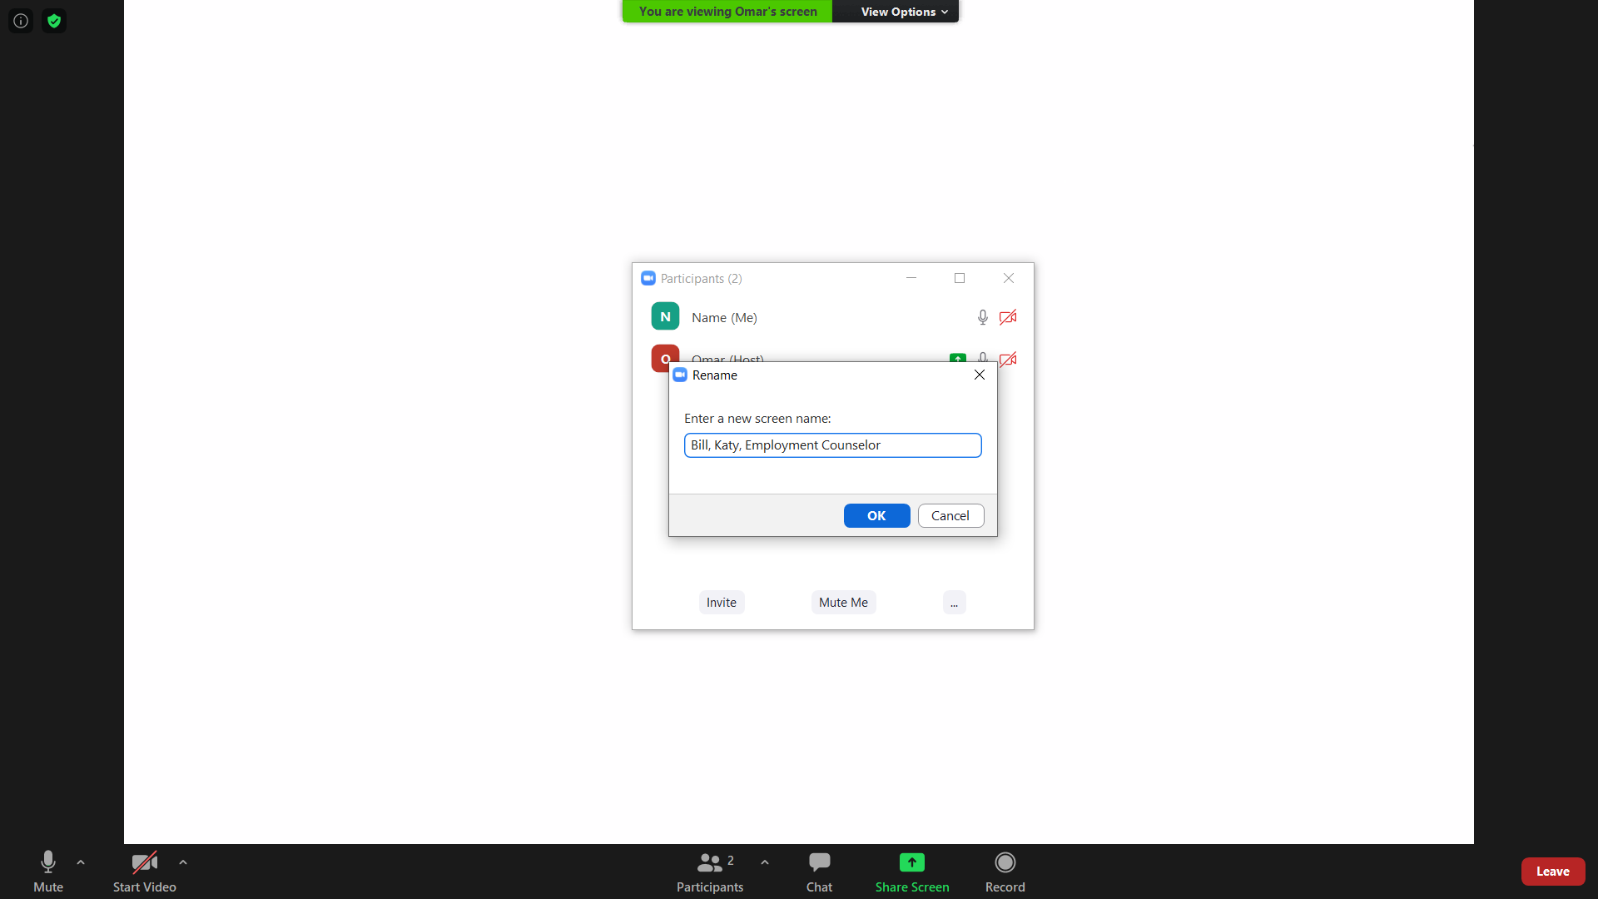
Participants More > Rename
First name, Work interested in
Staff First name, Office, Title
Notes:
“Including the work you are interested in will help me to customize examples relevant to your job search.”

Slide 3
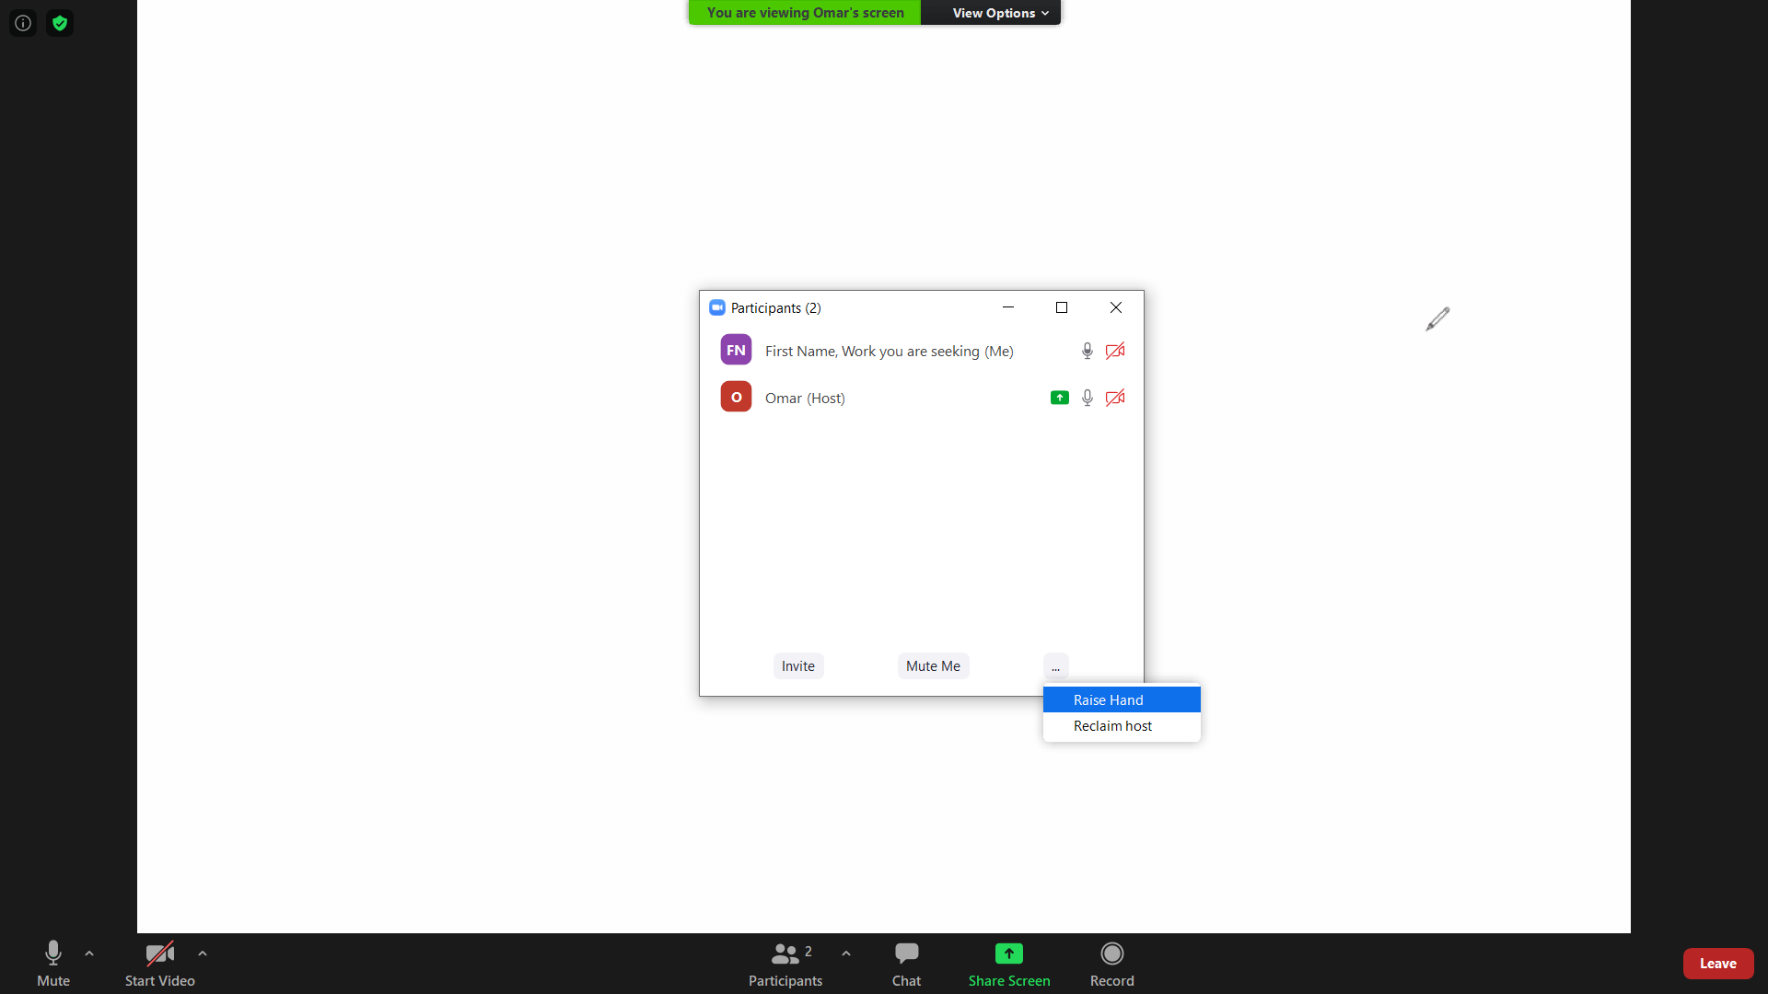
Participants … Raise Hand

Slide 4
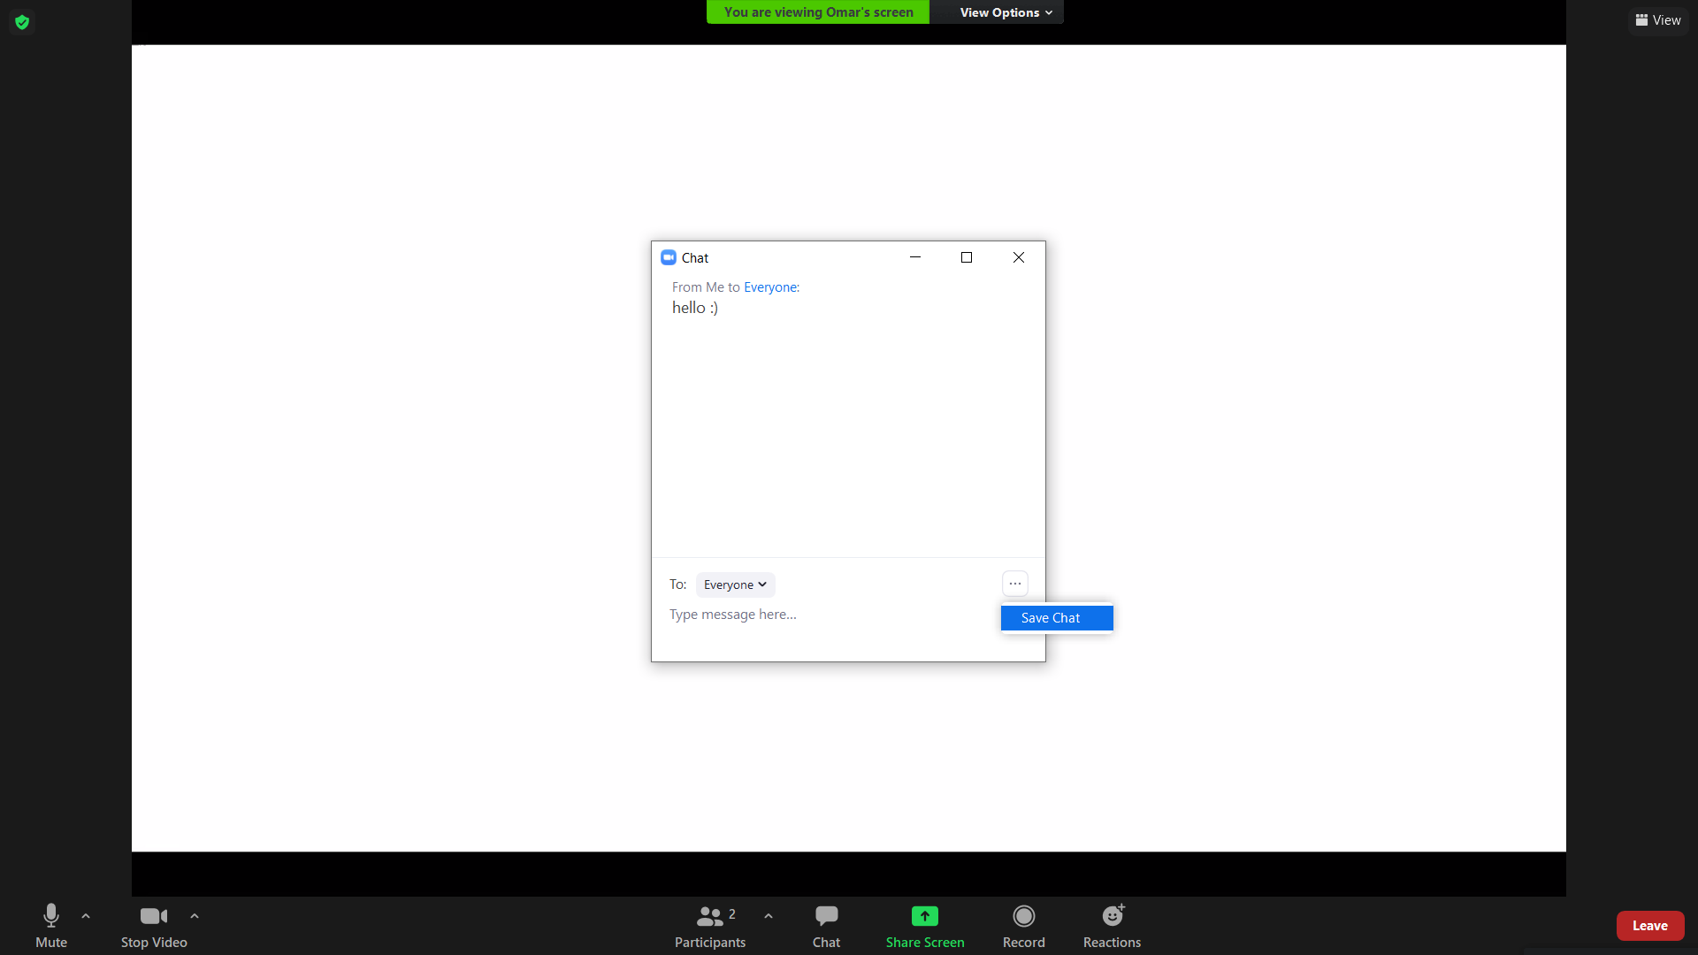
Chat & … Save Chat

Slide 5
What do you hope to learn in this class?
Purpose
Social Media
Networking
Lasting Impressions
Negotiating
Lessons
Digital Footprint
Networking
Lasting Impressions
Closing Statement
Thank You Notes
Negotiating Salary & Benefits

Slide 6
Digital Footprint
Notes:
Workbook
1-3

Slide 7
Social Media Rubric
POSITIVE SHARING |  |  | NEGATIVE SHARING
+2 pts | +1 pt | -1 | -2 | -3 | -4
Work experience Work-related skills Interpersonal skills | Groups, teams, sports, clubs Volunteering College, career goals | Politics Religion News items | Alcohol Guns Violence | Profanity Spelling, grammar errors Negative job / school talk | Drugs Sex “Flaming” by name
Jobvite.com Social Recruiting Survey
Notes:
Workbook
2
“Jobvite.com surveyed hundreds of recruiters about information posted on social media. This rubric categorizes information recruiters viewed as positive or negative and how severely negative items might offend and affect one’s chance at employment. In a moment, review one of your social media accounts, such as Facebook, LinkedIn, or Instagram, and look for items you see in the rubric. Add and/or subtract points accordingly.”
Give an example: “For example, if I browse through one of my accounts and see posts related to the first column under positive sharing - work experience, work-related skills, and interpersonal skills, I have 6 pts. I continue to browse and see divisive news that my friends have posted on my profile, I subtract 1 pt, since it’s considered negative sharing. I also see spelling errors; I subtract 3 more. My total is 2 pts.”
Give class a minute or two to calculate their digital footprint through the eyes of an employer.

Slide 8
Social Media Rubric Rating
 |  | ACTION TO TAKE
6 pts + | Your social media is spotless. | Keep actively managing your online presence.
3 to 5 | Some blemishes but also share good news. | Minor cleanup needed.
0 to 2 | You share good info, but tarnished by oversharing. | Think before you share.
-1 to -3 | Bad outweighs good; overall likely negative. | Tip scales back with positive sharing.
-4 to -7 | Not good. You share too many items that can harm your employment opportunities. | Major cleanup needed.
-8 pts or lower | You share it all; it’s rarely good and working against you. | Do over.
Notes:
Workbook
3
Explain rubric rating.

Slide 9
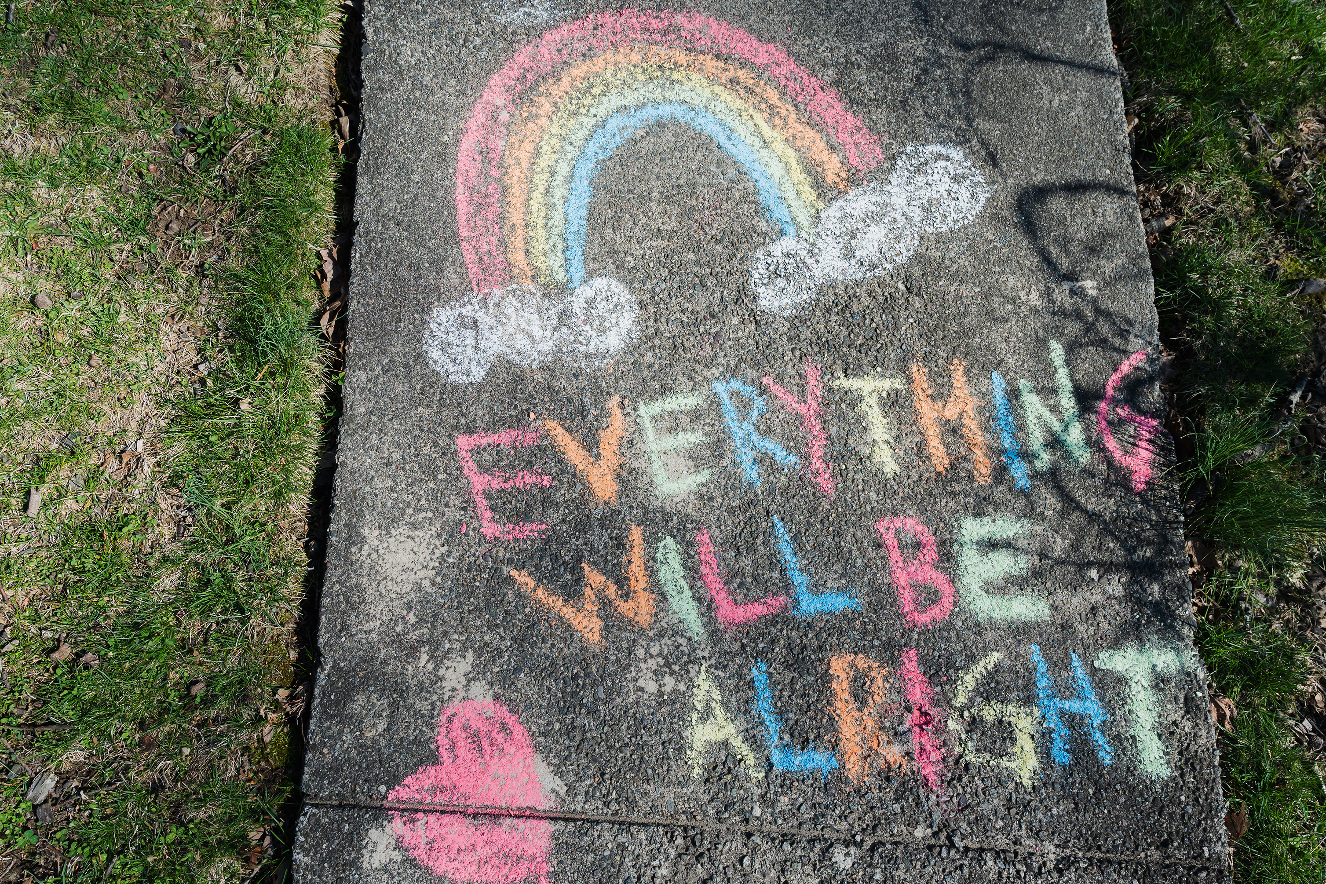
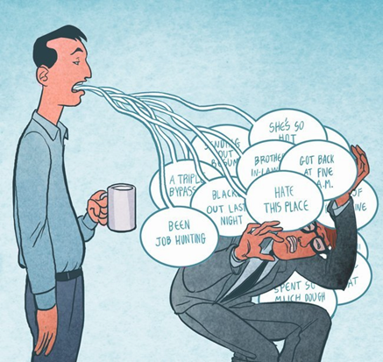
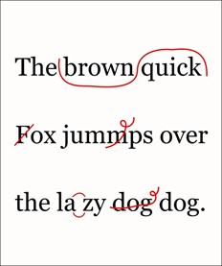
Tips to Improve Your Digital Footprint
Koren Shadmi
Share positive information
Avoid oversharing
Contribute
Proofread
Notes:
Workbook
3
“Keep the following 4 tips in mind while on social media:
(CLICK) 1 Share positive information,
(CLICK) 2 Avoid sharing too much, especially information that is seen negatively,
(CLICK) 3 Contribute to professional conversations you’re familiar with,
(CLICK) and 4, proofread – employers view your written work as an indication of your attention to detail. And remember, employers also make judgements on what your ‘friends’ post.”

Slide 10
Networking
Notes:
Workbook
4

Slide 11
Reflect
How can people who share your interests
help you network?
Who would be the most beneficial connection
in your phone? Why?
How can social media,
like Instagram / Facebook, help you network?
Notes:
Workbook
5-6

Slide 12
Lasting Impressions: Closing Statement Thank You Notes
Notes:
Workbook
7-11

Slide 13
Do you have any questions?
What is the biggest challenge
in this position?
What are your expectations
of this position?
How much does this job pay?
(Negotiate when they have
decided to hire you.)
Will I take a drug test?
Notes:
Instructor’s guide
83
“When you’re asked, ‘Do you have any questions?’, it usually means the interview is coming to an end.”
“Ask one or two questions to show your interest. Two examples include: What is the biggest challenge in this position? What are your expectations of this position?”
“Two questions not to ask: How much does this job pay? Will I take a drug test?”
“What questions would you ask?”

Slide 14
Closing Statement: Example
You shared that you are looking for:
Three years customer service experience
Familiar with CRM systems and practices
And a track record of overachieving
I have:
Five years customer service experience
Two years working with Customer Insight System
And two awards for surpassing call intake volume
I am very interested in working for your company.
Thank you for meeting with me today and l look forward to hearing from you. May I have your business card?
Notes:
Workbook
8
“When the interviewer indicates the end, typically by asking, ‘Do you have anything else to add?’, summarize WHY you are a good match by using information provided by the employer. ‘You shared that you are looking for:’ THIS is the information provided by the employer. ‘I have:’ This is YOUR information that addresses what the employer is looking for. End your closing statement by showing interest and gratitude, and asking for business cards.”

Slide 15
Closing Statement: Template
You shared that you are looking for:
Required experience
Required knowledge / skill
Required accomplishment
I have:
Relevant experience
Relevant knowledge / skill
Relevant accomplishment
I am very interested in working for your company.
Thank you for meeting with me today and l look forward to hearing from you. May I have your business card?
Notes:
Workbook
9

Slide 16
Lasting Impressions Tips
Be courteous with receptionist.
Make eye contact.
Remember and repeat names.
Thank everyone you meet
for their time and hospitality.
Express interest.
Collect business cards.
Notes:
Workbook
7

Slide 17
Thank You Note: Template & Example
Dear Ms. Landry,
Thank you for meeting with me on Tue, Jan 12, 2021 regarding the Relations Manager position at Comfort Inn.
I thought about what Michel said concerning feedback on your social media channels. In my last job as Guest Relations Manager, personally responding to comments on social media increased repeat business. By the way, you’re right about Luke’s Coffee - delicious!
I’m excited to be considered for this role and I look forward to hearing from you.
Respectfully,
First Last
(281) 123-4567
FirstLastName@gmail.com
Dear Mrs., Ms., Mr. (Last name),
Express appreciation. Remind interviewer of date interviewed on and position interviewed for.
Include information you didn’t mention in the interview.
Confirm your interest. State that you look forward to hearing from the interviewer.
Respectfully / Sincerely,
First Last Name
Phone
Professional Email
Notes:
Workbook
10-11
“Now let’s use this template to write a thank you note. Dear Mrs., Ms., Mr. Last name (CLICK) Dear Ms. Landry. First, express appreciation and remind the interviewer of the date interviewed on and position interviewed for. (CLICK) Thank you for meeting with me on Tue, Jan 12, 2021 regarding the Relations Manager position at Comfort Inn. Next, include information you didn’t mention in the interview. (CLICK) I thought about what Michel said concerning feedback on your social media channels. In my last job as Guest Relations Manager, personally responding to comments on social media increased repeat business. By the way, you’re right about Luke’s Coffee - delicious! Confirm your interest. State that you are looking forward to hearing from the interviewer. (CLICK) I’m excited to be considered for this role and I look forward to hearing from you. Respectfully or Sincerely, your First Last Name, phone, professional email.” (CLICK)
“Notice how the writer included a moment in the interview – the last sentence in 2nd paragraph – (CLICK) ‘By the way, you’re right about Luke’s Coffee – delicious!’ Personalizing your notes and emails can help the interviewer remember you.”

Slide 18
Your Turn
Dear Mrs., Ms., Mr. (Last name),
Express appreciation. Remind interviewer of date interviewed on and position interviewed for.
Include information you didn’t mention in the interview.
Confirm your interest. State that you look forward to hearing from the interviewer.
Respectfully / Sincerely,
First Last Name
Phone
Professional Email
Notes:
Workbook
11
“Thank you notes can reiterate your interest in the job and show your enthusiasm. Sending thank you letters can also keep you at the forefront of the decision-maker, especially if it’s sent within 24 hours of the interview.”
Give class a few minutes to write a thank you note to a recent interviewer or networking contact.

Slide 19
Thank You Note Tips
Send within 24 hours of interview.
Send to interviewer(s) and others
who helped you.
Email subject line –
“Thank You for Interview on (date)”
Reaffirm how you can contribute.
Notes:
Workbook
10

Slide 20
Negotiating Salary & Benefits
Notes:
Workbook
12-13

Slide 21
Preparing to Respond to Offers
Research company, position, competitors, industry, growth potential, salary ranges, etc.
Determine minimum acceptable salary.
Know your value; prepare relevant accomplishment statements.
Keep in mind career, family goals; values, beliefs:
Salary, vacation, flexible schedule, affordable health insurance, job security, advancement
Notes:
Workbook
13

Slide 22
Receiving the Offer
Be professional.
Thank employer.
Listen attentively; clarify:
Salary, work location, start date, schedule, probationary period, vacation, insurance, relocation expenses, bonuses, performance review schedule, merit increases, tool/uniform allowance, etc.
Suggest reasonable timeframe for your response.
Notes:
Workbook
13

Slide 23
Responding to Offer
Be flexible; make it a win-win situation.
Ask for all compensations at same time.
Focus on total package.
Do not enter into negotiations unless there’s a good chance of accepting offer.
Notes:
Workbook
13

Slide 24
Knowledge Check
Surveys indicate more than 80% of people find work through networking.
True
When asked, “Do you have any questions?”, reply with 1 or 2 that show you’re more interested in the work than the benefits.
True
Send thank you notes within 24 hours of interview.
True
To feel confident interviewing and negotiating – know your worth, needs, and prepare and practice.
True

Slide 25
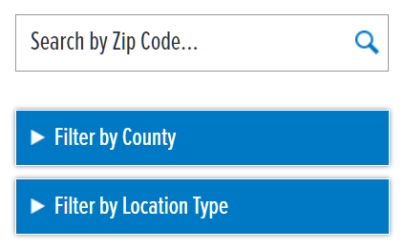
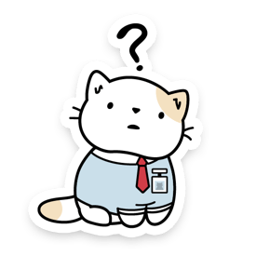
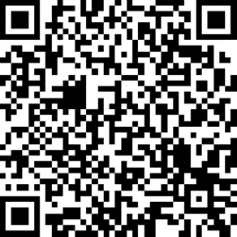
https://www.wrksolutions.com/
Notes:
Inform class to contact local WFS office for assistance.
Provide email address(es) in Chat, if needed.
https://www.surveymonkey.com/r/YBGBN6V

