Slide 1
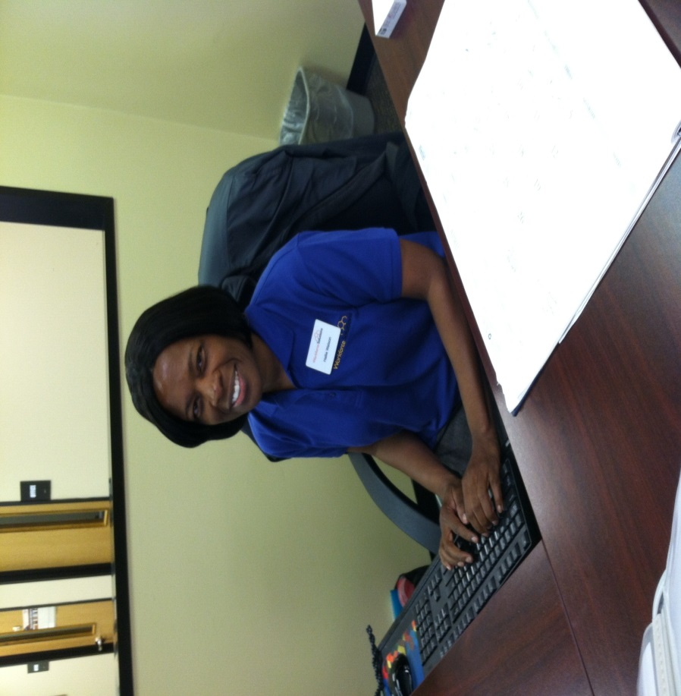
“I am workforce solutions”
Hallie Watson

Slide 2
Customer service story
Samuel Smith came in for a TANF orientation on October 17, 2013. He had custody of his 5 year daughter since she was a newborn. He was living with his mother and step father at the time he attended orientation. When he came in for orientation he had applied for SNAP and was denied. He was concerned his daughter had food to eat. I provided him with information to the Montgomery County Food Bank and other resources in the area for assistance, which he did get some assistance. He did not have transportation and was depending upon his mother to transport him around. Shortly after meeting Samuel his stepfather kicked him out of the house because he was not employed. He had no where to turn to so him and his daughter were left out on the streets until his sister allowed them to move in with her. He was assisted with resume and gas assistance while looking for work. Samuel did not have his GED but he had lots of work experience for a 23 year old and had the confidence he could find employment.

Slide 3
continued
His WIT profile was updated, but had very few referrals since he did not have his GED/High school diploma. Samuel stayed in contact with me weekly and was very appreciated for our support and encouragement. He found employment on Oct. 23 making $8/hour as a Mechanic Assistant working approx. 20 hours per week. This was not good enough for him and that did not set well with me either. Samuel was assisted with gas cards until he received his first pay stub. I continued to job search with him and provided him any assistance he needed. On Nov. 14 we secured Samuel a better job working as a Motor Technician at $14/hour. He was so excited about this job because he was getting over time pay and was able to purchase a vehicle. One of Samuel’s paychecks he had 80 regular hours and 54 hours overtime. He continued to thank me for all of the support and encouraging words that I gave him through the process of him finding a job.

Slide 4
continued
He has been a great asset to the company with his experience and the company is allowing him to get all the possible overtime. The last time I saw Samuel when he brought in his last paystub in January he was very excited about his life and his new career. He stated being on TANF for those 3-4 months helped him and his daughter when he needed it, but he knew that he did not want to be on the system for a long period of time.

Slide 5
Manager’s Comment
Hallie is a great asset to my team here in Conroe. She goes above and beyond to help every customer no matter what situation they are in. She always puts her customers needs first and is always looking for a way to help every customer. She exemplifies “WE ARE WORKFORCE SOLUTIONS” daily either with a customer at her desk as well as her peers. I am excited to nominate Hallie because this particular customer took the time to tell me how much he appreciated Hallie and everything she did for him and his daughter. I am very proud to have Hallie on my team!!

