Slide 1

Team Lead

Slide 2
Team Lead Transformers
After attending the National Workforce Institute (NWI) Supervisory Series, this dynamic trio committed to continuing what they’ve learned in the series by demonstrating their leadership skills as potential leaders in their efforts to keep evolving by converting those skills and their initiatives to Transformers with power, presence and recognition in our office and with community partners.

Slide 3
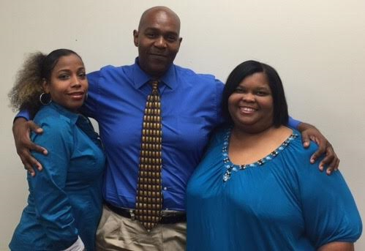
Who We Are
The team was established with the design that they act as team leads within the office and help to expound on the workforce principles with their peers. Krystal, LaTonya and Kevin embraced the concept of peer leaders and took it to another dimension. The name TRANSFORMERS was conceived as a message that we are always evolving and changing and with change comes new ideas, progress and transforming our customer’s lives for GOOD.

Slide 4
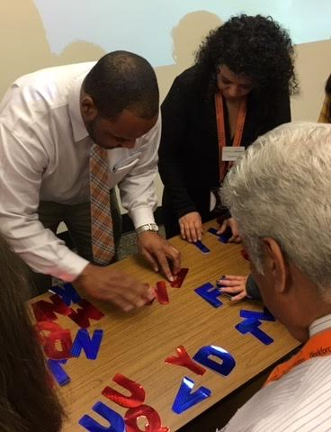
What We Do
The TRANSFORMERS now take the lead through great initiative to assist management with triaging the guest list during peak hours and coordinating staff activities for the office and around the I AM WORKFORCE SOLUTIONS principles using a peer power concept.
The TRANSFORMERS meet monthly on what they call a “Terrific Tuesday” to reiterate and focus on the I AM Workforce SOLUTIONS principles with all efforts designed to invoke teamwork, enthusiasm, and share knowledge gained from The Buzz, Honeycombs and Business Quarterly updates for Labor Market Information for the community and the Gulf Coast Region – Where the Jobs Are? They engaged their peers with interactive games, puzzles, role play, pep rallies that not only brought camaraderie but started the day off with laughter, smiles and encouragement to transform the lives of our customers.

Slide 5

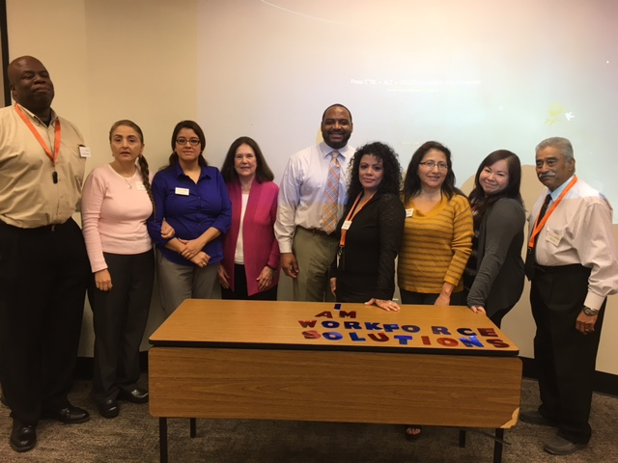
Why We Do It
Their presence is recognized and respected as they collaborate meeting topics around the Workforce Solutions principles and colors that everyone wears as a sign of unity and collaboration. The management team and their peers are all proud of their growth and how they have demonstrated leadership skills to think outside the box to foster positive change at East End for staff, community and customer service. One coworker shared that the “Peer Power” empowered her as she sat with her customer while being monitored. She was able to provide the best of services because she kept thinking “I AM WORKFORCE SOLUTIONS to my customer.” She shared that it elevated her to provide - the Best Services we could offer the customer.”

Slide 6
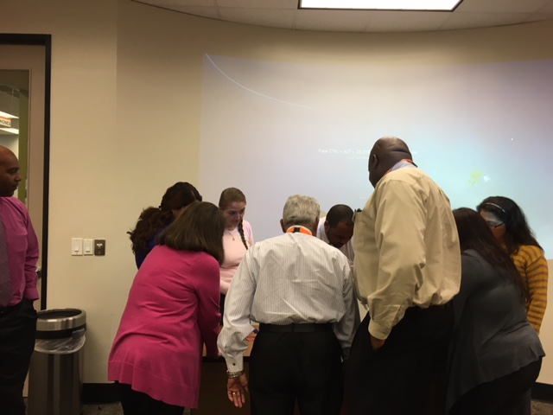
Krystal, LaTonya and Kevin, we salute the “TRANSFORMERS” for your continued efforts to ensure that we are WORKFORCE SOLUTIONS to each other, our customers and community!!

Slide 7
Team Lead

