Slide 1
“I AM Workforce Solutions” Service Award Nomination
Interfaith Tracking Unit

Slide 2
Interfaith Tracking Unit
Tracking Unit was piloted in late 2008 with five Career Offices. Proved to be successful with improving record keeping, data entry accuracy, and uniform implementation of policies and procedures.
Currently supports 13 WFS Career Offices in the Houston-Galveston Region.
13 Program Tracking Specialists, two Supervisors, and one Manager. The management team at the Tracking Unit has over 35 combined years of WFS experience.
Tracking Unit strives to provide the absolute best Internal and External Customer Service Experience!
EXCELLENT
Internal & External
Customer Service Experience!

Slide 3
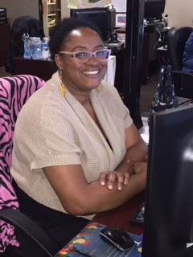
To my customer, I AM Workforce Solutions!
Rather than blaming co-workers, partner staff, managers, or other contractors for mistakes, the Tracking Unit helps fix the problem and deliver the service each customer needs.
Example:
The Tracking Unit provides ongoing feedback to Career Offices, monitoring reports and customer records to ensure services are provided accurately and timely. Information is shared weekly with Career Offices one-on-one and on conference calls.
They communicate with their partner NCI Tracking Unit regularly to ensure requests from external customers are acted on timely. They have created a great working relationship with NCI.
Accountability!

Slide 4
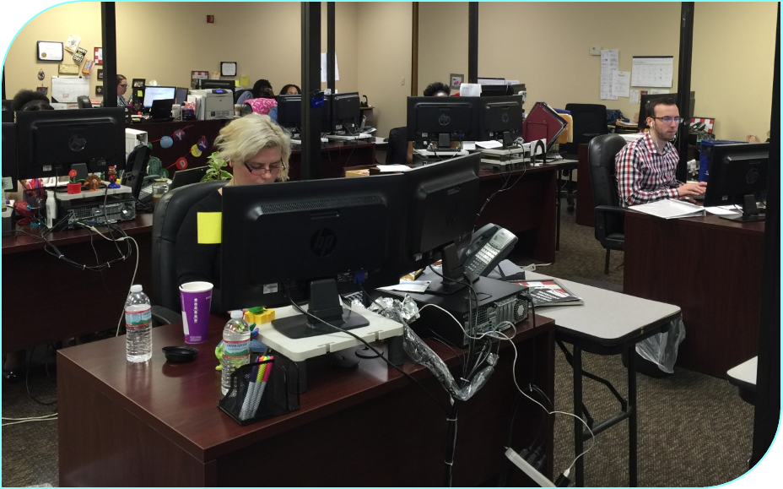
I understand the resources available throughout our system, and I am able to access those resources as necessary to meet my customer’s wants and needs!
The Tracking Unit has weekly coaching, information sharing, and on-the-job training to understand what other staff do, what offices do, and what other parts of Workforce Solutions do.
They understand how different job functions in Workforce Solutions work together and affect each other.
Example:
Implementation of routing TAA Orientations.
Using FACS to improve internal processes.
Sharing of information with new policy/ procedure implementation.
Resourceful!

Slide 5
Quality Involvement with Office Staff
Tracking Unit assists the offices to ensure services are opened accurately and timely in TWIST.
Tracking Unit provided webinar training to Career Offices to strengthen their knowledge and improve data entered on service report. Tracking Unit staff also go directly to offices to provide hands-on training and technical assistance.
They work closely with the Career Offices to ensure all data are received timely. They sample the data submitted and provide feedback directly to the Career Office Manager for future reference.
Accurate!

Slide 6
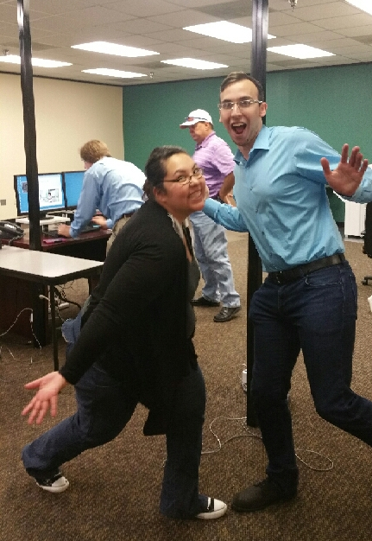
Here are some comments provided by Career Office Management:
“Outstanding work ethic and internal customer service to our staff and fellow colleagues” – Danielle Clark, Office Manager Waller
“Always willing to answer questions, as many times as it takes, to help my team gain a better understanding of process and procedure. They always present us with solutions to accommodate our customers whenever needed, whether by contacting HHSC directly or ensuring customers swiftly receive services, i.e., same-day childcare!” – Amanda Clarke, Office Manager Katy Mills
“The Tracking Unit is a huge support to my office. They offer a design that really allows us to spend more time with our customers, and they do so with a smile! They are very friendly and pleasant to communicate with.
It is a pleasure to work with each and every tracker; our offices wouldn’t be the same without them always there to answer questions. And they protect our system’s integrity!” – Nicole Quintero, Office Manager Willowbrook

Slide 7
Here are some comments provided by Career Office Management:
“We feel that the Tracking Unit staff support office functions on a daily basis. They are always available for a quick reference or question regarding services, and provide quality and valuable feedback. At all times, the Tracking Unit staff are friendly and are fantastic to work with. We absolutely love working with Paula and her team.” – Lucy Ybarra, Office Manager, Huntsville
“We feel they provide our staff and our customers with excellent service. They work with us to get answers or make sure data management is handled quickly and accurately. They are also great at providing quick service in priority situations with regard to a customer requesting services.” – Michelle Westlake, Office Supervisor, Conroe
“Without a doubt the Tracking Unit is an unsung hero in our system! They have always provided quality services to our staff and customers and represent the true meaning of I AM Workforce Solutions” – Roy Letbetter, Office Manager, Conroe

Slide 8
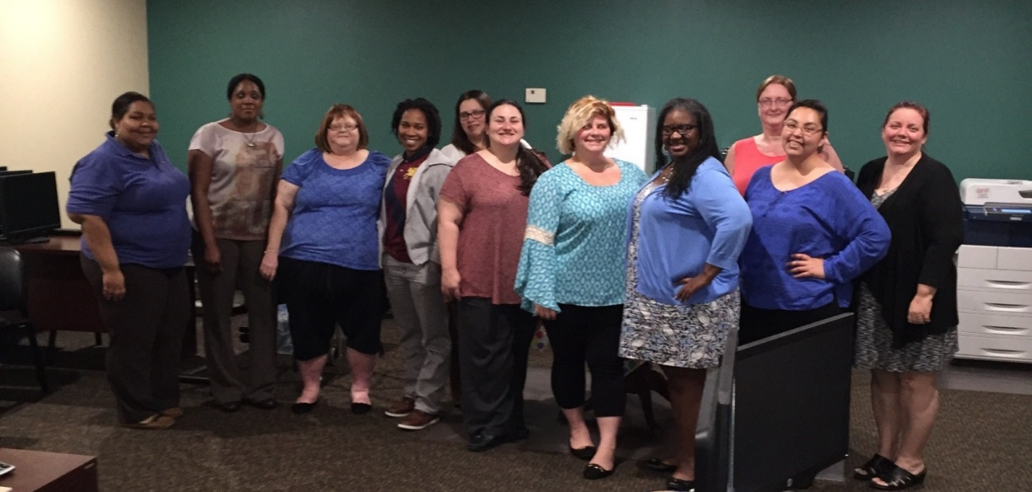
The Interfaith Tracking Unit continues to take on additional assignments, while continuing to provide exceptional customer service and support to the Career Offices and other WFS partners.
For these reasons, we would like to nominate the Interfaith Tracking Unit for the Customer Service Award!
Interfaith Tracking Unit Is Workforce Solutions!
They Deserve it!

