Slide 1
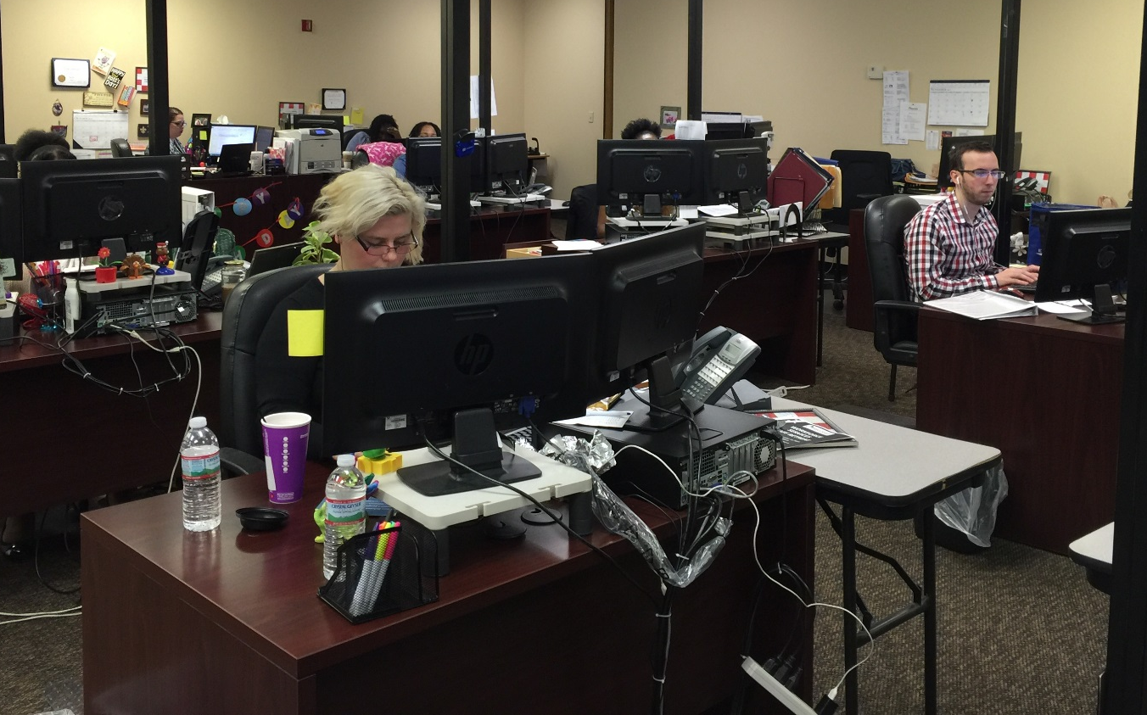
Customer Service Award Nomination
Interfaith of The Woodlands’ Tracking Unit

Slide 2
Interfaith Tracking Unit
The Tracking Unit was piloted in late 2008 with five Career Offices. It proved to be successful in improving record keeping, data-entry accuracy, and uniform implementation of policies and procedures.
Currently, it supports 13 Workforce Solutions Career Offices in the Houston and Galveston Region.
There are 13 Program Tracking Specialists, two Supervisors, and a Manager. The Tracking Unit’s leadership team has more than 35 combined years of WFS experience.
The Tracking Unit strives to provide the absolute best internal and external customer service experience!

Slide 3
To my customer, I AM Workforce Solutions!
Accountability!
Rather than assigning fault if a problem arises, the Tracking Unit helps address the issue and deliver the service each customer needs.
Example:
The Tracking Unit provides ongoing feedback to Career Offices, monitoring reports and customer records to ensure services are provided accurately and timely. Information is shared weekly with Career Offices one-on-one and on conference calls.
They communicate with their NCI partner regularly to ensure requests from external customers are acted on timely. They have fostered a great working relationship with the NCI Tracking Unit.

Slide 4
I understand the resources available throughout our system, and I am able to access those resources as necessary to meet my customer’s wants and needs!
The Tracking Unit has weekly coaching, information sharing, and on-the-job training to understand what other parts of Workforce Solutions do, including the various staff and office functions.
They recognize how these different functions work together and impact each other across the Workforce Solutions system.
Examples:
Implementation of routing TAA Orientations
Using FACS to improve internal processes
Information sharing for new policy/procedure implementation

Slide 5
Involvement with Open Service Report
The Tracking Unit assists the offices with ensuring services are opened accurately and timely in TWIST.
The Tracking Unit provided webinar training to Career Offices to strengthen their knowledge and improve data entered on service report.
They worked closely with the Career Offices to ensure all information was received timely. They also sampled a portion of the data submitted and feedback was provided directly to the Career Office Managers for future reference.

Slide 6
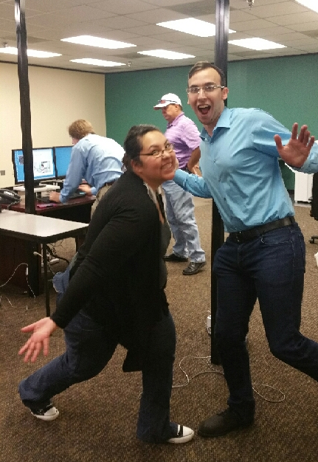
comments provided by Career Office Management:
“Outstanding work ethic and internal customer service to our staff and fellow colleagues” – Danielle Clark, Office Manager, Waller
“They are always willing to provide guidance even for the basics we should know! Always willing to help!” – Amanda Clarke, Office Manager, Katy Mills
“Always willing to go the extra mile to ensure we provide the best possible customer service through quality advice and quick action!” – Roy Letbetter, Office Manager, Conroe
“The Tracking Unit is a huge support to my office. They offer a design that really allows us to spend more time with our customers, and they do so with a smile! They are very friendly and provide pleasant communication.
It is a pleasure to work with each and every tracker. Our offices wouldn’t be the same without them always there to answer questions and protect our system’s integrity!” – Nicole Quintero, Office Manager, Willowbrook

Slide 7
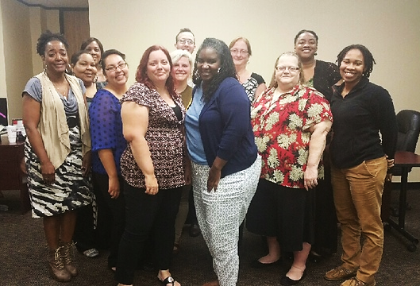
The Interfaith Tracking Unit continues to take on additional assignments while striving to provide exceptional customer service and support to the Career Offices and other Workforce Solutions partners.
For these reasons, we nominate the Interfaith Tracking Unit to receive the Gulf Coast Workforce Board’s Customer Service Award!
Interfaith’s Tracking Unit is Workforce Solutions!

