Slide 1
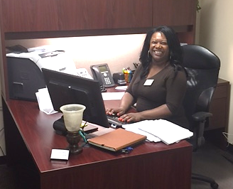
WORKFORCE SOLUTIONS
As a flower in the garden Bending toward the sun, Unfolds it’s tiny petals One, by one, by one… So faith expands it’s beauty Until at last it grows Into life’s lasting flower… The heart’s fair perfect rose.
Dennita Allen

Slide 2
W
Dennita is a Team Lead consistently willing to mentor her co-workers.
Her experience and expertise has led to requested training and guidance inter-office & within local and regional offices to ensure quality service delivery
ILLING

Slide 3
O
She provides an optimistic viewpoint to the customers that know and reference her by name- encouraging them to remain positive about employment outlooks
PTIMISTIC

Slide 4
R
In this industry being resourceful is a gem!
Dennita is aware of the resources available within the Houston area, inquires about other Resources to keep a steady list & never allows a customer To leave empty handed
Continuously extending her customer service skills to ensure that no customer is left behind…
ESOURCEFUL
Westheimer Office came in 2nd place 2015 (State Employee Charitable Campaign)
Dennita was the Lead of the Team! She motivated staff to participate in office fund raisers and events to raise funds.

Slide 5
K
True Story:
A customer parked his car in front of our building one day and it was running hot. The customer came into the office and approached Dennita just as he explained the problem with his vehicle. Dennita went to find a container – asked the customer to open his hood and poured water into the radiator. After the car was cooled She assisted the customer with job search!
Her kindheartedness appeals to every person that encounters Westheimer Workforce regardless of status/situation/or circumstance.
INDHEARTED

Slide 6

F
Most favorable one word description amongst staff
“ Fabulous”
Dennita is fabulous in her work ethic, in her customer service and in her dedication to perform her job duties
ABULOUS

Slide 7
O
In many ways Dennita is the glue to all processes in this office-
service is her 1st priority
She is always Willing to Lend a helping hand when asked or voluntarily for any task.
As a member of Bridging Gap Group (Sharing information for the collaborative agreement of systematic processing)
Acting as a Team Lead for her peers, conducting herself in a professional matter & aligning the expectations of the office to meet the goals of WFS
Volunteering for Socialite eVents, holiday events, & fundraising initiatives
Or Simply to offer assistance to a supervisor
BLIGING

Slide 8
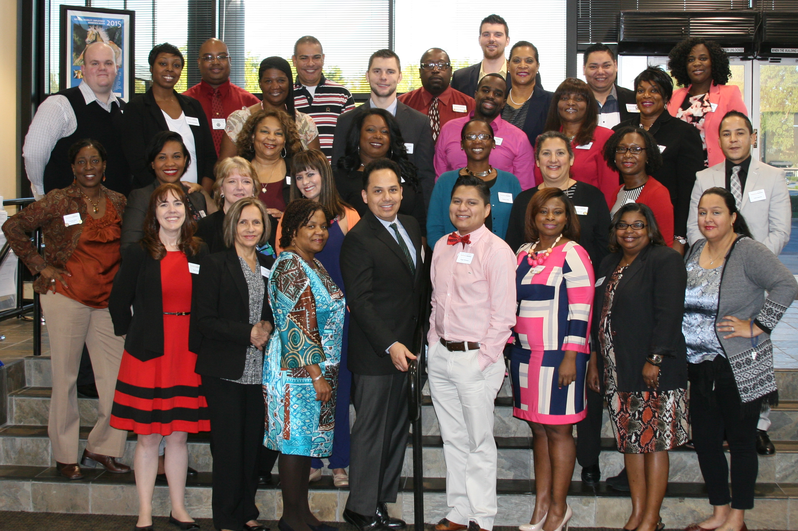
R
Dennita has achieved the admiration of her co-workers, supervisors, and customers.
She is held in the highest regard with the Westheimer family.
ESPECTED

Slide 9
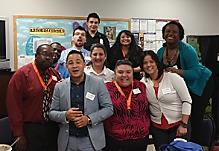

C
HEERFUL
keeps a smile on her face!

Slide 10
E
Dennita has a self-acclaimed title of “extraordinaire” however we would never disagree
XTRAORDINAIRE

