Slide 1
CUSTOMER SERVICE AWARD NOMINATION
SHERRIE BROOKS
EMPLOYMENT COUNSELOR
HUMBLE WORKFORCE SOLUTIONS

Slide 2
EMPLOYMENT COUNSELOR
Sherrie provides professional advice to customers who need job search guidance or career advice.
Sherrie listens to each customer request and always provides professional advice to help each customer.
Sherrie provides direct job matching of open system postings with customer’s skills and work requirements.

Slide 3
EMPLOYMENT COUNSELOR
Sherrie searches for qualified candidates for job postings.
Sherrie provides labor market information.
Sherrie work hands on and one on one with employers when having hiring events at the office.
Sherrie helps customers to access services through the use of the all resources.

Slide 4
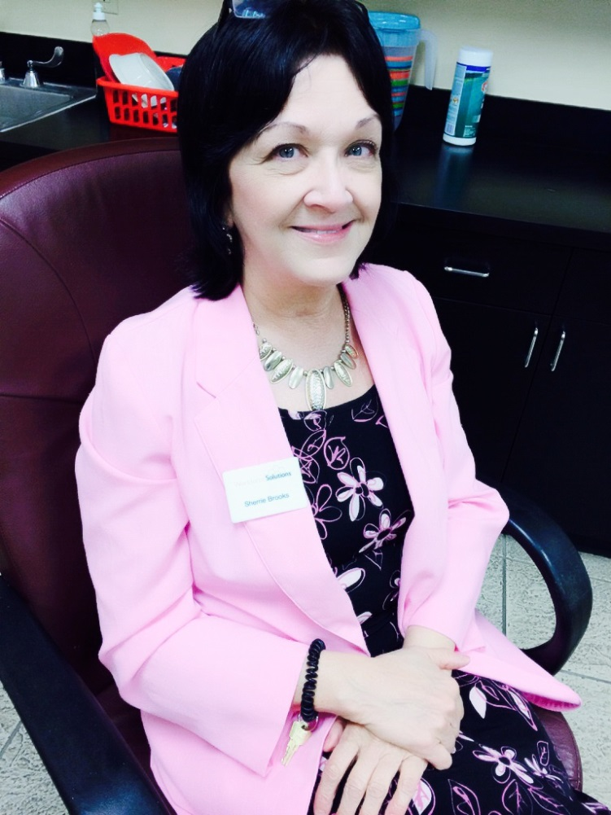
Customer Comments!
“She was so motivating during a depressing time of me having no luck with
work searching. She improved my work in texas account and within 1 week
I received a permanent position”-B. Blackmon
“I wish everyone was as nice and persistent as Ms. Sherrie Brooks. She is
Amazing!”-J. Senyk
“Mrs. Sherrie Brooks is an awesome counselor”- Woods
“Mrs. Sherrie Brooks was very knowledgeable and customer friendly in
assisting me today. She is definitely an asset to your
establishment”- S. Black
“Thanks to Mrs. Sherrie Brooks she is an exceptional employee. She has
Made my life great”-S. Scott

Slide 5
Why Nominate Sherrie Brooks
Sherrie consistently gives every customer the best customer service every time. She became a full-time employee on 10/01/13. She always has a smile on her face and is willing to go above and beyond to help every customer. She works with a non-profit organization called Autumns Dawn that transitions Autistic adults to independent living. After every time they bring a client to our office to meet with Sherrie, we get an email from them to let us know once again she did an amazing job. She has currently found three of their clients full-time employment.

Slide 6
I Am Workforce Solutions
To my customer, I AM Workforce Solutions
Sherrie demonstrates this everyday with each of her customers. She greets every customer with what kind of job can I find you today. She truly wants to find all customers that job or career they have been searching for.

