Slide 1
Information session
February 8, 2022
Notes:
We are so pleased to have you joining us for today’s information session about Employer Services!
This session will provide an overview of our workforce system, the many pieces that come together to allow us to serve employers and individuals in the Gulf Coast region, and specific information about what we look for in contractors. Our goal is for you to leave with helpful information, so there will be plenty of time at the end of this presentation for Q&A at the end.
Again thank you for being here.

Slide 2
Employer Service
Notes:
The subject of today’s information session is the Financial Aid Payment Office, which is a critical piece of our workforce system. We will discuss its purpose and function in detail later in this presentation.
But first, let’s dig into Workforce Solutions – who we are and what we do.

Slide 3
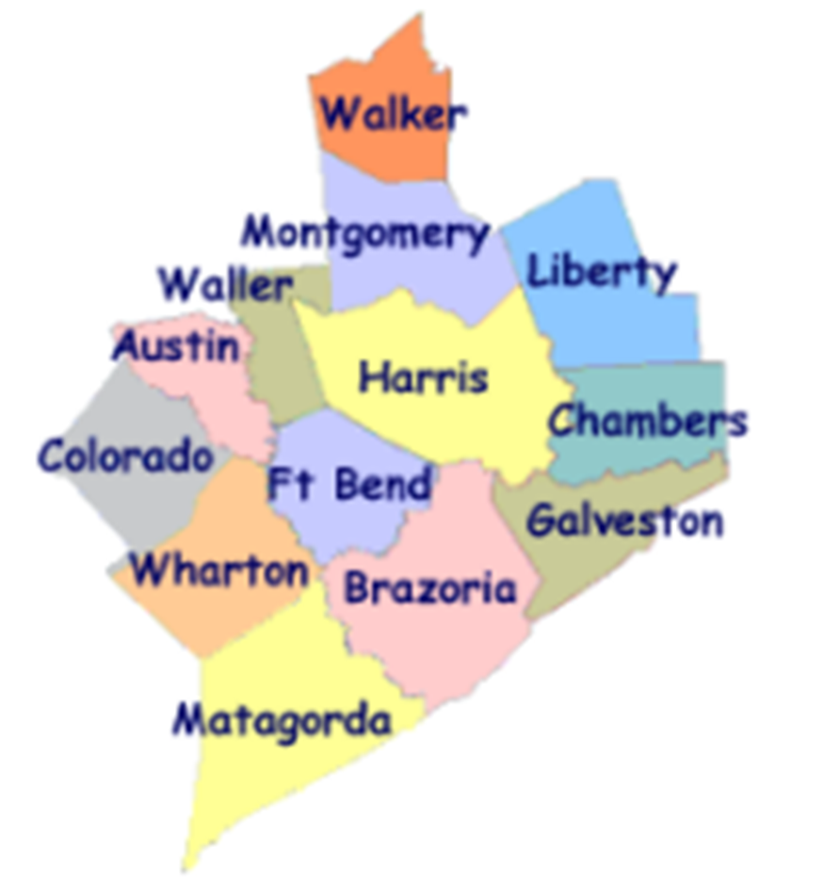
Workforce Solutions
ABOUT US:
Gulf Coast Workforce Board – Workforce Solutions is the public workforce system serving the 13-county Gulf Coast region
We elevate the economic and human potential of the Gulf Coast region by fulfilling the diverse needs of the employers and individuals we serve
What we can do:
List and fill open jobs, including HR consulting
Offer career advice and job placement assistance
Support individuals with their education and training needs
Provide work-based learning opportunities
Support families with early education financial aid
Assist individuals with disabilities with education and job opportunities
Notes:
The Gulf Coast Workforce Board and its operating affiliate Workforce Solutions are the public Workforce system in the 13-county Houston-Galveston region.
Business-led and community-focused, the Workforce Board sets the region’s Workforce agenda and the strategic direction for the Workforce Solutions system.
The Houston-Galveston Area Council (H GAC) is the Board’s staff, serving as the system’s corporate home office and providing management of and direction to sub-recipients that operate within the Workforce Solutions network.

Slide 4
Workforce Solutions
PURPOSE
To keep our region a great place to do business, work and live.
MISSION
We elevate the economic and human potential of the Gulf Coast region by
fulfilling the diverse needs of the businesses and individuals we serve.
VISION
Our region attracts and retains the best employers, affords everyone the dignity
of a job, remains vitally important to the global economy — and all within it are
thriving.
VALUES
We Are Employer-driven
We Care Passionately
We Take Responsibilities Seriously
We Imagine Possibilities
Notes:
Part of understanding who we are as a system, is knowing our purpose, mission, vision, and values.
Our purpose is to keep our region a great place to do business, work, and live.
PURPOSE
To keep our region a great place to do business, work and live.
MISSION
We elevate the economic and human potential of the Gulf Coast region by fulfilling the diverse needs
of the businesses and individuals we serve.
VISION
Our region attracts and retains the best employers, affords everyone the dignity of
a job, remains vitally important to the global economy — and all within it are thriving.
The values that guide our behaviors as we execute our purpose, mission, and vision are:
VALUES & BEHAVIORS
We Are Employer-driven
We Care Passionately We Take Responsibilities Seriously We Imagine Possibilities
Advocate for others Be accountable Seek multiple perspectives
Inspire hope Bring fresh thinking Follow up and follow through
Fuel progress Drive results Engage one another in making a difference

Slide 5
A meaningful impact
Notes:
We expect these efforts to result in more competitive employers, a better educated workforce, more and better jobs, and higher incomes.
Workforce Solutions helps employers meet their human resource needs and individuals build careers.
We deliver direct service to businesses and people throughout the region. Our system is all about making the labor markets that impact our region work more efficiently for employers and workers. We do this by identifying and filling imbalances or gaps between supply and demand in an effort to keep our region the best place to do business, work and live. Our entire system works to provide employers, individuals, educators, students, and parents with up-to-date and useful information on opportunities for growth, good wages, and future careers.

Slide 6
2021 Impact
24,600 employers and 428,000 individuals served
Spent at least $13.3 million on scholarships for more than 3,400 individuals in high-skill, high-growth occupational training
Supported nearly 22,000 families and 42,000 children with early education subsidies
Helped more than 69,800 individuals go to work
Raised the incomes of 32,747 by 20 percent or more
Helped 76.6% of individuals pursuing a post-secondary education attain a credential (certificate or degree)
Notes:
Workforce Solutions knows that our region is more than just a point on a map. It is the home of millions of people and the location of thousands of businesses. And the relationship between those two is what keeps our region bustling with activity and rich in promise. When we identify and pursue every opportunity to bring vibrancy to the labor market, we generate more promise and hope. Our region becomes a magnet for amazing businesses and amazing talent. People flock here for jobs and businesses rush for opportunities to grow. We become a place where businesses and people want to plant their roots because they see a bright future here. Abundance follows, and as a result, we become an even more important player in the world economy and all in our region thrive.
This philosophy has produced the following results over the past year (read bullets)

Slide 7
How We Do It
Notes:
Workforce Solutions creates this impact by helping employers meet their human resource needs and supporting individuals as they build careers.
We deliver direct service to businesses and people throughout the region.
Our system is all about making the labor markets that impact our region work more efficiently for employers and workers. We do this by identifying and filling imbalances or gaps between supply and demand in an effort to keep our region the best place to do business, work and live.
Our entire system works to provide employers, individuals, educators, students, and parents with up-to-date and useful information on opportunities for growth, good wages, and future careers.

Slide 8
Pieces of the System
Employer Service
Career Offices
Financial Aid Payment Office
Financial Aid Support Center
Texas Workforce Commission Integration Management Team
Youth Service – Next Gen
The Regional Team
Regional Quality Assurance Team
Staff Training & Development
Education Opportunity Consortium
Early Education Quality (Childcare)
Vocational Rehabilitation Services
Veteran Staff
Notes:
We know that individual’s job needs can best be met by meeting employers’ needs for a well-educated and well-trained workforce; therefore, the local workforce system has two principal components:
Our Employer Service division provides information and markets and sells service to employers.
Our Career Offices provide a pathway to an array of information, resources and opportunity for residents of this region.
Workforce Solutions is committed to being employer-driven -- you heard it mentioned when we covered our values. Employer service is the lead component in the delivery system, with employers as the primary customer. This is the case because it is the employers that drive the volume, diversity and timing of opportunities we can offer the individuals we serve.
Though we have two principal service components, our Workforce Solutions system has many interconnected pieces that must work together to deliver our services. The Board procures contractors for the operation of each of the pieces of the Workforce Solutions, which include (read bullets)

Slide 9
Employer service

Slide 10
What is Employer Service?
Our Vision
The Employer Service Division is the principal marketing and sales force for Workforce Solutions, responding to employers’ needs for skilled workers by providing professional advice and consultation providing real-time labor market intelligence and current information about area employers’ wants and needs to the entire Workforce Solutions system.
Opportunities for Improvement
Employer Relationships
Responsiveness and Accountability
Communication
Notes:
Our local workforce system has two principal components: an “employer” component and a “people” component that offers access to an array of services to those who work, live and do business in the Gulf Coast region.
Our Vision
The Employer Service Division is the principal marketing and sales force for Workforce Solutions, responding to employers’ needs for skilled workers by providing professional advice and consultation that offers real-time labor market intelligence and current information about area employers’ wants and needs to the entire Workforce Solutions system.
The Employer Service Division also provides employers with information on human resources needs – including talent acquisition, development, and retention.
Opportunities for Improvement
Employer Relationships
Responsiveness and Accountability
Communication
As the 4th largest workforce board in the country, we continue to evaluate the customer service experience we provide to our employers. We have identified vital areas for improvement as we continue to grow through this process. We're an employer-driven system; therefore, building and maintaining strong employer relationships is essential to our success. Responding to emails and phone calls promptly allow us to follow up and follow through on our commitments. Finally, communication is critical in business to ensure we listen to the wants and needs of the employer, and expectations are managed up front on outcomes.

Slide 11
How Employer Service Division Works
Functions
Ensuring high-level relationships with chambers, economic development councils, and business associations throughout the region
Introduces new businesses to Workforce Solutions
Outreaching and expanding services to at least 64% of the 25,000 companies that we served last year (ensuring repeat business)
Creating an additional 1,700 new jobs in the Gulf Coast region
Creating new opportunities with employers as part of our talent development efforts
Provide Educational Seminars to Human Resource professional
Notes:
The primary functions for the Employer Service Division are:
Develop and ensuring high-level relationships with chambers, EDCs, and business associations throughout the region.
Introduce new businesses to Workforce Solutions, we can grow our footprint and network.
Through outreach and expanding services to at least 64% of the 29,5000 companies that we served last year (ensuring repeat business) and quality customer service.
Being a part of the discussion with our partners at the EDCs/Chambers, we help to create an additional 1,700 new jobs in the Gulf Coast region.
Through our Talent Development team, we create new opportunities with employers as part to help upskill or reskill individuals that meet the employers need.
We provide Educational Seminars to Human Resource professional, so they can learn the latest on any changes to employment law.

Slide 12
Current Operations
We have two contractors within the Employer Service Division responsible for different performance measures in our region. The Employer Service Division has a combined number of 117 staff housed in a central office (Houston) and throughout our Workforce Solutions career offices in the region.
The overall budget for Employer Service is $19.5 million to support the combined staff of 117 and other operational costs.
Staffing- between two contractors:
5 Directors
5 Managers
6 Supervisors
3 Data Analyst
3 Compliance Specialist
2 Quality Assurance
6 Sr. Business Advisor
6 Talent Advisor
22 Business Consultants
6 Project Specialists
6 Recruiters
7 Talent Coaches
3 Training Facilitators
18 Financial Aid Specialists
4 Employer Support specialists
15 Business Service Representatives
Staff is currently working both in-person and remotely due to the pandemic.
Notes:
We have two contractors within the Employer Service Division responsible for different performance measures in our region. The Employer Service Division has a combined number of 117 staff housed in a central office (Houston) and throughout our Workforce Solutions career offices in the region. We have divided the unit into two sections that work collaboratively as one for the system. One contractor interfaces with community partners and the other handles administrative duties.
The overall budget for Employer Service is $19.5 million to support the combined staff of 117 and other operational costs.
Staff is currently working in-person and remotely due to the pandemic.

Slide 13
A Look at the Data
Service Volume
The Employer Service Division attracts and retains businesses for the workforce system and builds talent through training opportunities to meet employers’ needs. Our Talent Development team processed over $3 million in training support dollars to employers participating in on-the-job training and scholarships to help offset related technical instruction or classroom learning.
Service to Employers/Individuals for FY 2021:
Assisted 400 employers served through Talent Development Services that included over $1.4 million dollars in new hire reimbursements through the On-the-Job Training incentive. Average reimbursement per new hire -$2,800
Assisted 340 individuals through scholarships for related technical instruction—(classroom learning) totaling $1.6 million. Average scholarship per individual - $4,600
Notes:
The Employer Service Division attracts and retains businesses for the workforce system and builds talent through training opportunities to meet employers’ needs. Our Talent Development team processed over $3 million in payments/vouchers for reimbursements to employers participating in on-the-job training and scholarships to help offset related technical instruction or classroom learning.
Service to Employers/Individuals for FY 2021:
Over 400 employers reimbursed through participating in on-the-job training at $1.4 million.
Average reimbursement for employer during OJT is $2,800
Assisted 340 individuals through scholarships for related technical instruction—(classroom learning) at $1.6 million.
Average cost per individual $4,600

Slide 14
Questions
Notes:
What questions can we address for you today?

Slide 15
What’s Next

Slide 16
Workforce Solutions
Contracting With Us
An RFP will be extended in the coming weeks.
If your contact information changes, please reach out to Deborah Duke (Deborah.duke@wrksolutions.com) to share updates.
For more information about Workforce Solutions, visit www.wrksolutions.com.

