Slide 1
Contact Center RFP
January 19, 2022
Notes:
We are so pleased to have you joining us for today’s information session about XXXX!
This session will provide an overview of our workforce system, the many pieces that come together to allow us to serve employers and individuals in the Gulf Coast region, and specific information about what we look for in contractors. Our goal is for you to leave with helpful information, so there will be plenty of time at the end of this presentation for Q&A at the end.
Again thank you for being here.

Slide 2
H-GAC Scope, Purpose, Mission
Notes:
The subject of today’s information session is the Financial Aid Support Center, which is a critical piece of our workforce system. We will discuss its purpose and function in detail later in this presentation.
But first, let’s dig into Workforce Solutions – who we are and what we do.

Slide 3
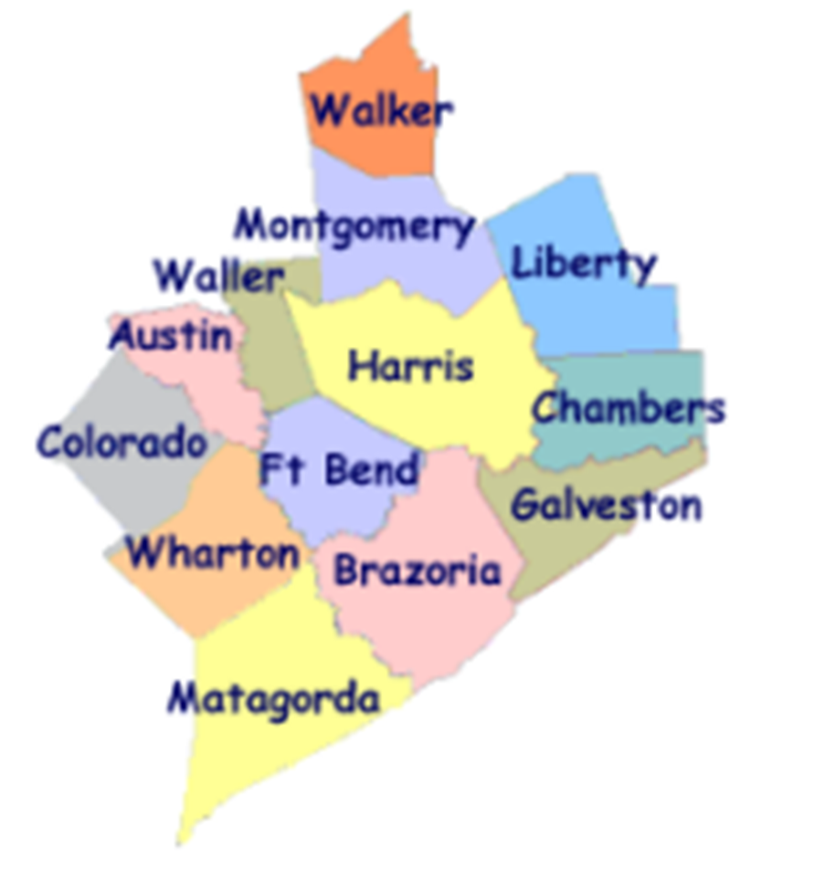
Workforce Solutions
ABOUT US:
Gulf Coast Workforce Board – Workforce Solutions is the public workforce system serving the 13-county Gulf Coast region
We elevate the economic and human potential of the Gulf Coast region by fulfilling the diverse needs of the employers and individuals we serve
What we can do:
List and fill open jobs, including HR consulting
Offer career advice and job placement assistance
Support individuals with their education and training needs
Provide work-based learning opportunities
Support families with early education financial aid
Assist individuals with disabilities with education and job opportunities
Notes:
The Gulf Coast Workforce Board and its operating affiliate Workforce Solutions are the public Workforce system in the 13-county Houston-Galveston region.
Business-led and community-focused, the Workforce Board sets the region’s Workforce agenda and the strategic direction for the Workforce Solutions system.
The Houston-Galveston Area Council (H GAC) is the Board’s staff, serving as the system’s corporate home office and providing management of and direction to sub-recipients that operate within the Workforce Solutions network.

Slide 4
Workforce Solutions
PURPOSE
To keep our region a great place to do business, work and live.
MISSION
We elevate the economic and human potential of the Gulf Coast region by
fulfilling the diverse needs of the businesses and individuals we serve.
VISION
Our region attracts and retains the best employers, affords everyone the dignity
of a job, remains vitally important to the global economy — and all within it are
thriving.
VALUES
We Are Employer-driven
We Care Passionately
We Take Responsibilities Seriously
We Imagine Possibilities
Notes:
Part of understanding who we are as a system, is knowing our purpose, mission, vision, and values.
Our purpose is to keep our region a great place to do business, work, and live.
PURPOSE
To keep our region a great place to do business, work and live.
MISSION
We elevate the economic and human potential of the Gulf Coast region by fulfilling the diverse needs
of the businesses and individuals we serve.
VISION
Our region attracts and retains the best employers, affords everyone the dignity of
a job, remains vitally important to the global economy — and all within it are thriving.
The values that guide our behaviors as we execute our purpose, mission, and vision are:
VALUES & BEHAVIORS
We Are Employer-driven
We Care Passionately We Take Responsibilities Seriously We Imagine Possibilities
Advocate for others Be accountable Seek multiple perspectives
Inspire hope Bring fresh thinking Follow up and follow through
Fuel progress Drive results Engage one another in making a difference

Slide 5
A meaningful impact
Notes:
We expect these efforts to result in more competitive employers, a better educated workforce, more and better jobs, and higher incomes.
Workforce Solutions helps employers meet their human resource needs and individuals build careers.
We deliver direct service to businesses and people throughout the region. Our system is all about making the labor markets that impact our region work more efficiently for employers and workers. We do this by identifying and filling imbalances or gaps between supply and demand in an effort to keep our region the best place to do business, work and live. Our entire system works to provide employers, individuals, educators, students, and parents with up-to-date and useful information on opportunities for growth, good wages, and future careers.

Slide 6
2021 Impact
24,600 employers and 428,000 individuals served
Spent at least $13.3 million on scholarships for more than 3,400 individuals in high-skill, high-growth occupational training
Supported nearly 22,000 families and 42,000 children with early education subsidies
Helped more than 69,800 individuals go to work
Raised the incomes of 32,747 by 20 percent or more
Helped 76.6% of individuals pursuing a post-secondary education attain a credential (certificate or degree)
Notes:
Workforce Solutions knows that our region is more than just a point on a map. It is the home of millions of people and the location of thousands of businesses. And the relationship between those two is what keeps our region bustling with activity and rich in promise. When we identify and pursue every opportunity to bring vibrancy to the labor market, we generate more promise and hope. Our region becomes a magnet for amazing businesses and amazing talent. People flock here for jobs and businesses rush for opportunities to grow. We become a place where businesses and people want to plant their roots because they see a bright future here. Abundance follows, and as a result, we become an even more important player in the world economy and all in our region thrive.
This philosophy has produced the following results over the past year (read bullets)

Slide 7
How We Do It
Notes:
Workforce Solutions creates this impact by helping employers meet their human resource needs and supporting individuals as they build careers.
We deliver direct service to businesses and people throughout the region.
Our system is all about making the labor markets that impact our region work more efficiently for employers and workers. We do this by identifying and filling imbalances or gaps between supply and demand in an effort to keep our region the best place to do business, work and live.
Our entire system works to provide employers, individuals, educators, students, and parents with up-to-date and useful information on opportunities for growth, good wages, and future careers.

Slide 8
Pieces of the System
Employer Service
Career Offices
Financial Aid Payment Office
Financial Aid Support Center
Texas Workforce Commission Integration Management Team
Youth Service – Next Gen
The Regional Team
Regional Quality Assurance Team
Staff Training & Development
Education Opportunity Consortium
Early Education Quality (Childcare)
Vocational Rehabilitation Services
Veteran Staff
Notes:
We know that individual’s job needs can best be met by meeting employers’ needs for a well-educated and well-trained workforce; therefore, the local workforce system has two principal components:
Our Employer Service division provides information and markets and sells service to employers.
Our Career Offices provide a pathway to an array of information, resources and opportunity for residents of this region.
Workforce Solutions is committed to being employer-driven -- you heard it mentioned when we covered our values. Employer service is the lead component in the delivery system, with employers as the primary customer. This is the case because it is the employers that drive the volume, diversity and timing of opportunities we can offer the individuals we serve.
Though we have two principal service components, our Workforce Solutions system has many interconnected pieces that must work together to deliver our services. The Board procures contractors for the operation of each of the pieces of the Workforce Solutions, which include (read bullets)

Slide 9
Financial Aid Support center (FASC)
Notes:
Good Morning. My name is Jennifer Starling. I’m a Senior Planner with the WFS Gulf Coast Board.

Slide 10
What is the Financial Aid Support Center?
Our Vision
A department responsible for making accurate and timely financial aid determinations, ensuing customers receive the highest quality customer service, and timely notification for eligibility.
We also envision a unit that will respond to customer inquires for information quickly and provide guidance/resources.
Opportunities for Improvement
Technology Enhancements
Timely Determination
Responsiveness to customers via various methods of communication
Uniformity of procedures
Notes:
Workforce Solutions offers financial aid to help individuals get the skills and credentials they need to get a job, keep a job or get a better job. Our Vision for the FASC is department responsible for making accurate and timely financial aid determinations, ensuing customers receive the highest quality customer service, and timely notification for eligibility.
There are several opportunities for improvement. We would like to see technology enhancements related to reporting system for calls, tracking applications, communication with customers, and productivity. Timely Determination and Responsiveness-We want to elevate our customer’s experience by reducing the amount of time to determine eligibility and address inquiries timely. Finally, we want to ensure there is uniformity with our policies and procedures.

Slide 11
Current Operations
The FASC receives $6.1 million to support 90.5 staff and other operational costs.
Staffing:
75 Financial Aid Customer Support Specialist
9 Supervisors
1 Manager
1 Electronic Record Coordinator
1 Data Analyst
3.5 Management and Support Staff
Staff work both in person and remotely
Notes:
The FASC is operating with a budget of $6 million. The staffing consist of 75 Financial Aid Customer Support Specialist, 9 Supervisors, and 5.5 Support Staff. Staff work both in person and remotely.

Slide 12
How the FASC Operates
Functions
    Training/Educational assistance
    Work Support
    Childcare
Technology
    The Workforce Information System of Texas (TWIST)
    DocuWare
    Chronicall
    Gazelle
Notes:
The FASC works closely with the FAPO office and career offices.
The FASC is responsible for processing financial aid request for customers seeking assistance with paying for training, work support, childcare. Most maintenance relating to childcare recipients is handled by the FASC . This includes making updates to income, family status, and changes in the type of care needed.
The Workforce Information System of Texas (TWIST) is used for data entry, DocuWare for storing customer documents and Chronicall for managing calls, and Gazelle is our FA Management system use to process scholarship related payment request.

Slide 13
FASC Data for October 2020 to September 2021
  Childcare
    Applications received-51,466
    Children-24,746
  Scholarship
    Applications received-9,898
    Processed over 4500 request
  Inbound Call
    Monthly Averaged-21,000
    Answered less than 50%
Notes:
Between October 2020-September 2021 we received over 51,000 application for childcare resulting in over 24,000 children in care per day. This includes customer applying for the first time and recertifying for continued care.
Applications for scholarship includes work support and training for youth/young adult, adults and dislocated workers.
We received almost 10,000 application from customers requesting assistance with education and work support. We processed over 4500 request for payments to education vendors.
We averaged 21,00 calls per month roughly 1000 per day and answers. We answered less than 50% of the calls.

Slide 14
Envisioning the Future
Real Time Performance Dashboard/Portal
Tracks call volume
Identifies backlogs for real time action
Communicates red/yellow/green for volume awareness
Data Expectations
Service Level – 90% of calls answered in 60 seconds
Quality Monitoring – Quality Assurance – Live or Recorded - Individual
Trending and Forecasting Information – Intraday/Day/Month/Year
Capacity Planning – For forecasting and staffing
Desktop Procedures
Fully Documented and Approved Desktop Procedures
Training incorporates Desktop Procedures

Slide 15
Questions
Notes:
What questions can we address for you today?

Slide 16
What’s Next

Slide 17
Workforce Solutions
Contracting With Us
An RFP will be extended in the coming weeks.
If your contact information changes, please reach out to Deborah Duke (Deborah.duke@wrksolutions.com) to share updates.
For more information about Workforce Solutions, visit www.wrksolutions.com.

