Slide 1
Information session
February 9, 2022
Notes:
We are so pleased to have you joining us for today’s information session about Staff Training and Development!
This session will provide an overview of our workforce system, the many pieces that come together to allow us to serve employers and individuals in the Gulf Coast region, and specific information about what we look for in contractors. Our goal is for you to leave with helpful information, so there will be plenty of time at the end of this presentation for Q&A.
Again, thank you for being here.

Slide 2
Staff Training and Development
Notes:
The subject of today’s information session is Staff Training and Development, which is a critical piece of our workforce system. We will discuss its purpose and function in detail later in this presentation.
But first, let’s dig into Workforce Solutions – who we are and what we do.

Slide 3
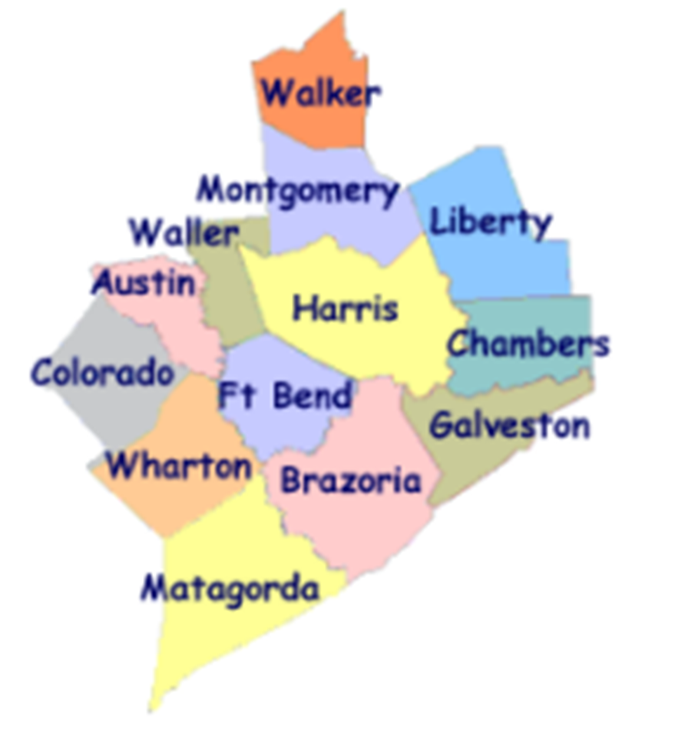
Workforce Solutions
ABOUT US:
Gulf Coast Workforce Board – Workforce Solutions is the public workforce system serving the 13-county Gulf Coast region
We elevate the economic and human potential of the Gulf Coast region by fulfilling the diverse needs of the employers and individuals we serve
What we can do:
List and fill open jobs, including HR consulting
Offer career advice and job placement assistance
Support individuals with their education and training needs
Provide work-based learning opportunities
Support families with early education financial aid
Assist individuals with disabilities with education and job opportunities
Notes:
The Gulf Coast Workforce Board and its operating affiliate Workforce Solutions are the public Workforce system in the 13-county Houston-Galveston region.
Business-led and community-focused, the Workforce Board sets the region’s Workforce agenda and the strategic direction for the Workforce Solutions system.
The Houston-Galveston Area Council (H GAC) is the Board’s staff, serving as the system’s corporate home office and providing management of and direction to sub-recipients that operate within the Workforce Solutions network.

Slide 4
Workforce Solutions
PURPOSE
To keep our region a great place to do business, work and live.
MISSION
We elevate the economic and human potential of the Gulf Coast region by
fulfilling the diverse needs of the businesses and individuals we serve.
VISION
Our region attracts and retains the best employers, affords everyone the dignity
of a job, remains vitally important to the global economy — and all within it are
thriving.
VALUES
We Are Employer-driven
We Care Passionately
We Take Responsibilities Seriously
We Imagine Possibilities
Notes:
Part of understanding who we are as a system, is knowing our purpose, mission, vision, and values.
Our purpose is to keep our region a great place to do business, work, and live.
PURPOSE
To keep our region a great place to do business, work and live.
MISSION
We elevate the economic and human potential of the Gulf Coast region by fulfilling the diverse needs
of the businesses and individuals we serve.
VISION
Our region attracts and retains the best employers, affords everyone the dignity of
a job, remains vitally important to the global economy — and all within it are thriving.
The values that guide our behaviors as we execute our purpose, mission, and vision are:
VALUES & BEHAVIORS
We Are Employer-driven
We Care Passionately We Take Responsibilities Seriously We Imagine Possibilities
Advocate for others Be accountable Seek multiple perspectives
Inspire hope Bring fresh thinking Follow up and follow through
Fuel progress Drive results Engage one another in making a difference

Slide 5
A meaningful impact
Notes:
We expect these efforts to result in more competitive employers, a better educated workforce, more and better jobs, and higher incomes.
Workforce Solutions helps employers meet their human resource needs and individuals build careers.
We deliver direct service to businesses and people throughout the region. Our system is all about making the labor markets that impact our region work more efficiently for employers and workers. We do this by identifying and filling imbalances or gaps between supply and demand in an effort to keep our region the best place to do business, work and live. Our entire system works to provide employers, individuals, educators, students, and parents with up-to-date and useful information on opportunities for growth, good wages, and future careers.

Slide 6
2021 Impact
24,600 employers and 428,000 individuals served
Spent at least $13.3 million on scholarships for more than 3,400 individuals in high-skill, high-growth occupational training
Supported nearly 22,000 families and 42,000 children with early education subsidies
Helped more than 69,800 individuals go to work
Raised the incomes of 32,747 by 20 percent or more
Helped 76.6% of individuals pursuing a post-secondary education attain a credential (certificate or degree)
Notes:
Workforce Solutions knows that our region is more than just a point on a map. It is the home of millions of people and the location of thousands of businesses. And the relationship between those two is what keeps our region bustling with activity and rich in promise. When we identify and pursue every opportunity to bring vibrancy to the labor market, we generate more promise and hope. Our region becomes a magnet for amazing businesses and amazing talent. People flock here for jobs and businesses rush for opportunities to grow. We become a place where businesses and people want to plant their roots because they see a bright future here. Abundance follows, and as a result, we become an even more important player in the world economy and all in our region thrive.
This philosophy has produced the following results over the past year (read bullets)

Slide 7
How We Do It
Notes:
Workforce Solutions creates this impact by helping employers meet their human resource needs and supporting individuals as they build careers.
We deliver direct service to businesses and people throughout the region.
Our system is all about making the labor markets that impact our region work more efficiently for employers and workers. We do this by identifying and filling imbalances or gaps between supply and demand in an effort to keep our region the best place to do business, work and live.
Our entire system works to provide employers, individuals, educators, students, and parents with up-to-date and useful information on opportunities for growth, good wages, and future careers.

Slide 8
Pieces of the System
Employer Service
Career Offices
Financial Aid Payment Office
Financial Aid Support Center
Texas Workforce Commission Integration Management Team
Youth Service – Next Gen
The Regional Team
Regional Quality Assurance Team
Staff Training & Development
Education Opportunity Consortium
Early Education Quality (Childcare)
Vocational Rehabilitation Services
Veteran Staff
Notes:
We know that individual’s job needs can best be met by meeting employers’ needs for a well-educated and well-trained workforce; therefore, the local workforce system has two principal components:
Our Employer Service division provides information and markets and sells service to employers.
Our Career Offices provide a pathway to an array of information, resources and opportunity for residents of this region.
Workforce Solutions is committed to being employer-driven -- you heard it mentioned when we covered our values. Employer service is the lead component in the delivery system, with employers as the primary customer. This is the case because it is the employers that drive the volume, diversity and timing of opportunities we can offer the individuals we serve.
Though we have two principal service components, our Workforce Solutions system has many interconnected pieces that must work together to deliver our services. The Board procures contractors for the operation of each of the pieces of the Workforce Solutions, which include (read bullets)

Slide 9
Staff Training and Development

Slide 10

Part of the Franchise
Workforce Solutions units and contractors work together in an integrated fashion to deliver high-quality service for our customers and achieve the Board’s results. Each contractor is responsible for ensuring work that is linked and integrated with other contractors gets carried out efficiently.
The Staff Training and Development contractor supports the entire system by providing high-quality training, consulting services, and guidance to staff and leadership.
Notes:
As we mentioned earlier, our entire system works together to make this region the best place to do business, work, and live. We operate under a franchise model, where all the pieces of the system and contractors who operate those pieces work together in an integrated fashion to deliver high-quality service for our customers and achieve the Board’s results. Each contractor is responsible for ensuring work that is linked and integrated with other contractors gets carried out efficiently.
The staff professional development contractor is an integral part of this system that ties the pieces together; helps contractors align with our purpose, mission, vision and values; helps ensure staff understand how they are connected; and drives system efficiencies by educating and mentoring staff in practices essential to providing exceptional service. In a system that is continuously changing and evolving, educating and mentoring staff in a cost-efficient manner is essential to providing exceptional service.

Slide 11
Current Status of Staff Training and Development
Key Components
Workforce Solutions specific courses
Business related courses
Safety & EO related courses
New Employee Academy
Technical Assistance & Coaching
Supervisory Series
Workgroups and Special Projects
Learning Management System
Reports
2022 Staffing and Budget
6 Full-time staff in Texas
$926,955
Notes:
Workforce Solutions has funded a staff professional development contractor to design and operate a Workforce Solutions staff development unit for more than 10 years. The current contractor uses a combination of live and self-paced virtual sessions, on-site coaching and training at various system locations, and pre-recorded webinars to deliver content.
The key components of the current staff training and professional development system are: (read bullets)
The current contractor employs 6 full-time staff in Texas and 6 additional out of state staff that support the local team as 45% or less of their total responsibilities to provide professional development services to more than 1,500 system staff, for a budget of just under $930,000.

Slide 12
Performance Requirements
Contract Deliverables
100% on time completion
Customer Satisfaction
90% or more “satisfied” or “very satisfied” on evaluations
Increased Knowledge
at least 80% of post test scores show improvement
Transfer of Knowledge
at least 75% of survey responses indicate staff skills have improved
Technical Assistance
at least 75% of survey responses indicate satisfaction with technical assistance
Notes:
The performance requirements expected from our current contractor are that they (read slide)

Slide 13

Our Vision for Staff Training and Development
Support the constantly evolving need for staff skilling and professional development for all the “pieces of the Workforce Solutions system”
Notes:
Our vision for staff training and development is to find one or more contractors that are able to seamlessly continue to offer the currently provided components while supporting the constantly evolving need for staff skilling and professional development for all the “pieces” of the Workforce Solutions. This support must be provided in a manner that acknowledges the future of work, adapts to the constantly changing business environment, and addresses the need for in person, online, synchronous, asynchronous, and hybrid learning models that appeal to all learning styles and are accessible to staff of all ability levels. Interested organizations should be able to demonstrate how they will Incorporate tools, technology, and online learning platforms or similar structures, to deliver content in a way that engages staff in the learning process and makes applying the lessons learned on the job a seamless process.

Slide 14
Questions
Notes:
We hope that this information session has provided you with a good overview of our Workforce Solutions system and the role Staff Training and Professional Development plays.
Are there any questions we can address for you today?

Slide 15
What’s Next

Slide 16
Workforce Solutions
Contracting With Us
An RFP will be extended in the coming weeks.
If your contact information changes, please reach out to Deborah Duke (Deborah.Duke@wrksolutions.com) to share updates.
For more information about Workforce Solutions, visit www.wrksolutions.com.
Notes:
An RFP will be out in the near future. The information will be available on the Workforce Solutions website as well as the Houston-Galveston Area Council website.

