Slide 1
Work in texas
How to navigate wit

Slide 2
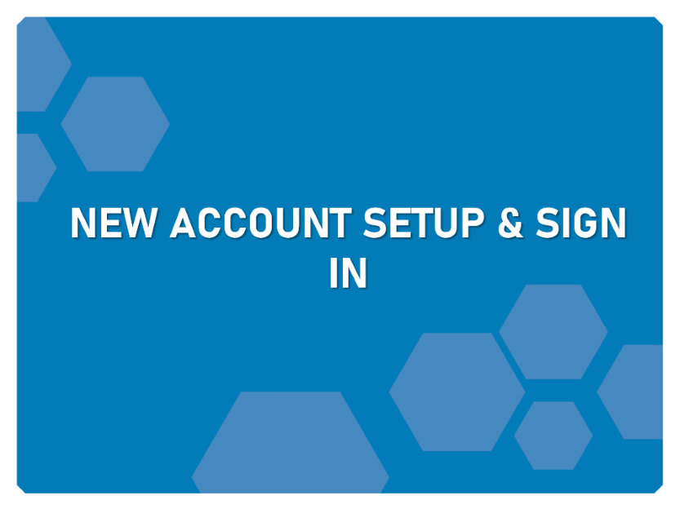
Learning Objectives

Slide 3
New account setup & sign in

Slide 4
New Account Setup
Federal Employer ID (FEIN)
To Create a New Account You Will Need:
Unemployment Tax Account # (UI TAX ID)
Information for the primary company location and contact

Slide 5
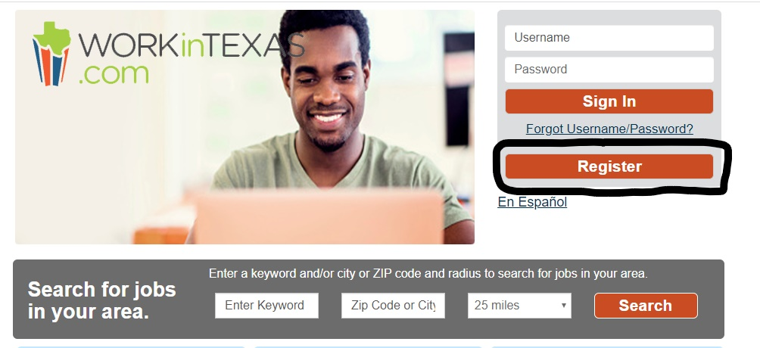
New Account Setup
1. Click the “register” button on home page below the Sign In button.
2. Under Option 3 – Create a User Account, click Employer & Agents.
3. Follow the steps and fill in all required (*) fields.

Slide 6
Sign In
1. Enter your user name and password.
Click “Sign In”
OR
Follow the steps and fill in all required (*) fields.

Slide 7
THANK YOU

