Slide 1

Work in texas
How to navigate wit

Slide 2
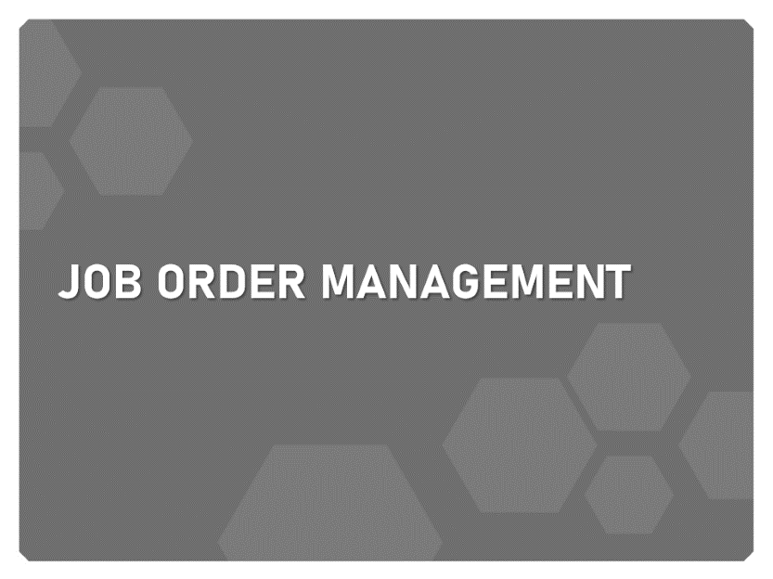
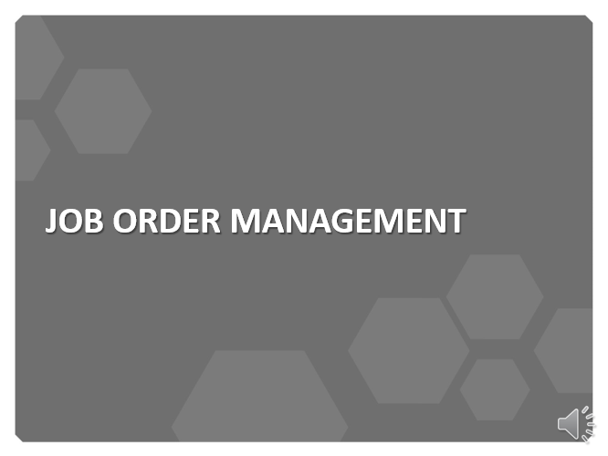
Learning Objectives

Slide 3
Job order management

Slide 4
Steps to generate a job order

Slide 5
Create a Job Order
1. Quick Menu > Manage Jobs
2. Job Orders tab > Add New Job Order
3. Select the Manual Entry Custom Job Order Option

Slide 6
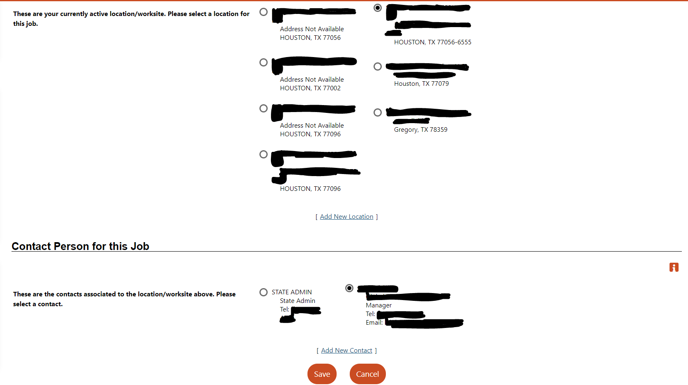
Create a Job Order
4. Enter Job Title, use keywords job seekers would use
5. If necessary, Search for an occupation, then click Next
6. Select one job Location and Contact Person (contact will only appear if they are associated with the selected location)

Slide 7
Create a Job Order
7. Job Order Display Options > Complete the Job Details section.
8. Enter a Job Description (to start off with editable sample text for the position, click Insert Sample Text)
9. Select Skill Set Select Method

Slide 8
Create a Job Order
10. Confirm the selected skills, tools, and technologies on the next page.
11. Enter requirements such as hiring, minimum education and experience, and other specialized requirements.
12. Enter compensation amount, hours, and benefits.

Slide 9
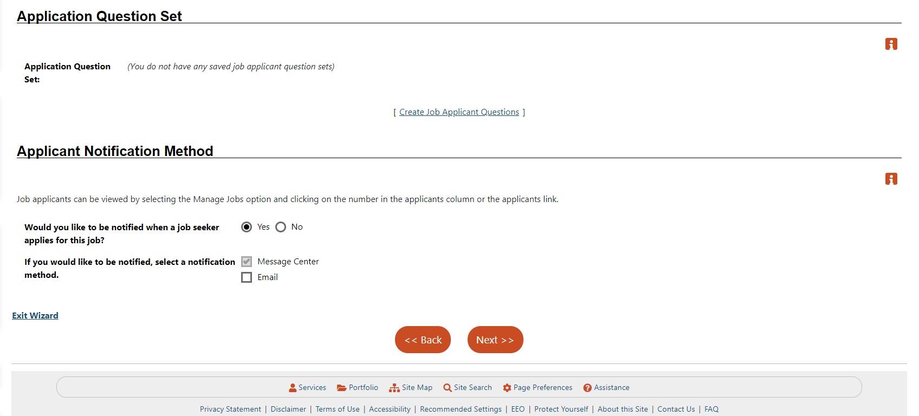
Create a Job Order
13. Identify Job Application Methods Accepted and required Job Applicant Information.
(add an Application Question Set (if applicable); and specify if you would like to be notified, and how, when applicants apply)

Slide 10
Create a Job Order
14. Specify whether to upload the job order to external sites; provide any Other Information, then click Finish.
15. Review the job order details and edit if necessary.

Slide 11
Change or copy a job order

Slide 12
Change or Copy a Job Order
1. From the Quick Menu, click Manage Jobs.
2. Job Orders tab > Show Filter Criteria link > Search for and Display the job order
3. To edit an Existing Job Order:
a. Click the Edit link in the Action column of the Job Orders tab.
b. For each section you wish to change, click the Edit link in that section, then click Save.
c. When all changes are complete for the job, click Return to Job Orders at the bottom of the page

Slide 13
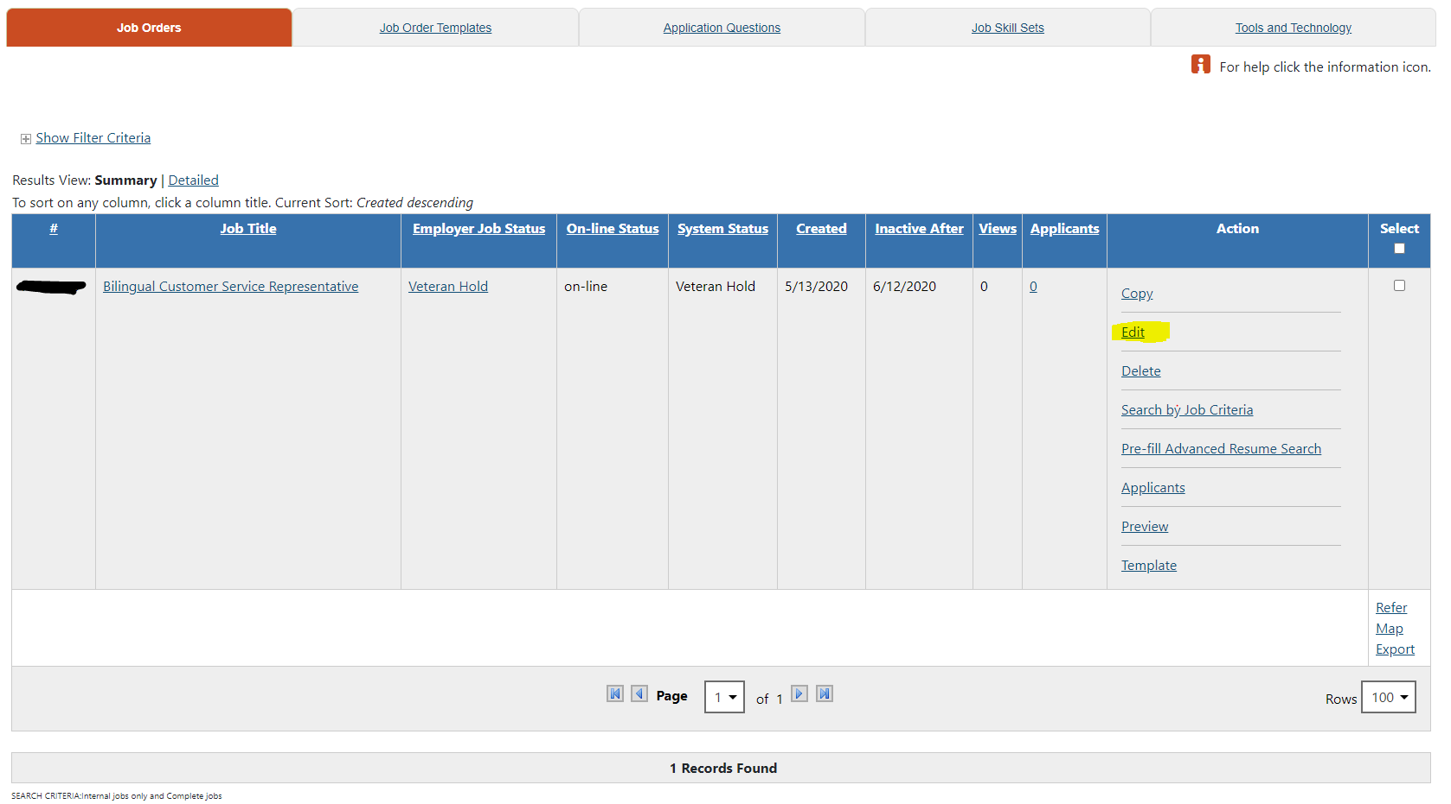
Change or Copy a Job Order
3. To edit an Existing Job Order:
a. Click the Edit link in the Action column of the Job Orders tab.
b. For each section you wish to change, click the Edit link in that section, then click Save.
c. When all changes are complete for the job, click Return to Job Orders at the bottom of the page

Slide 14
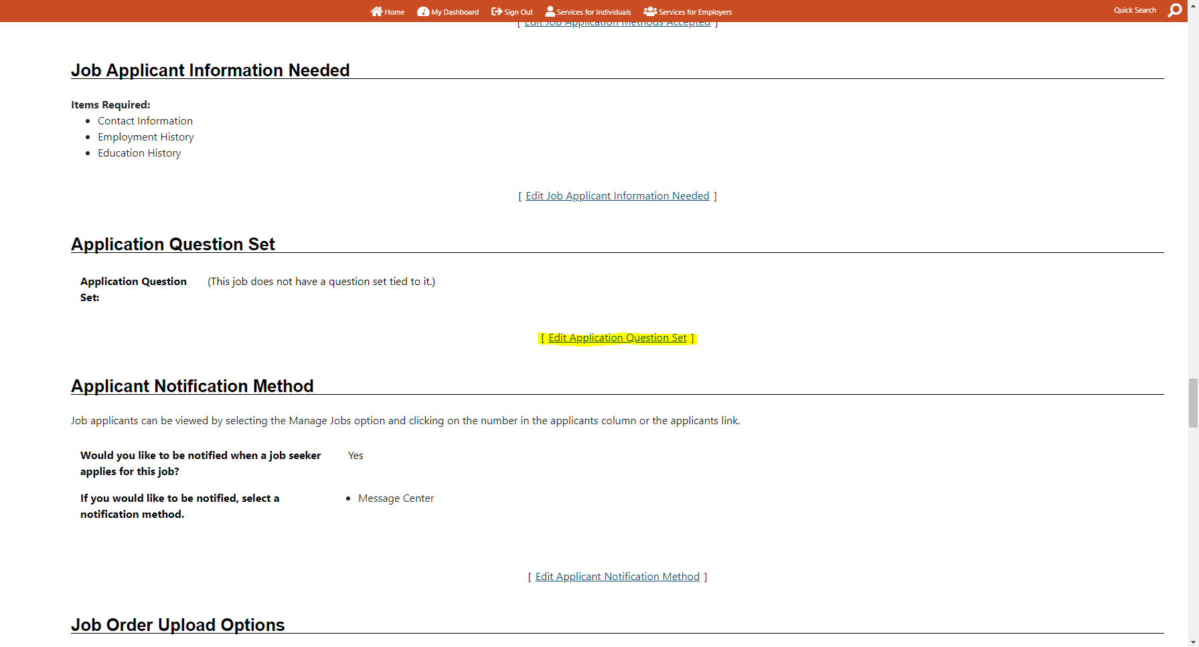
Change or Copy a Job Order
4. To link an application question set to an existing job order:
a. Click the Edit link in the Action column of the Job Orders tab.
b. Scroll down to the Application Question Set section and click Edit Application Question Set.
c. Select whether to create new or edit existing Applicant Questions and follow on-screen directions.
d. Click Save, then Return to Job Orders.

Slide 15
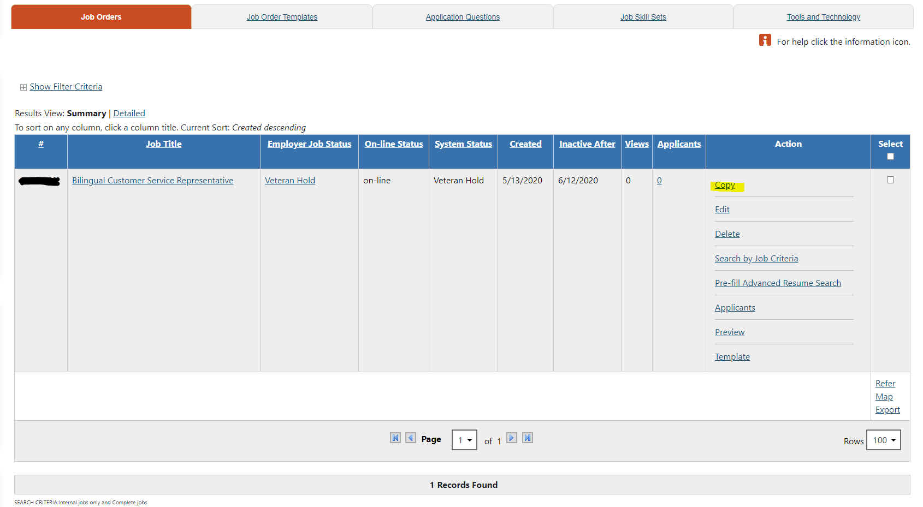
Change or Copy a Job Order
5. To copy a job order to create a new one:
a. Click the Copy link in the Action column of the Job Orders tab.
b. To make an exact copy (with a new number), click Copy job as is, then Copy Job. OR To change key areas for the copy, click Copy job with advanced options, make the changes, then click Copy Job Now.

Slide 16
Change or Copy a Job Order
6. To create a reusable template from a job order to create new ones:
a. Click the Template link in the Action column of the Job Orders tab.
OR
b. From the job order details page, click Create Template link.
c. Name the template and click Save. Access your templates from the Job Order Templates tab.

Slide 17
Thank you

