Slide 1
Work in texas
How to navigate wit

Slide 2
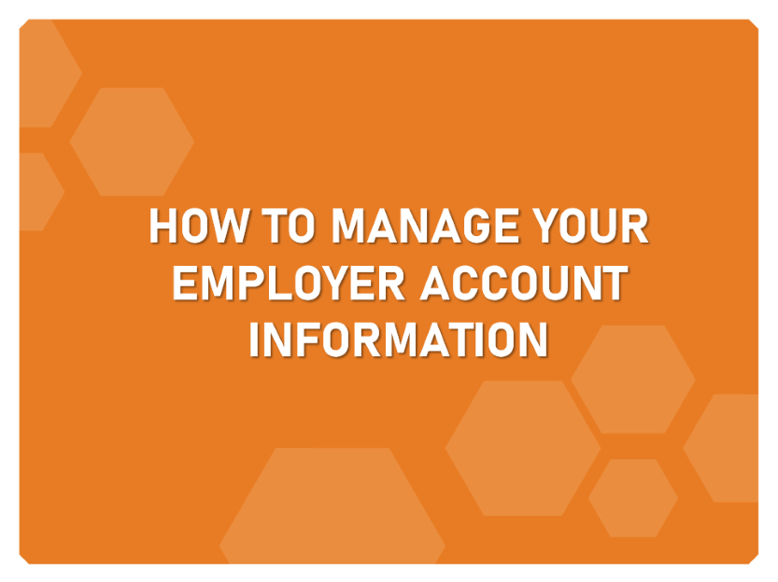
Learning Objectives

Slide 3
How to manage your employer account information

Slide 4
How To Manage Your Info.
Step 1. Quick Menu > Employer > Employer Profiles > Corporate Profile
Step 2. Change any information you’d like to - click on the tab title, make the changes, and then click save.
Tabs You Can Customize Include:
General Information
Locations
Contacts/Users

Slide 5
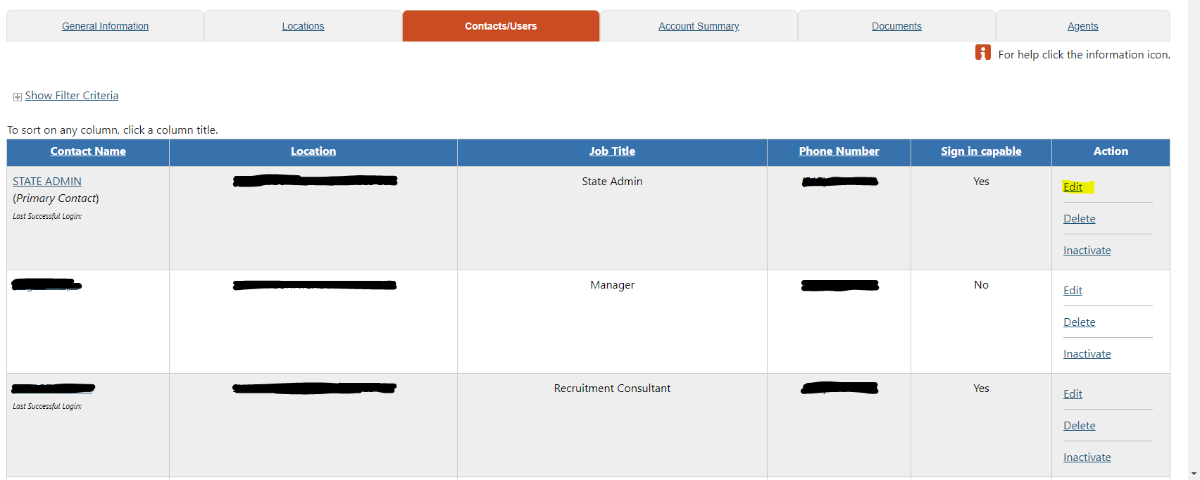
How To Manage Your Info.
1. Employer Portfolio > Employer Profiles > Corporate Profiles > Contact/User Tab

Slide 6
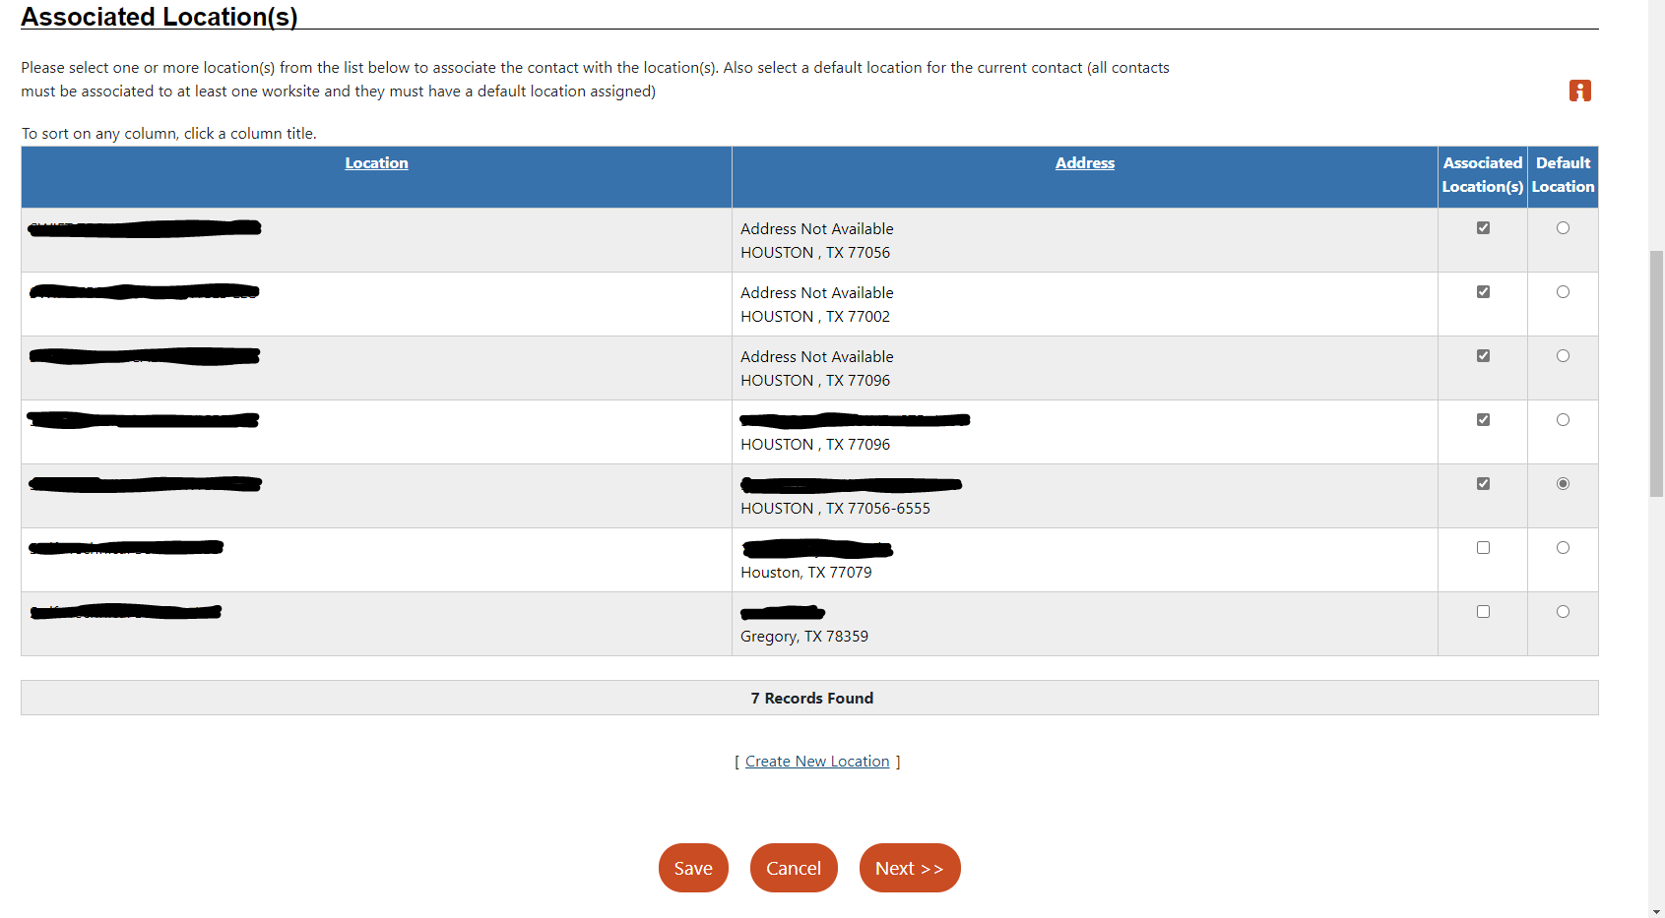
How To Manage Your Info.
Associated Location(s) within “Contact Information Tab”

Slide 7
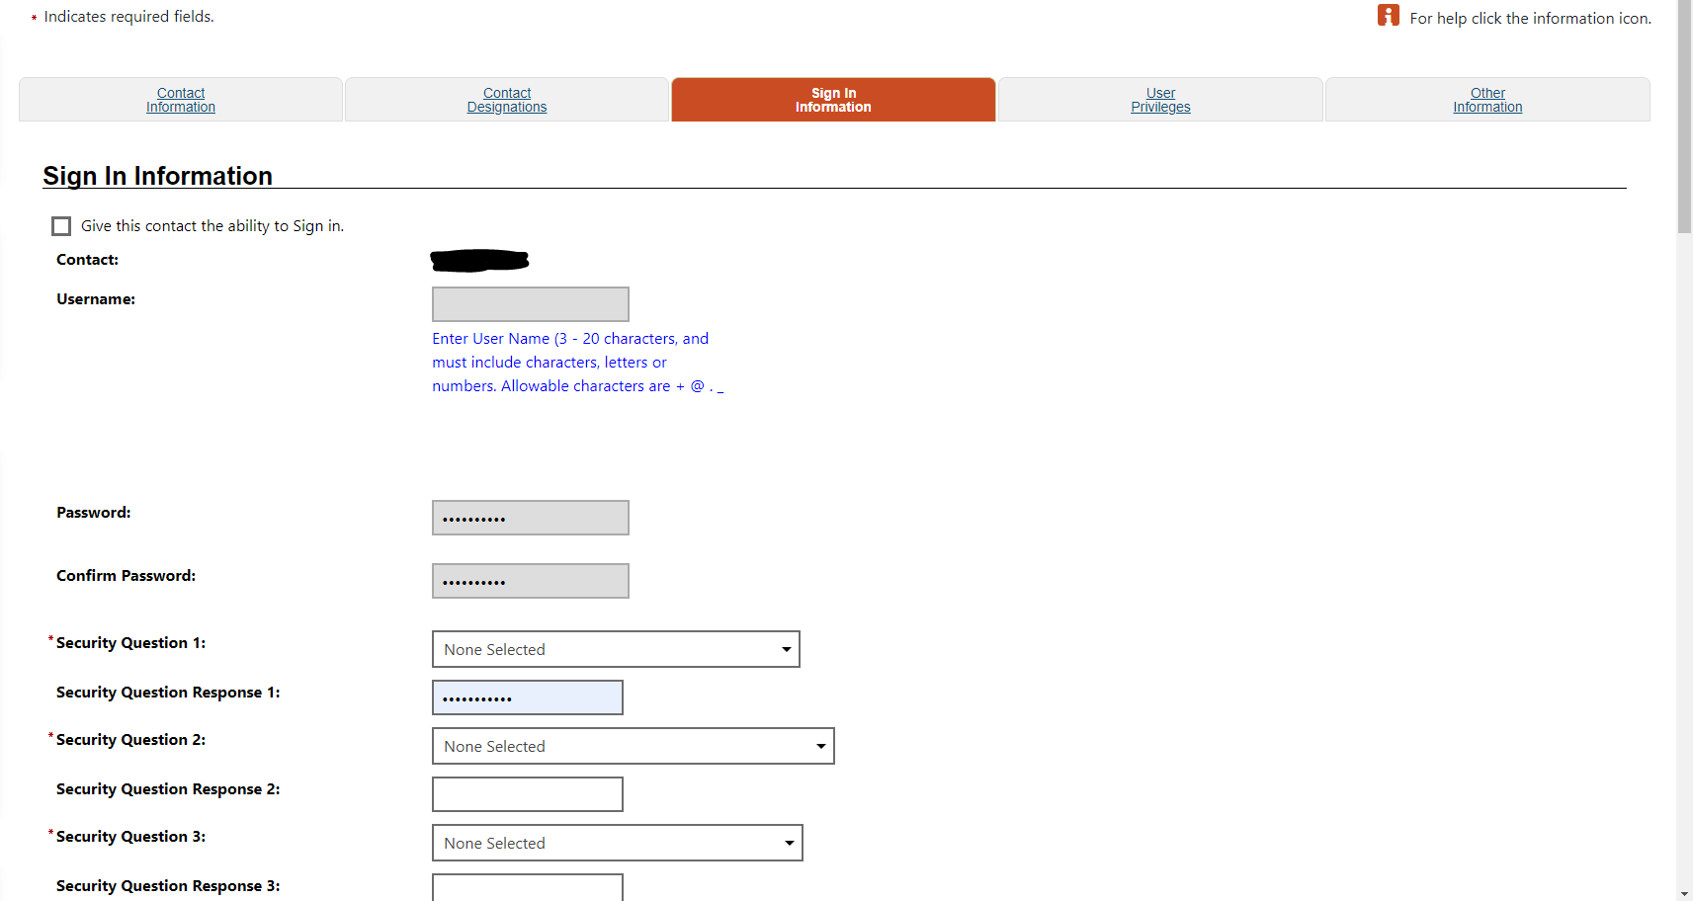
How To Manage Your Info.
Be able to view sign in information and provide others their information & access.

Slide 8
THANK YOU

