Slide 1

Work in texas
How to navigate wit

Slide 2


Learning Objectives

Slide 3
Managing job candidates and applicants

Slide 4
Managing Job applicants

Slide 5
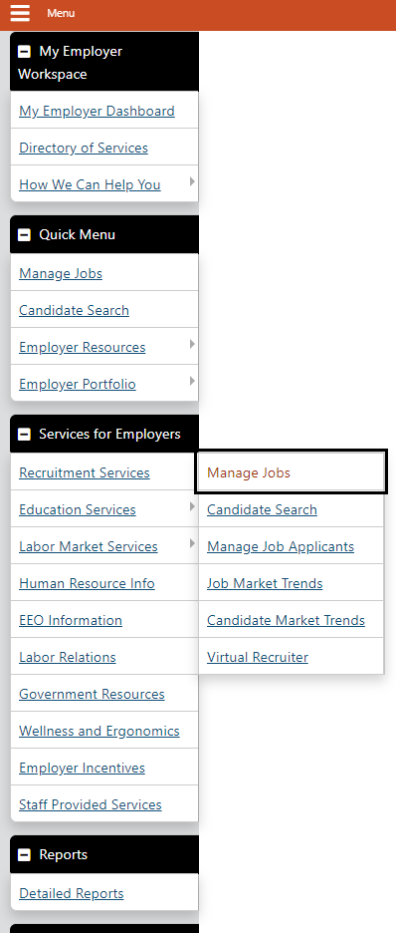
Job Applicant Tab
1. Services for Employers menu > Recruitment Services > Manage Job Applicants
2. If desired, you can select to display all applicants, including inactive job orders, as well as select a job order from the drop-down list to see only those specific applicants.

Slide 6
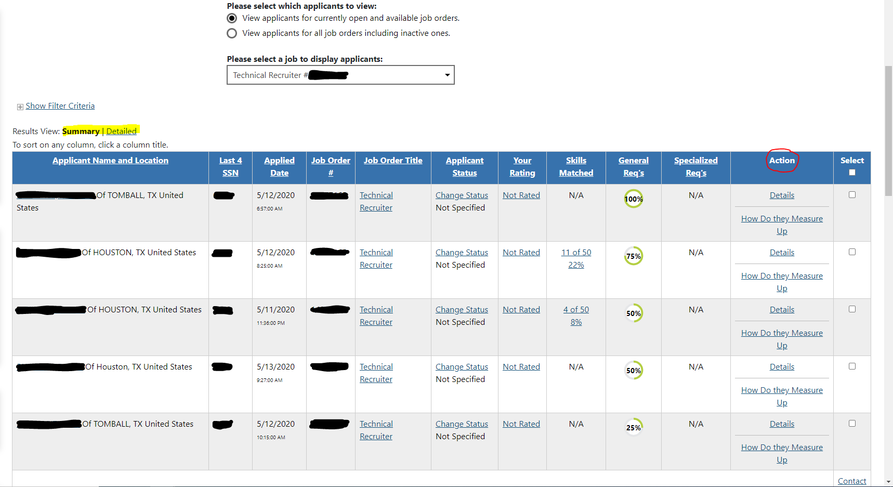
Job Applicant Tab
3. From the Job Applicants tab, you can access several functions which includes:
  Review job order details; click a Job Order Title link.
  Re-sort results; click a column heading and click again to reverse the sort order.
  View applicant details on a series of tabs; click an Applicant Name link or Details in the Action column.

Slide 7
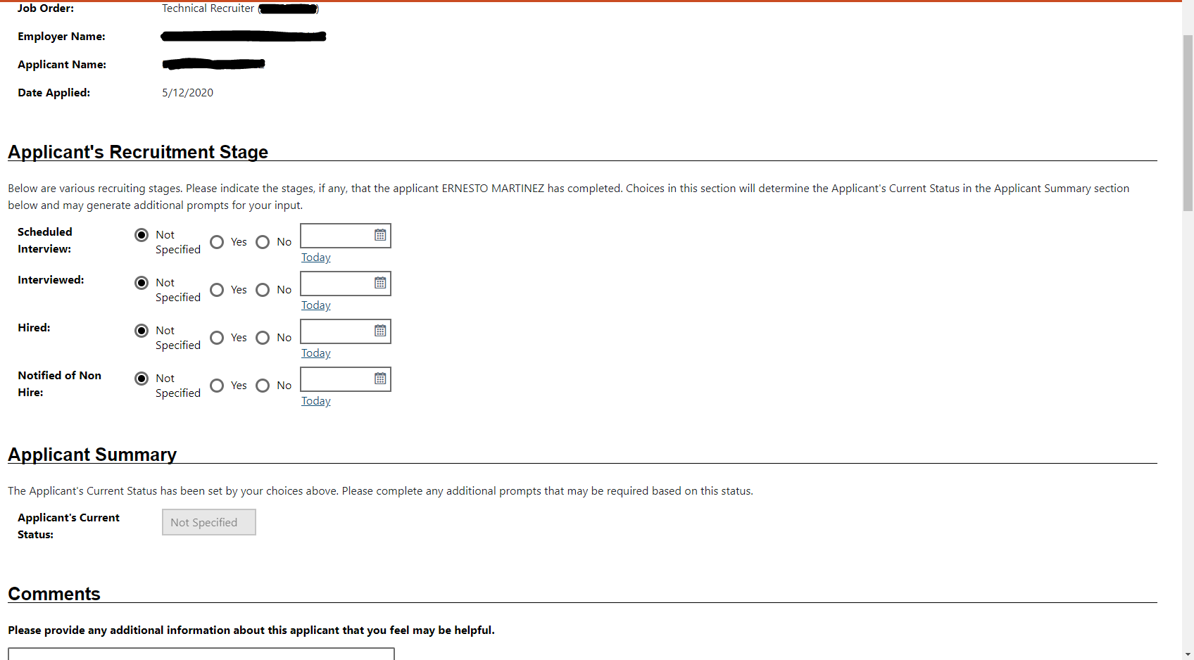
Job Applicant Tab
3a. From the Job Applicants tab, you can access several functions which includes (continued):
  Choose between the Summary or Detailed Results View.
  Update their status in the recruitment process; click a Change Status link.
  Rate the applicant and add notes; click a Your Rating link.

Slide 8
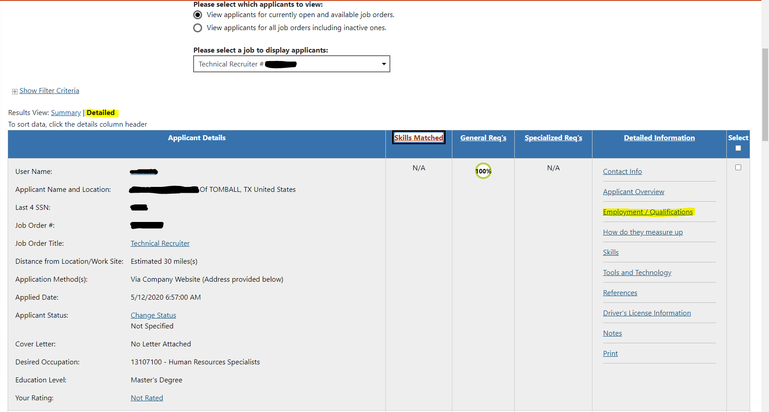
Job Applicant Tab
To view applicants based on posted job:
Services for Employers > Recruitment Services (hover) > Manage Job Applicants
To view applicant’s work history, education, and certifications (if applicable):
Detailed > Employment / Qualifications

Slide 9
Search for Candidate Résumés

Slide 10
Search for Candidate Résumés
1. From the Quick Menu, click Candidate Search.
2. Click to change the Desired Work Location Area, if desired.

Slide 11
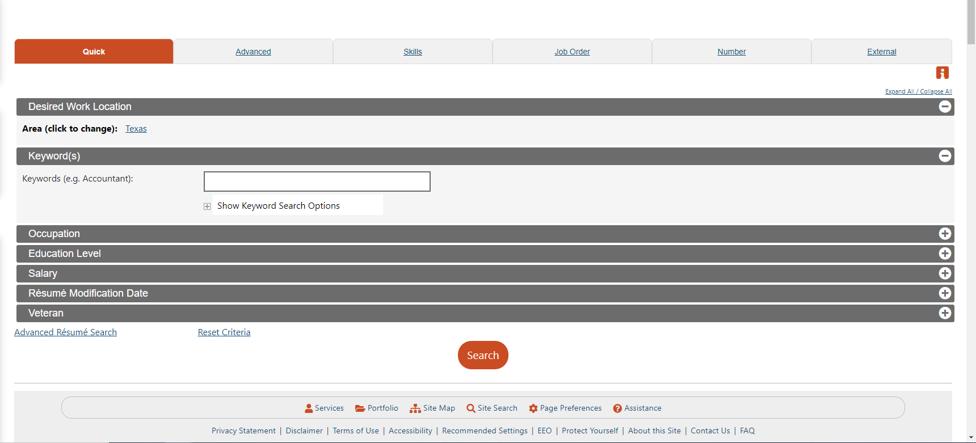
Search for Candidate Résumés
3. Select one of the following search method tabs, enter your criteria, then click Search:
Quick – search by keyword, occupation, education level, veteran status, etc.
Advanced – rank certain criteria by specifying if it is Required or Desired; you can also further filter search results by numerous criteria.
Skills – search by an existing skill set, or create a new one to search by.

Slide 12
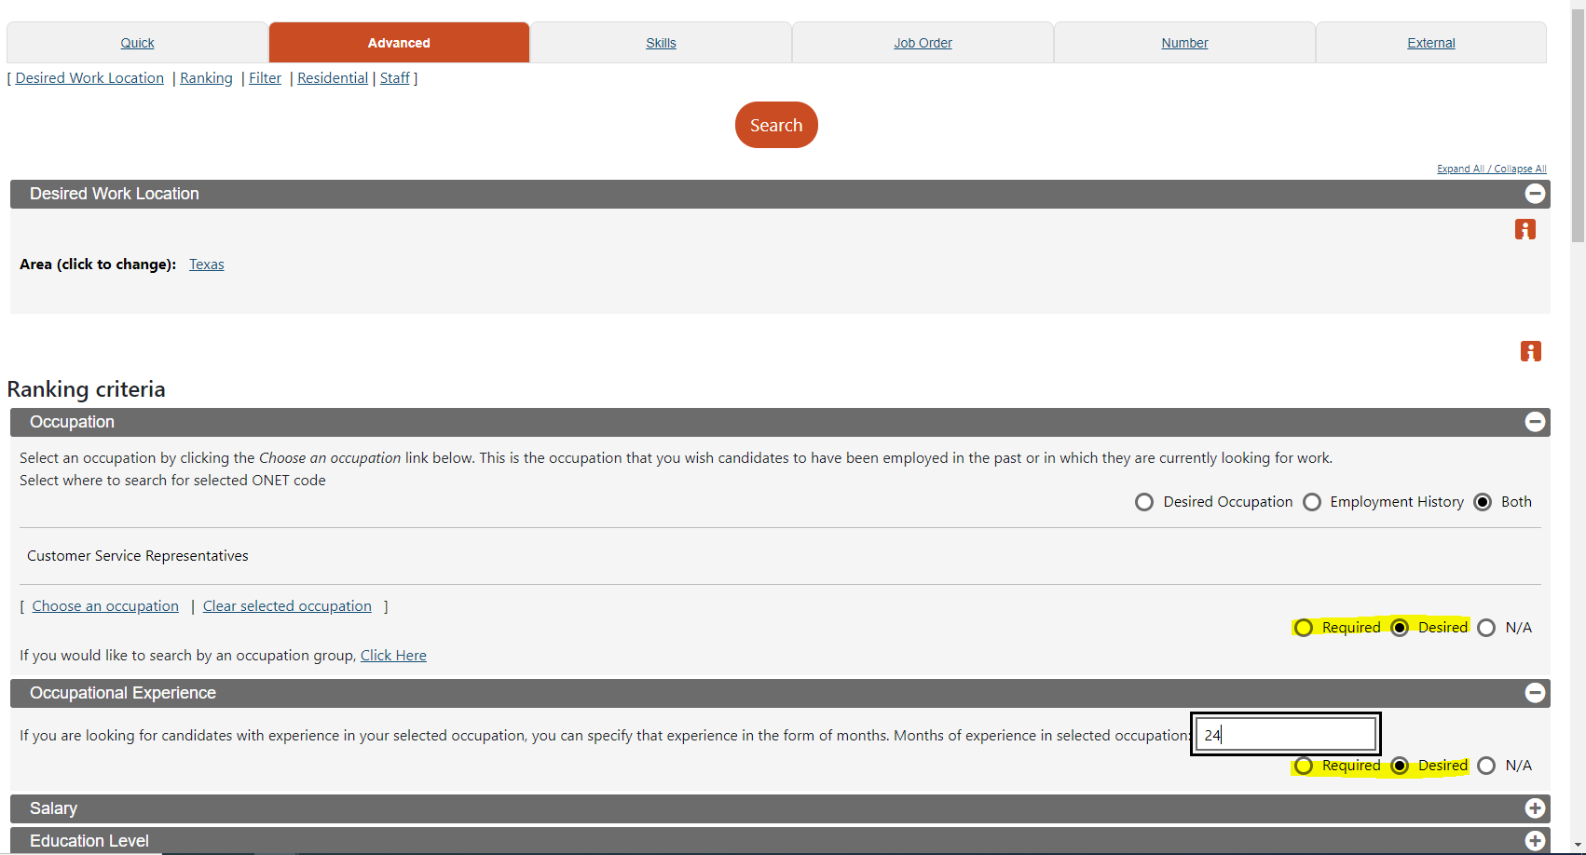
Search for Candidate Résumés
3. Select one of the following search method tabs, enter your criteria, then click Search:
Quick – search by keyword, occupation, education level, veteran status, etc.
Advanced – rank certain criteria by specifying if it is Required or Desired; you can also further filter search results by numerous criteria.
Skills – search by an existing skill set, or create a new one to search by.

Slide 13
Manage Résumé Search Results

Slide 14
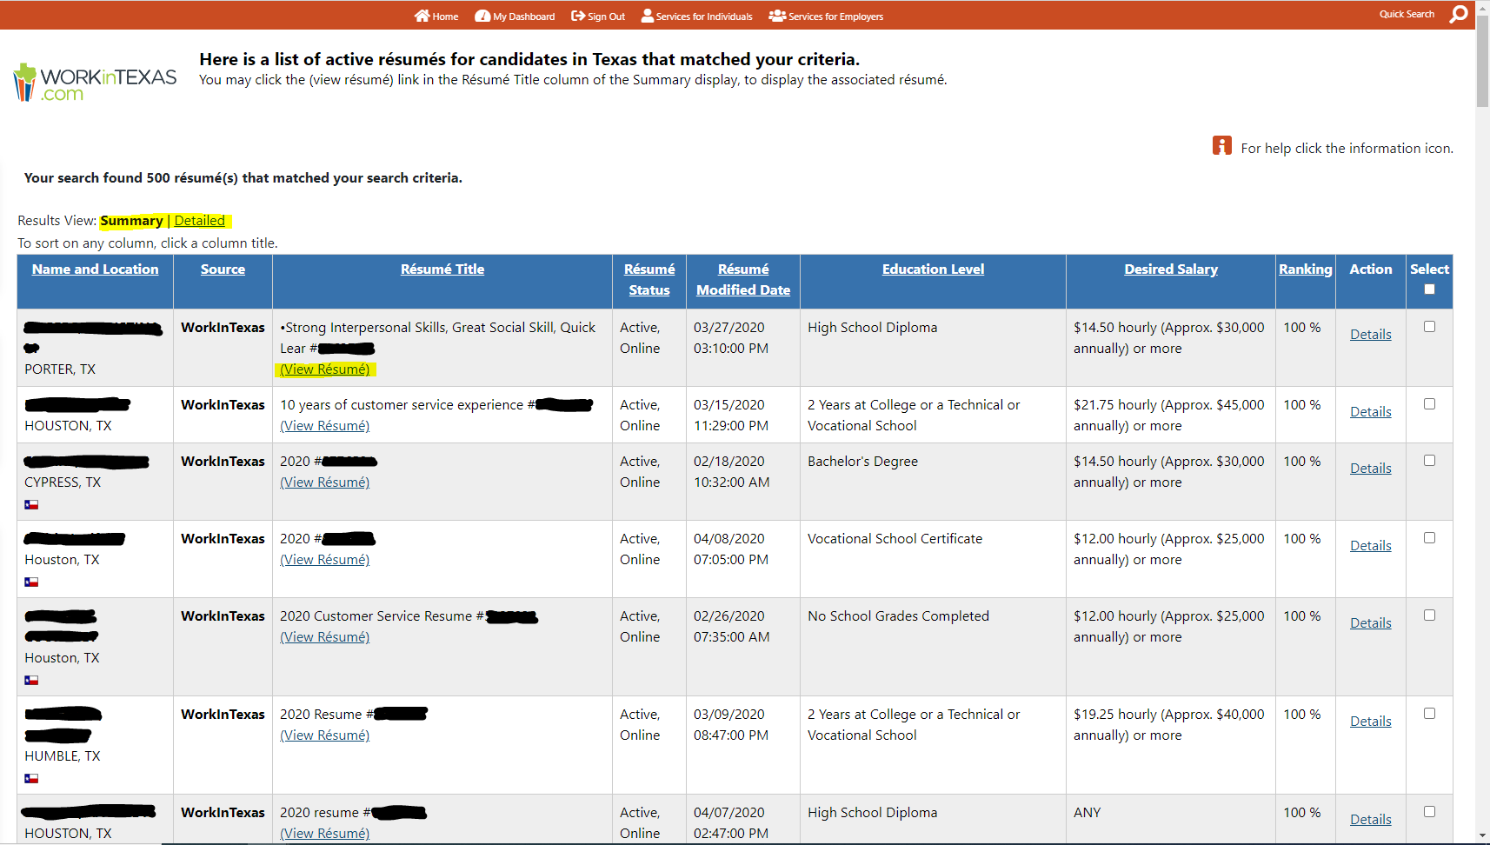
Résumé Search Results
On a résumé search results page you can:
Choose between the Summary or Detailed Results View.
View résumé details
View a formatted résumé
Save a candidate/résumé to favorites from either of the above two detail pages

Slide 15
Résumé Search Results
(Continued)
On a résumé search results page you can (continued):
View skills/requirements; click a percentage icon.
Re-sort results; click a column heading and click again to reverse the sort order.
Change how many records are displayed per page; select the desired number at the bottom of the page.
Navigate multiple pages; click the arrows to navigate one page at a time, or enter a desired page number at the bottom of the page.

Slide 16
Create a Virtual Recruiter Résumé Search Alert

Slide 17
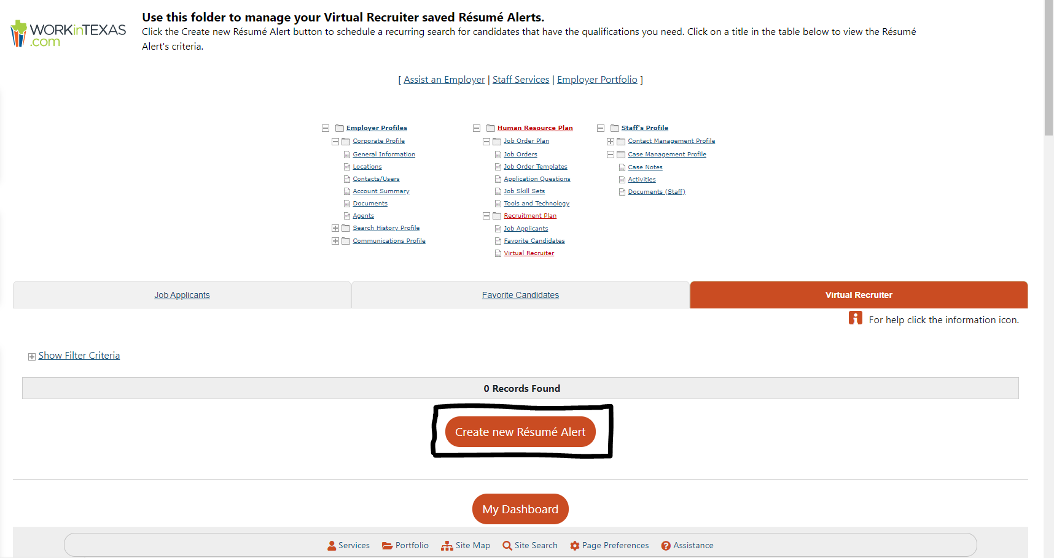
Create a Virtual Recruiter Résumé Search Alert
Save candidate résumé search criteria from the Quick, Advanced, or Skills tabs to create a Virtual Recruiter search alert.
Conduct a candidate résumé search as described in “Search for Candidate Résumés” on the previous page.
2. At the bottom of the search results page, click Save search.
3. Enter a title for this candidate search alert.

Slide 18
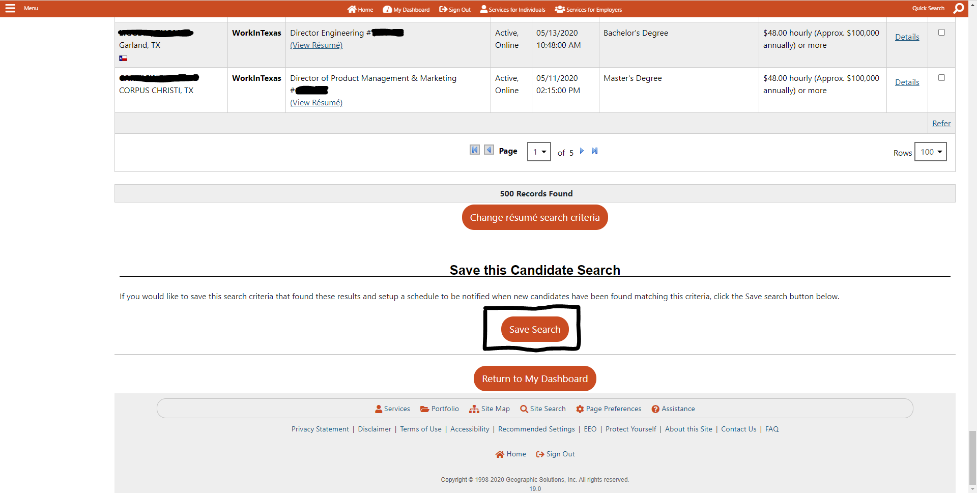
Create a Virtual Recruiter Résumé Search Alert
Save candidate résumé search criteria from the Quick, Advanced, or Skills tabs to create a Virtual Recruiter search alert.
Specify how often to run the search.
Select how you wish to be notified (e.g., email, text message).
Enter an expiration date (defaults to 90 days), then click Save.

Slide 19
Thank you

