Slide 1
Navigating
For Job Seekers (Module 2)
Creating a Resume
Notes:
Hello, and welcome to navigating Work In Texas. In this module we will learn how to create your resume.
(Click to Reveal)

Slide 2
Getting started:
Notes:
At this point you have already created your WorkInTexas profile. If you have not completed this step, please refer to Module 1 for help. Let us get started
(Click to Reveal)

Slide 3
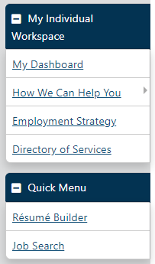
Getting Started
Create a Résumé
From the Quick Menu, click Résumé Builder.
Click the Create new Résumé button.
Complete all required fields (*).
Enter a Résumé Title.
Tip: To get employers’ attention, create résumé titles that reflect your desired occupation, as the title is a searchable field. Omit personally identifying information in the title, such as your name.
Notes:
Assuming that you have logged into your workintexas account and are now looking at your desktop, Scroll down the left-hand menu bar until you see this section labeled quick menu. In this section you will find a link labeled resume builder. Click on this link and you will be taken to another page where you will see the button indicated here and labeled create new resume. Click on this button. In this new section, just complete all the required fields, which are labeled with an asterisk, and ensure that you enter a resume title. It is highly suggested that you name your resume so that you can quickly distinguish what resume you're going to be looking at while still getting the attention of the employer who is looking to fill their job position. Try to keep from using any personal identifiable information such as your name, date of birth, or anything that looks or sounds unprofessional.
(Click to Reveal)

Slide 4
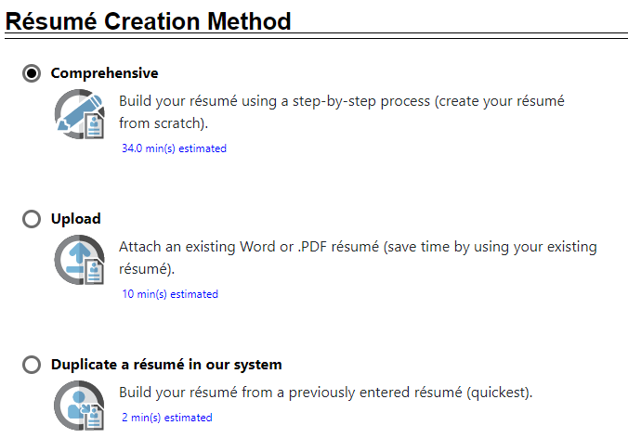
Getting Started
Create a Résumé
Choose how you want to create your résumé:
Note: Comprehensive – Uses a wizard to complete form pages for each résumé section; requires the most time, but employers are most likely to find this résumé type.
Notes:
Here you will also be given three options to get your resume into the system. You can either upload an existing resume, which must be in Word or PDF, duplicate a current resume that you already have created in the system, or build a resume from scratch using the comprehensive wizard. In this lesson we will use the comprehensive method to build a resume from scratch.
(Click to Reveal)

Slide 5
Getting Started
Create a Résumé
Click Next. Continue clicking Next to proceed from page to page.
Specify if you want employers to be able to see your résumé in their candidate searches, then click OK to confirm your choice
Tip: Selecting ‘Yes’ will give you the greatest visibility; however, if you choose ‘No,’ you can still use your résumé to apply for jobs.
Notes:
What you selected comprehensive go ahead and click on next and keep clicking next to go from page to page filling in any information that's necessary. If you want your resume to appear in searches from employers looking to fill their positions when you get to this box, select yes my resume will be available online for employers to view. If you do not wish to have your resume visible during searches this is where you would select no. You'll still be able to use this resume to apply for any job, but it will not come up in any searches by employers.
(Click to Reveal)

Slide 6
Getting Started
Create a Résumé
Choose your Desired Location, Occupation, and Salary on the next three pages.
Create your Desired Job Type profile by clicking the Add New Profile link. Indicate your preferences such as full-time/part-time, days available, shift, willingness to travel or relocate, etc.
Answer the Driver’s License Information and transportation questions.
Indicate if you have a Security Clearance or speak any foreign Languages.
Notes:
On the next 3 pages choose your desired location whether it be in Houston, Galveston, Lake Jackson, Katy, etc. Select the occupation you are looking for and the salary you are looking to receive. If you need help deciding on salary, you can pull up labor market information to Work in Texas or the o’net website. This will be taught in a later lesson. You can create your desired job type by clicking the add new profile link and indicating your preferences such as full time part time days available shift willingness to travel or ability to relocate etc . Answer the drivers license information and transportation questions and then indicate if you have or have had a security clearances and or speak any foreign languages
(Click to Reveal)

Slide 7
Getting Started
Create a Résumé
On the Résumé Templates page, you have a few options
Choose an existing template and use as is; click Skip this step, I will use the current template.
Choose an existing template and modify its formatting and/or structure; click Save.
Include/exclude, rename, and rearrange sections.
Create a new template from scratch; click New Template.
Notes:
This will bring you to the resume templates page and you have a few options. You can use an existing template, or you can create a new template. If you choose to use an existing template, select the template and modify its format and or structure and then click save. If you do not have one on file or would just like to create one, then you would click on new template here.
(Click to Reveal)

Slide 8
Getting Started
Create a Résumé
On the Résumé Templates page, The following sections will only display if you opted to include them in the template:
Enter your Education and Training history, Occupational Licenses & Certificates, and Employment History on the next three pages.
Specify whether employers may view your salary history and reason for leaving former job(s) by checking the box at the bottom of the page.
Modify your Job Skills and Technical Skills and Tools lists as needed on the next two pages (employer searchable).
Notes:
On the resume templates page , the following sections will only display if you opted to include them in this template. On the next 3 pages, you will enter your education and training history, any occupational licenses you may hold or certificates, and your employment history. Specify whether employers may view your salary history and reason for leaving former jobs by checking the box at the bottom of the page. You will also need to modify your job skills and technical skills as well as any tools you are familiar with over the next 2 pages. Try not to select all and go through each Section 1 by 1. These are the keywords that will match the job postings as well as increase visibility when employers search for candidates.
(Click to Reveal)

Slide 9
Getting Started
Create a Résumé
On the Résumé Templates page, The following sections will only display if you opted to include them in the template:
Enter your Ability Summary, Objective, Honors & Activities, and any Additional Information on the next four pages.
Check your Contact information and specify which entries you want to appear on your résumé by checking the boxes at the bottom of the page.
Enter your Detailed References and specify if they should appear on your résumé or just be mentioned that they are available on request by checking the boxes.
Notes:
As you continue you will enter your abilities summary, your objective, any honors and activities, as well as any additional information that you feel are relevant to your job search. Check your contact information and specify which entries you want to appear on your resume by checking the boxes at the bottom of the page. This is also where you will enter any detailed references and specify if they should appear on your resume or just be mentioned they're available upan request by checking the appropriate box.
(Click to Reveal)

Slide 10
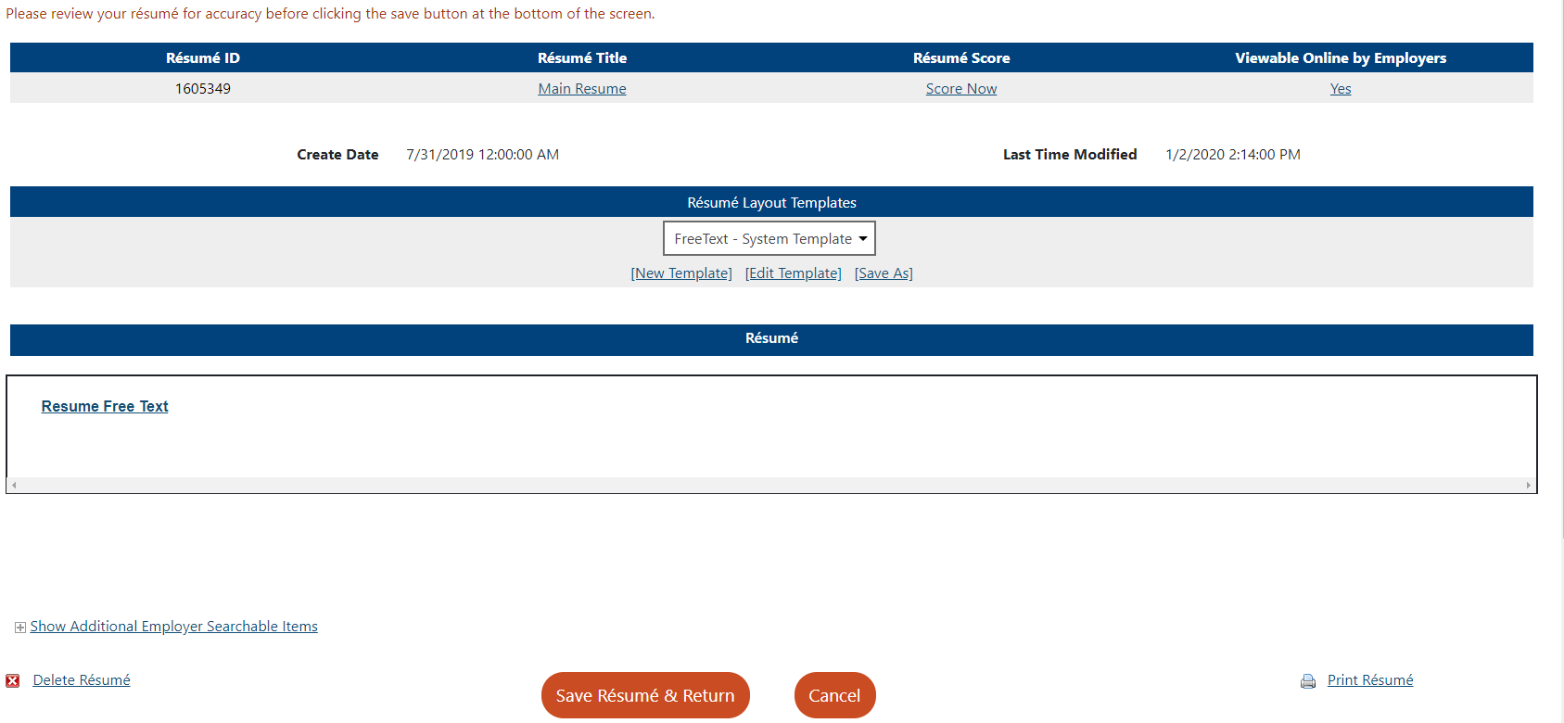
Getting Started
Create a Résumé
Click Finish. Your formatted résumé displays.
From the Résumé review page, you can:
Score your résumé; click Score Now.
Modify the résumé; click on the underlined section headings.
Modify the template or any of the sections; click Edit Template.
Print, copy, email, download, or delete it; links are at the bottom of the page.
2
1
3
4
Notes:
At this point you have completed your resume and just need to click finish to continue. You'll be shown your list of resumes on the next page. It is recommended that you score your resume to see how it compares to the occupation that you are looking to fill. If you need to make any modifications you can click on modify the resume and click on the underlined section headings. Here you can also edit the format of your template. Finally, you also have the options to print, copy, email, download, or delete any resume from this section.
(Click to Reveal)

Slide 11
Conclusion
Notes:
We hope this module was helpful in getting you registered with the workintexas system. Thank you and be sure to check out the other modules in this series.
(Click to End)

