Slide 1
Navigating
For Job Seekers (Module 4)
Explore Opportunities
Notes:
Hello, and welcome to navigating Work In Texas. In this module we will learn how to create your resume.
(Click to Reveal)

Slide 2
Explore Opportunities:
Notes:
At this point you have already created your WorkInTexas profile. If you have not completed this step, please refer to Module 1 for help. Let us get started
(Click to Reveal)

Slide 3
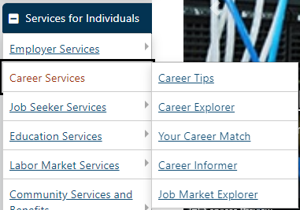
Explore Opportunities
Identify an Occupation/Career to Pursue
Research Occupations
From the Services for Individuals menu, click Career Services4Career Informer.
Notes:
Researching Occupations
Assuming that you have logged into your workintexas account and are now looking at your desktop, Scroll down the left-hand menu bar until you see this section labeled Services for Individuals, click Career Services and then on Career Informer in the submenu to display the Occupations search page, where you can look up occupations using numerous criteria.
(Click to Reveal)

Slide 4
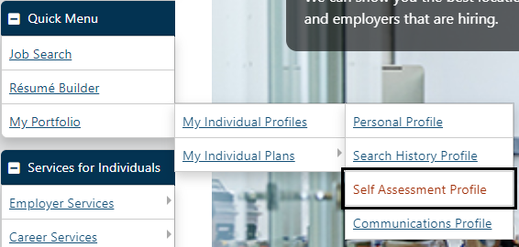
Explore Opportunities
Identify an Occupation/Career to Pursue
Assess Your Skills and Preferences
From the Quick Menu, click My Portfolio4My Individual Profiles4Self Assessment Profile.
Notes:
To assess your skills and preferences and help you identify a career that is compatible with your skills, taking the self assessment can help.
From the Quick Menu, click My Portfolio then My Individual Profiles and the on Self Assessment Profile as shown.
Click on each tab title to enter or change information about your Job Skills, Personal Skills, Work Interests and Values, and the Tools and Technology you have experience with.
To do all five assessments from one page, click the Multiple tab.
Once you’ve completed all desired assessments, click the Find Matching Occupations and Jobs button at the bottom of the page.
(Click to Reveal)

Slide 5
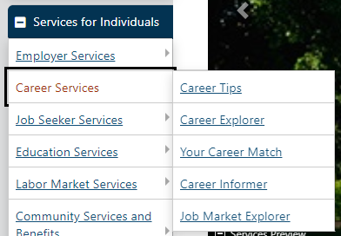
Explore Opportunities
Identify an Occupation/Career to Pursue
Match Your Skills and Preferences with Occupations to Find the Ideal Career
From the Services for Individuals menu, click Career Services4Career Explorer and explore the links.
Notes:
To match your skills and preferences and help you identify a career that is compatible with your skills, using the Career Explorer can help.
From the Services for Individuals, click Career Services and then on Career Explorer as shown.
Click on each tab title to enter or change information about your Job Skills, Personal Skills, Work Interests and Values, and the Tools and Technology with which you have experience.
(Click to Reveal)

Slide 6
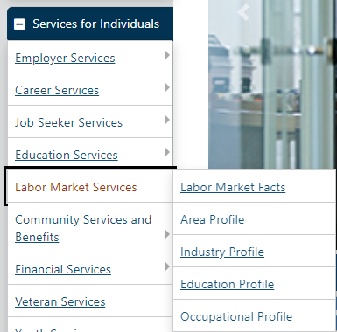
Explore Opportunities
Identify an Occupation/Career to Pursue
Research the Job Market for Your Geographic Area/Occupation
From the Services for Individuals menu, click Labor Market Services4Labor Market Facts to explore a wealth of Labor Market Information for any area you specify.
Notes:
In module 2 we touched on using Labor Market Information to help with salary expectations. To research the labor market information for your area, find the services for individuals' menu on the left. Then click on labor market services and then labor market facts in the sub menu. Not only can you find out salary information, but you can explore a wealth of information for your area specifically for the job that you are looking to obtain.
(Click to Reveal)

Slide 7
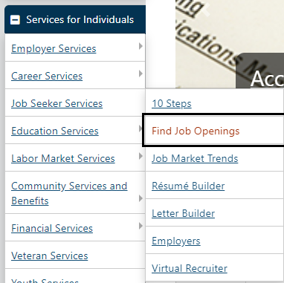
Explore Opportunities
Research Employers
• From the Services for Individuals menu, click Job Seeker Services and then Employers to search for employers using various criteria.
Notes:
If you're looking to gather information about a specific employer, you can do that while still using the workintexas platform. Again, from the services for individual's menu, you will select jobseeker services and then employers . This will take you where you can gather information on in almost any employer posting a job within the system.
(Click to Reveal)

Slide 8
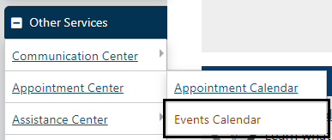
Explore Opportunities
Find Employment Recruiting Events in Your Area
• From the Other Services menu, click Appointment Center and then Events Calendar to search for events you’re interested in (by Event Category).
Notes:
Now that you have gathered a wealth of information on your skills, labor market information, and specific employers you can navigate to do work in Texas event calendar. Here you can search for hiring events and information sessions within the system. Just navigate to the other services section on the left-hand menu, click appointment center, and then click on events calendar.
(Click to Reveal)

Slide 9
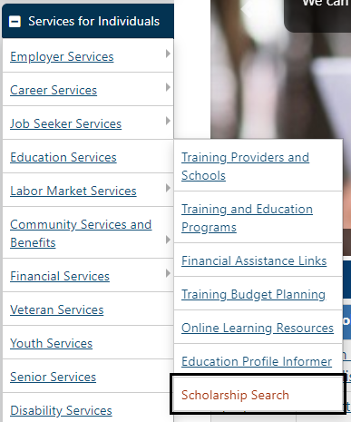
Explore Opportunities
Get Financial Assistance
Find Educational Scholarships You Might Qualify For
• From the Services for Individuals menu, click Education Services and then Scholarship Search.
Notes:
After researching careers and labor market information you may find that advancing your education or certification will help you land that job. Workforce solutions has many opportunities and scholarships to help you achieve that goal. Navigate to the services for individuals' section, click on education services, and then select scholarship search.
(Click to Reveal)

Slide 10
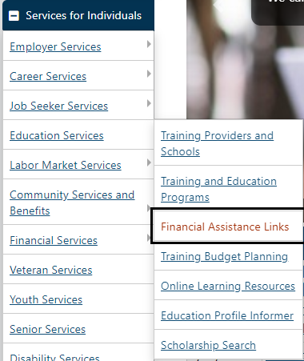
Explore Opportunities
Get Financial Assistance
Research Sources of Educational Financial Aid
1. From the Services for Individuals menu, click Education Services and then Financial Assistance Links.
2. Click a desired link to learn more (links to external websites).
Notes:
If you find that you are in need of some financial assistance, you can find the financial assistance links under the services for individuals menu. Then click on education services and financial assistance links. There you can click on any desired link to learn more about some of those opportunities to help you with your financial needs.
(Click to Reveal)

Slide 11
Explore Opportunities
Get Training, Education Credentials, or Licensing/Certification for Your Career
Find Free and Online Learning Resources
1. From the Services for Individuals menu, click Education Services then Online Learning Resources.
2. Click a desired link to learn more (links to external websites).
Notes:
There are several educational opportunities that can be accomplished online and many are free to you. To find these opportunities, under the services for individual section again, click on education services and then online learning resources.
(Click to Reveal)

Slide 12
Explore Opportunities
Get Training, Education Credentials, or Licensing/Certification for Your Career
Research Training/Educational Programs
• From the Services for Individuals menu, click Education Services and then Training and Education Programs to search or browse alphabetical listings by area.
OR
• To browse more specific program listings, click Education Services and then Education Profile Informer.
Notes:
Another way to get information about training and educational programs is by clicking on education services from the services for individual's menu and then selecting training and education programs. Here you can browse listings in your area which are sorted alphabetically. Or if you'd like more specific programs when you click on education services go down and select education profile informer as discussed earlier.
(Click to Reveal)

Slide 13
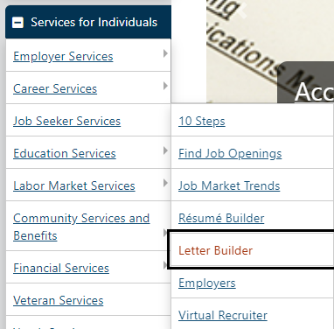
Explore Opportunities
Create a Cover Letter for a Specific Job Application
From the Services for Individuals menu, click Job Seeker Services and then Letter Builder to create and manage your letters.
Notes:
This leaves a couple more frequently used areas to explore. When applying for a specific job you might want to add a cover letter along with your resume. To build this letter, under the services for individual section, click on jobseeker services and then letter builder. If you have any questions about creating an effective cover letter, I would suggest taking the cover letter module provided by WRK solutions.
(Click to Reveal)

Slide 14
Explore Opportunities
Prepare for an Interview
From the Services for Individuals menu, click Job Seeker Services then select 10 Steps to read interviewing tips along with lots of other job-seeking best practices.
Notes:
There are several modules for online learning or within the Career Center to help you prepare for your next job. The last option we will discuss will be the 10th step tip menu. In the services for individuals section, click on Job Seeker Services and then select 10 steps. Here you can read interviewing tips along with lots of other job seeking best practices.
(Click to Reveal)

Slide 15
Conclusion
Notes:
We hope this module was helpful in getting you working with the workintexas system. Thank you and be sure to check out the other modules provided by workforce solutions.
(Click to End)

