Slide 1
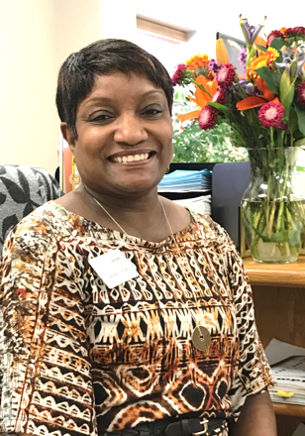
Bay City Personal Services Representative Delores Thomas IS “I AM WORKFORCE SOLUTIONS"

Slide 2
DEDICATED
Delores Thomas is dedicated. She exceeds in her daily job performance and goes above and beyond what is expected of her.

Slide 3
CARING AND RESPECTFUL
She is caring and respectful!
Delores is wonderful with her peers and customers and is an example to all around her.

Slide 4
COMPASSIONATE
Delores shows compassion and commitment to those who come in contact with her no matter what their need.

Slide 5
PRODUCTIVE
Delores does what is asked of her without hesitation and does her job well.

Slide 6
EFFICIENT
She is efficient with her time and her peers. She comes to work ready for her day, every day, and is a leader in her field.

Slide 7
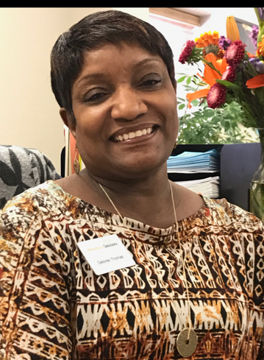
Delores Thomas IS “I AM WORKFORCE SOLUTIONS”

