Slide 1
WORKFORCE SOLUTIONS
As a flower in the garden Bending toward the sun, Unfolds its tiny petals One, by one, by one… So faith expands its beauty Until at last it grows Into life’s lasting flower… The heart’s fair perfect rose.
Westheimer Greeter Dennita Allen
Helping with Young Adult Work Experience recruitment efforts

Slide 2
W
Dennita is a Team Lead consistently willing to mentor her co-workers.
Her experience and expertise has led to HER BEING requested to PROVIDE training and guidance WITHIN THE office and ACROSS local and regional offices to ensure quality service delivery.
ILLING

Slide 3
O
She provides an optimistic viewpoint to customers – WHO know and reference her by name – encouraging them to remain positive about THEIR employment outlooks.
PTIMISTIC

Slide 4
R
In this industry, being resourceful is a gem!
Dennita is aware of the resources available within the Houston area, inquires about other Resources to keep a steady list, AND never allows a customer To leave empty handed.
SHE IS Continuously extending her customer-service skills to ensure no customer is left behind…
ESOURCEFUL

Slide 5
K
ONE SMALL EXAMPLE:
A customer parked his car in front of our OFFICE one day, and it was running hot. The customer came into the office, approached Dennita, AND explained the problem with his vehicle. Dennita went to find a container, asked the customer to open his hood, and poured water into the radiator. After the car was cooled, She assisted the customer with HIS job search.
Her kindheartedness appeals to every person WHO encounters Westheimer Workforce regardless of status, situation, or circumstance!
INDHEARTED

Slide 6
F
Most favorable one word description amongst staff
“ Fabulous”
Dennita is fabulous in her work ethic, in her customer service, and in her dedication to perform her job duties.
ABULOUS

Slide 7
O
In many ways, Dennita is the glue to all processes in this office:
service is her FIRst priority
for any task, She is always Willing to Lend a helping hand voluntarily OR when asked
As a member of THE "Bridging THE Gap" WORKGroup (Sharing information for the collaborative agreement of systematic processing)
Acting as a Team Lead for her peers, conducting herself in a professional matter, AND aligning the expectations of the office to meet the goals of WORKFORCE SOLUTIONS
Volunteering for Social, holiday, AND fundraising EVENTS
offerING assistance to a supervisor
BLIGING

Slide 8
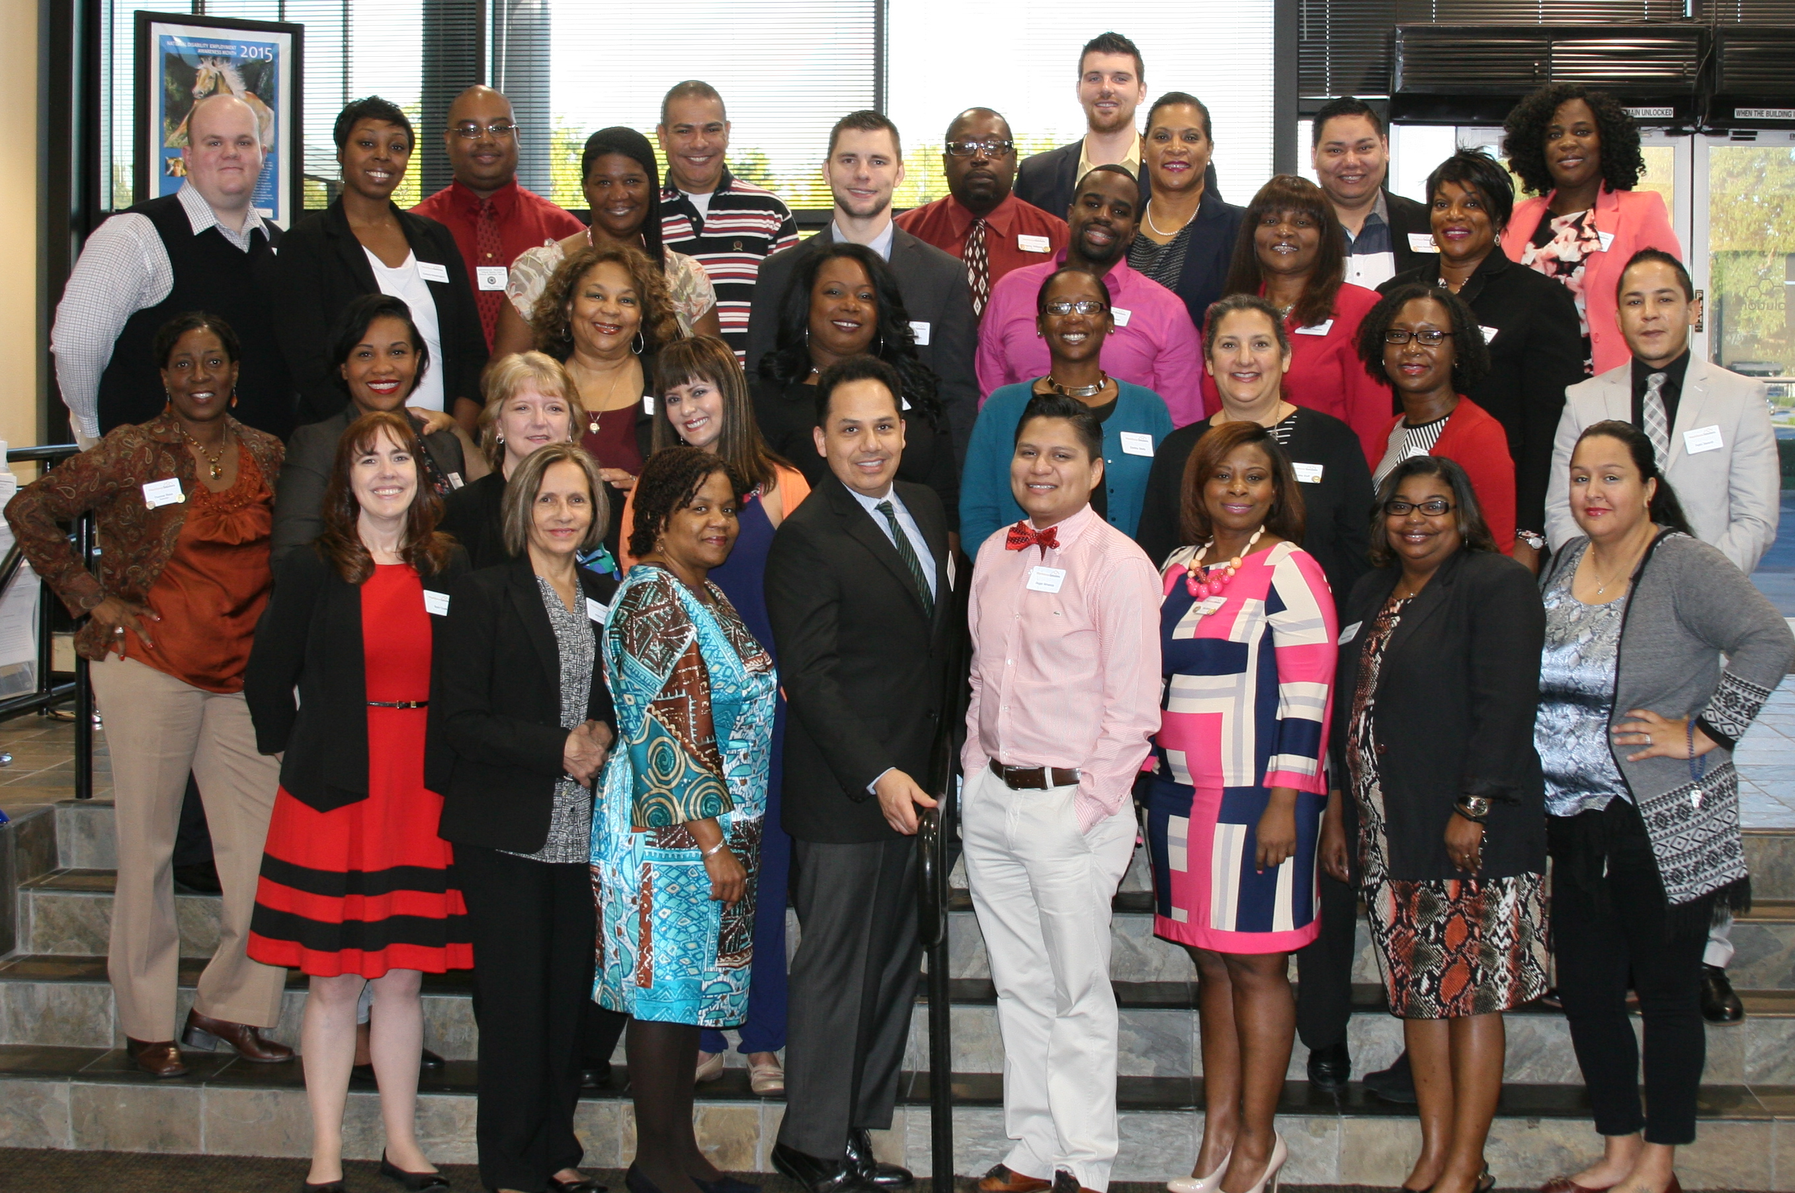
R
Dennita has EARNED the admiration of her co-workers, supervisors, and customers.
She is held in the highest regard BY the Westheimer family.
ESPECTED

Slide 9
C
HEERFUL
keeps a smile on her face!

Slide 10
E
Dennita has THE self-PROclaimed title of “extraordinaire” – we agree!
XTRAORDINAIRE

