Slide 1
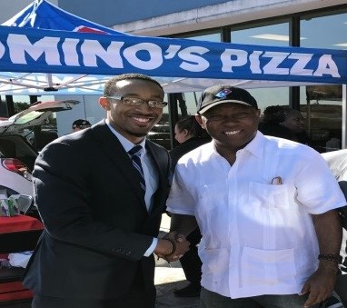
Jason Hamilton Brown
I AM Workforce Solutions Nomination
Equal Opportunity Employer/Program. Auxiliary Aids and Services are
available upon request to individuals with disabilities.
Relay Texas: 1-800-735-2989 (TDD) and 1-800-735-2988 (Voice) or 711

Slide 2
Understanding The Resources…
Jason started in March 2017 and was tasked with organizing the Hire Houston Youth Kickoff & Hiring Event on Saturday May 6, 2017 at WS – Southeast
He used resources within and outside our system to pull together help from Employer Services, ITEP, ad BakerRipley to work as one team
Lead grassroots effort to reach out to young adults from recruiting in our career offices, having a presence at local high schools, utilizing social media, and securing commitments from local homeless shelters and community partners

Slide 3
Small Innovation, Huge Impact
Hire Houston Kickoff featured employers outside a room, brought the action out to entire career office
Assigned employers to staff cubicles as they arrived to not show any potential no-shows as traditional job fairs do with empty tables
Secured employer commitments to interview all young adults, not simply collect resumes, direct to website
All applications, paper or electronic, were completed prior to meeting with employers
We gave away neckties and taught how to tie them!

Slide 4
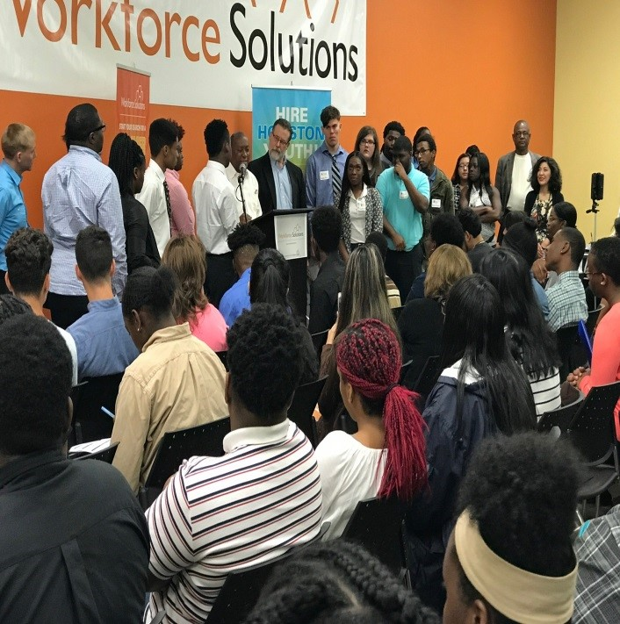
Houston Mayor Sylvester Turner
Houston Mayor Sylvester Turner spoke to a crowd of 200 young adults plus parents and employers!

Slide 5
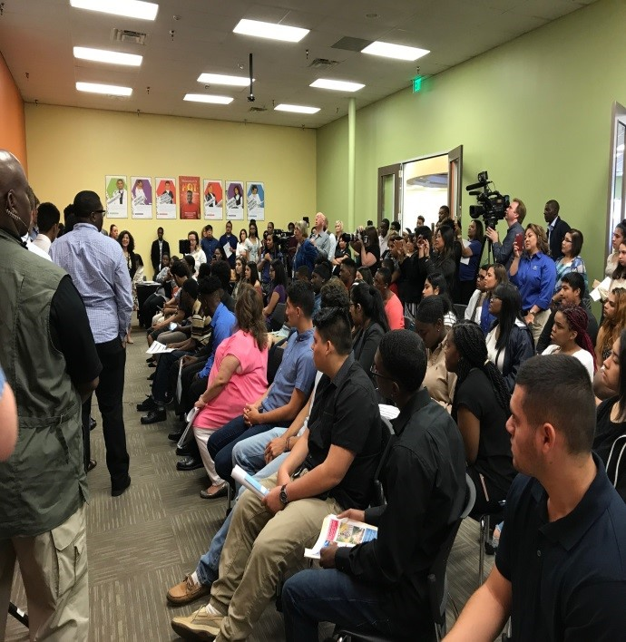
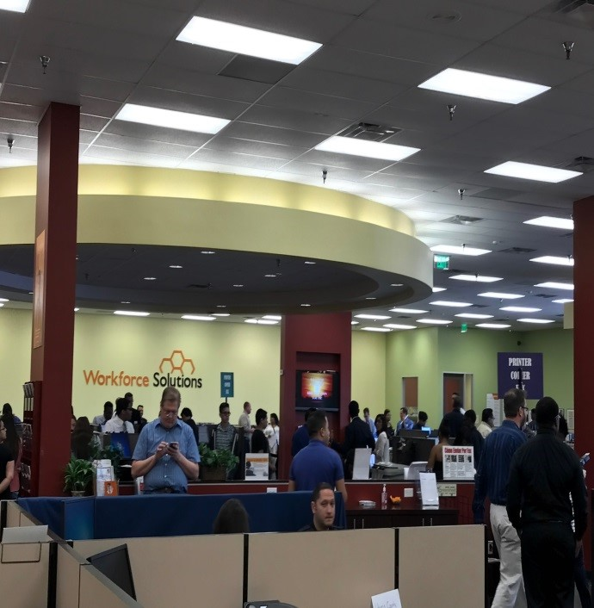
200 Young Adults!
Based on employer surveys, employers expect to fill 55 positions from the event
Jason has already started planning post-event services for those not extended offers!

Slide 6
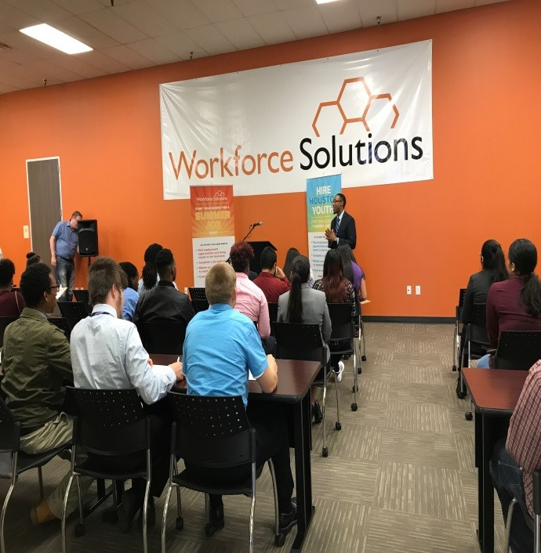
Jason IS Workforce Solutions!
His professionalism, excellent customer service, hard work ethic, team work, and high energy embody our number one Guiding Principle – Jason IS Workforce Solutions!!!

